Slide 1
Continuous Delivery
Continuous Integration
& Continuous Deployment

Slide 2
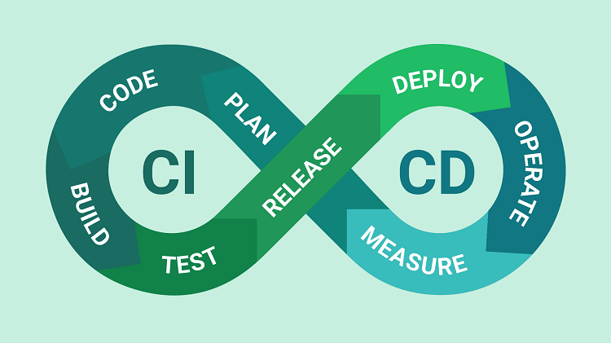
What is Continuous Delivery
Continuous Delivery is an engineering paradigm in which teams produce and release value in short cycles
Continous Intergration
Continous Deployment

Slide 3
Continuous Integration
The practice of merging all developers' working copies to a shared mainline several times a day, everything related to the code fits here
Compile
Unit Test
Static Analysis
Dependency vulnerability testing
Store artifact

Slide 4
Continuous Deployment
A software engineering approach in which the value is delivered frequently through automated deployments.
Creating infrastructure
Provisioning servers
Copying files
Promoting to production
Smoke Testing
Rollbacks

Slide 5
8 Principles of Continuous Delivery
Repeatable Reliable Process
Automate Everything
Version Control Everything
Bring the Pain Forward
Build-in Quality
"Done" Means Released
Everyone is Responsible
Continuous Improvement

Slide 6
Benefits of CICD
Reduce cost
Avoid unnecessary cost
Increase Revenue
Protect Revenue

Slide 7
Reduce cost
Catch Compile Errors After Merge => Less developer time on issues from new developer code
Automate Infrastructure Cleanup => Less infrastructure costs from unused resources

Slide 8
Avoid unnecessary cost
Catch Unit Test Failures => Less bugs in production and less time in testing
Detect Security Vulnerabilities => Prevent embarrassing or costly security holes
Automate Infrastructure Creation => Less human error, Faster deployments

Slide 9
Increase Revenue
Faster and More Frequent Production Deployments => New value-generating features released more quickly
Deploy to Production Without Manual Checks => Less time to market

Slide 10
Protect Revenue
Automated Smoke Tests => Reduced downtime from a deploy-related crash or major bug
Automated Rollback Triggered by Job Failure => Quick undo to return production to working state

Slide 11
When you need CI/CD or Continuous Delivery?
Investing more time in a release cycle than delivering value
Going through integration hell every time we finish a feature
Code gets lost because of botched merges
Unit test suite hasn't been green in ages
Deployments contribute to schedule slip
Friction between ops and development departments
Only one engineer can deploy a system
Deployments are not cause for celebration

