Slide 1

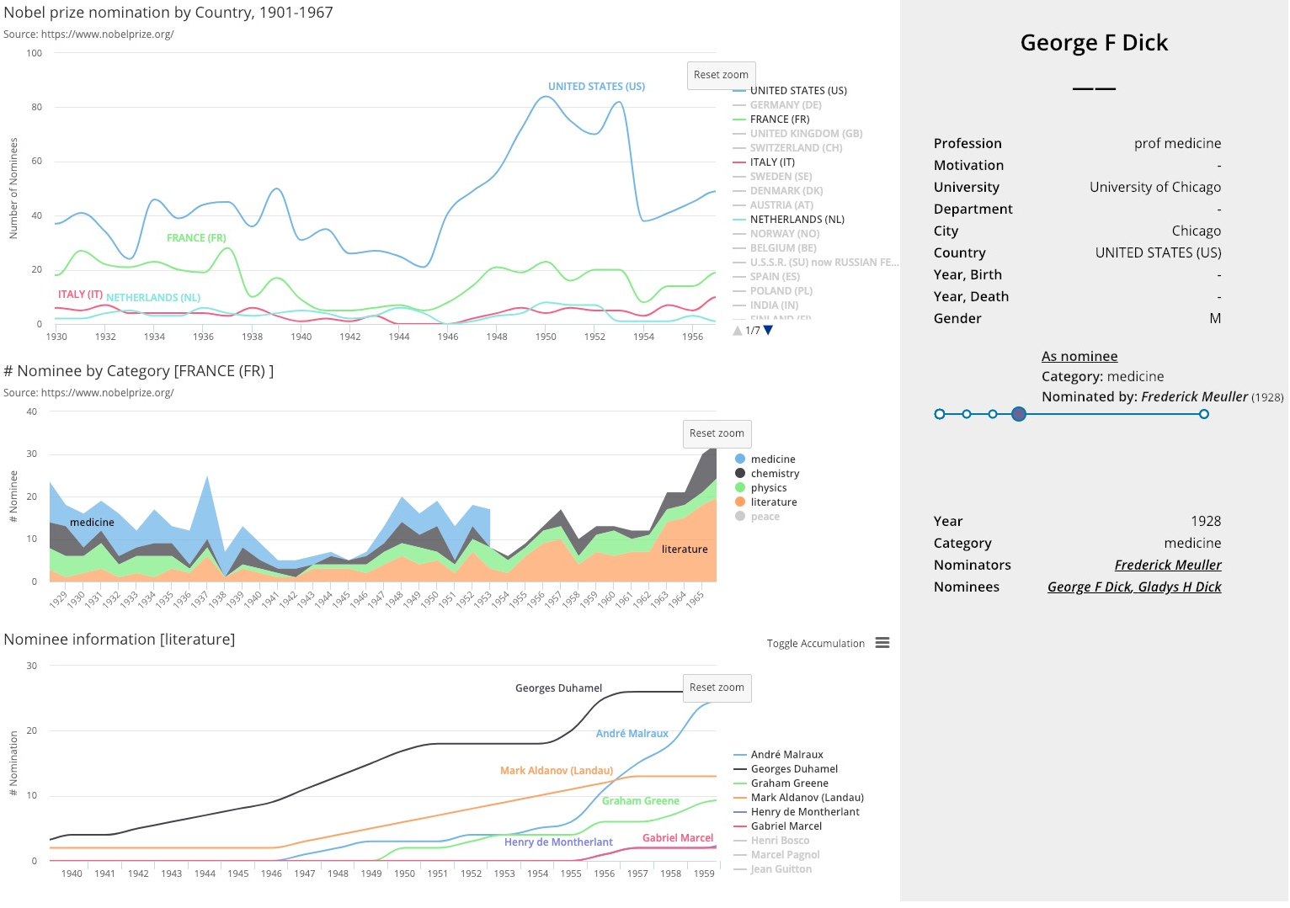
Visualize the Nobel Nomination Database
可视化与可视计算概论 2018
金奕成、叶子博
We implement an interactive visualization system for the Nobel Nomination Database using D3.js and Highcharts.js.
The goal of the system is to find the story behind nomination numbers of country/category/person.
PROJECT DESIGN
INTRODUCTION
Up Left: Nomination Numbers by Country
Middle Left: Nomination Numbers by Category ( Specific Country)
Down Left: Nomination Numbers by Person ( Specific Country and Category)
Right: Personal Information of a specific person
DATA DESCRIPTION
TECHNIQUE DETAILS
We use the data collected from the official website of the Nobel Prize. It concludes nearly all nominations from 1901 to 1966, 18347 total. The extra person database concludes more than 12000+ nominators/nominees.
After crawling the web page and cleaning the data using Python (Requests + BeautifulSoup + JSON), the resulting dataset is saved as three JSON files by nomination number, person and country. Then, we load the JSON file in a JavaScript script that binds the initialization data to the chart when the chart is initialized. After running, the script monitors events such as mouse clicks in each chart, and updates the data of the chart linked in the callback function. We implement three successively hierarchically-linked charts. We use the slightly modified timeknots library in the sidebar to implement the timeline, and use a custom tooltip over the chart and timeline to override the original tooltip for readability. Besides, we set hyperlinks in the name of the sidebar to implement jumps between different people.

