Slide 1

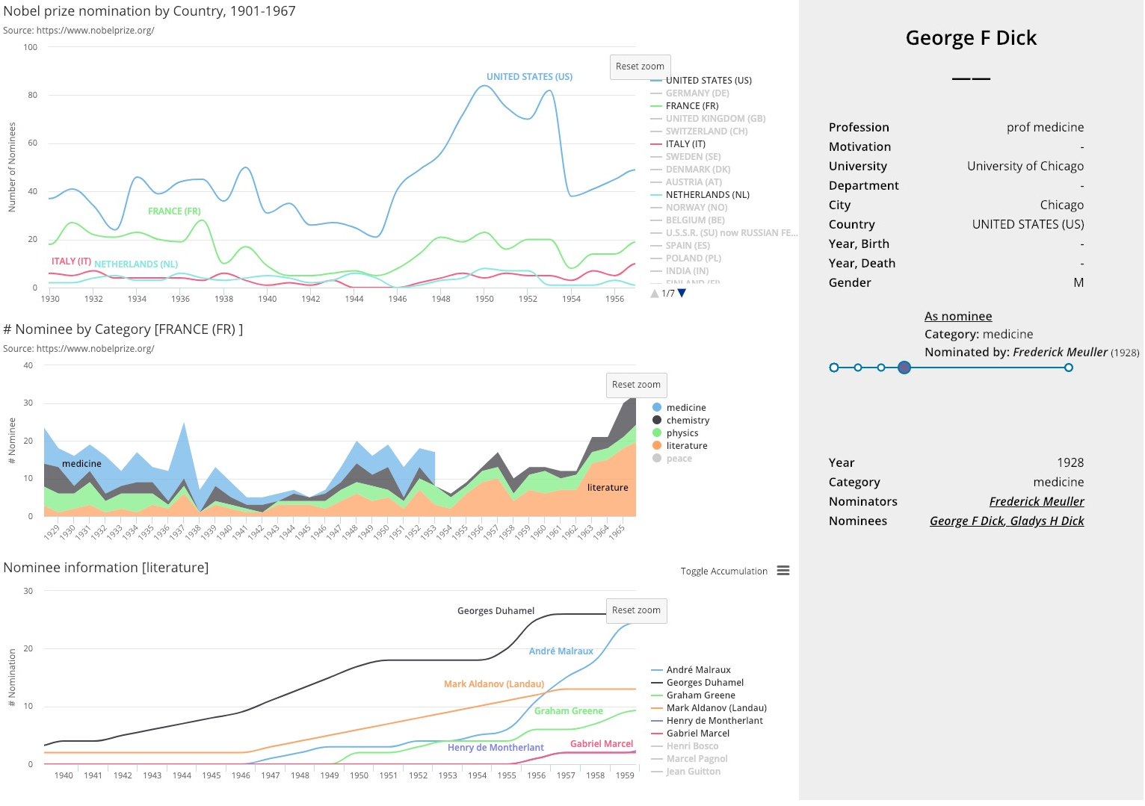
Visualize the Nobel Nomination Database
可视化与可视计算概论 2018
金奕成、叶子博
INTRODUCTION
PROJECT DESIGN
We implement an interactive visualization system for the Nobel Nomination Database using D3.js and Highcharts.js.
The goal of the system is to find the story behind nomination numbers of country/field/person.
Up Left: Nomination Numbers by Country
Middle Left: Nomination Numbers by Category ( Specific Country)
Down Left: Nomination Numbers by Person ( Specific Country and Category)
Right: Personal Information of a specific person
DATA DESCRIPTION
TECHNIQUE DETAILS
We use the data collected from the official website of the Nobel Prize. It concludes nearly all nominations from 1901 to 1966, 18347 total. The extra person database concludes more than 12000+ nominators/nominees.

