Slide 1
Rain in Australia
Will it rain tomorrow?

Slide 2
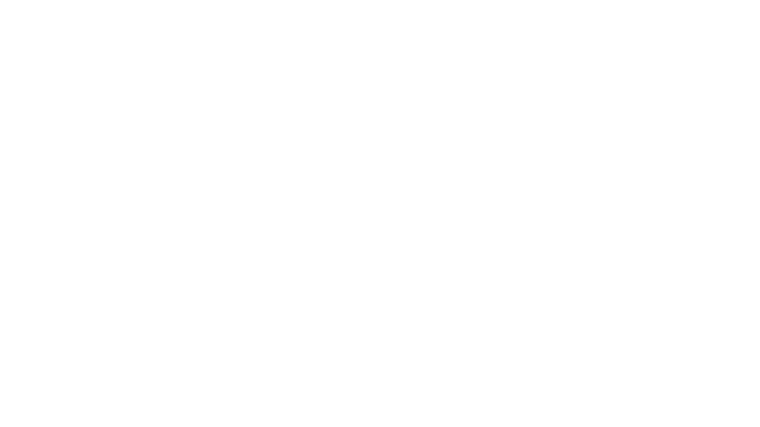


OVERVIEW
Introduction
Data Cleaning
EDA
Modeling

Slide 3

Introduction
Rains are essential part of our lives. God gives the gift of rains to humans. Weather department tries to forecast when will it rain. hence, I try to predict whether it will rain in Australia tomorrow or not.

Slide 4
The problem
we will try to answer the question that whether or not it will rain tomorrow in Australia. We implement many classification models with Python and Scikit-Learn.
To answer the question, we build a classifier to predict whether or not it will rain tomorrow in Australia. We train a binary classification model

Slide 5

DATASET
142193 Observations
23 Features
From

Slide 6
Data Cleaning
Drop all rows contain Nan values in categorical features
1
Populate rows that contain nan values with median value
2
Fix the unbalanced data with over sampling
3
Drop date column
4

Slide 7
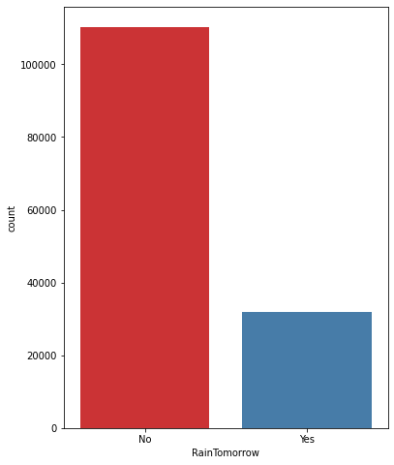
Exploratory Data Analysis (EDA)
Q1. What is distribution of 'RainTomorrow' variable looks like?

Slide 8
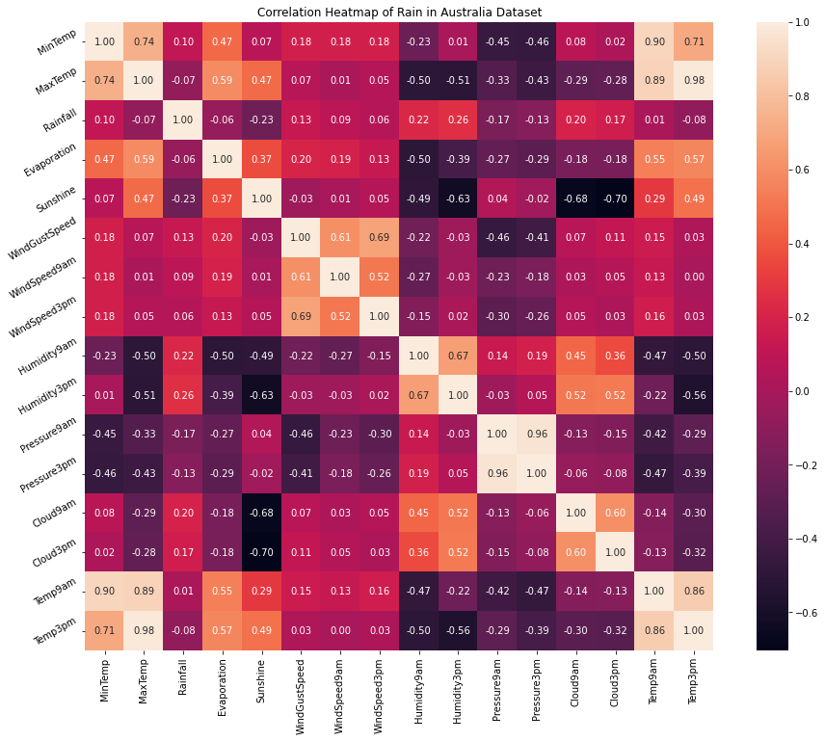
Exploratory Data Analysis (EDA)
Q2. What are the patterns and relationships (correlation) in the dataset.

Slide 9
Exploratory Data Analysis (EDA)
As you can see from the heat map The following pairs of features are having high correlation between them:
MaxTemp and MinTemp
Pressure9am and Pressure3pm
Temp9am and Temp3pm
Evaporation and MaxTemp
MaxTemp and Temp3pm

Slide 10
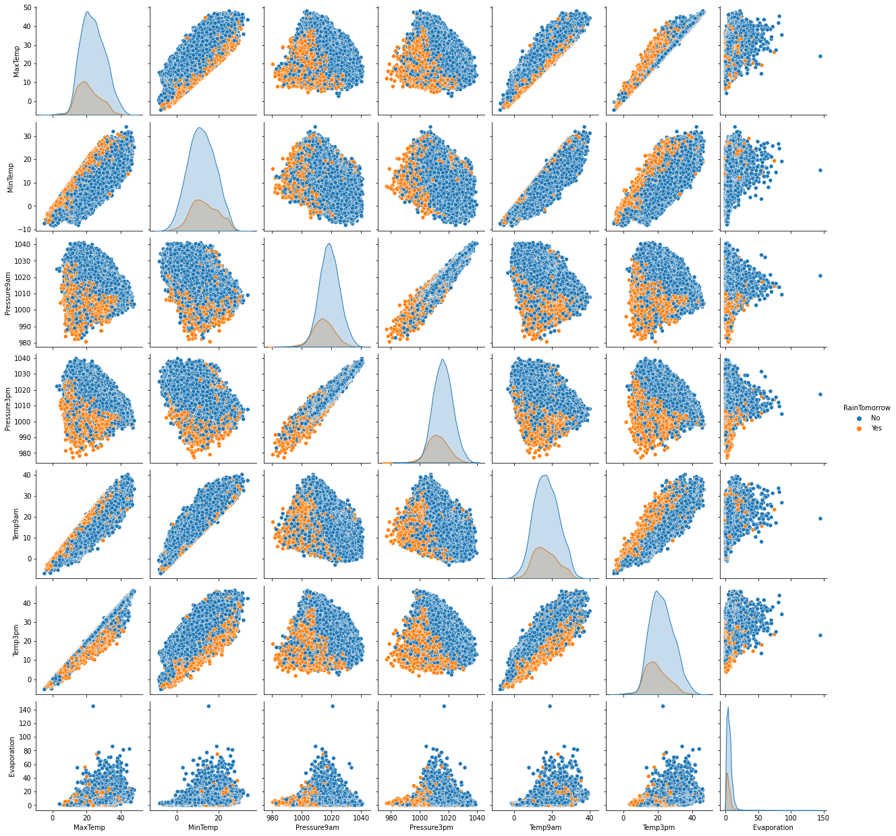
Exploratory Data Analysis (EDA)
Q3. What is 'RainTomorrow' distribution looks like among these highly correlated features?

Slide 11

Machine Learning Model
Classifications

Slide 12
Regression Algorithms
Logistic Regression
Decision Tree Classifier
Random Forest Classifier
K Neighbors Classifier

Slide 13
MODELS
Model | Accuracy | AUC | Recall | Prec. | F1 | Kappa | MCC
K Neighbors Classifier | 0.8427 | 0.83 | 0.5129 | 0.6973 | 0.591 | 0.4964 | 0.5054
Decision Tree Classifier | 0.7916 | 0.7034 | 0.5449 | 0.5291 | 0.5368 | 0.4024 | 0.4026
Logistic Regression | 0.8468 | 0.8688 | 0.4998 | 0.7234 | 0.5911 | 0.5007 | 0.5137
Random Forest Classifier | 0.8598 | 0.8899 | 0.525 | 0.7693 | 0.624 | 0.5416 | 0.5566

