Slide 3
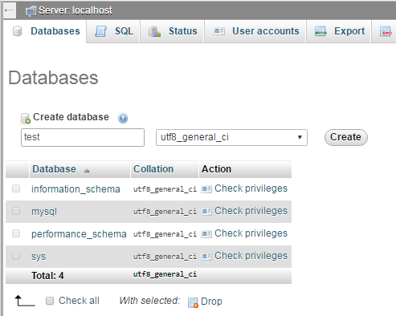
Database
If no “test” database, then create one “test” database first.

Slide 4
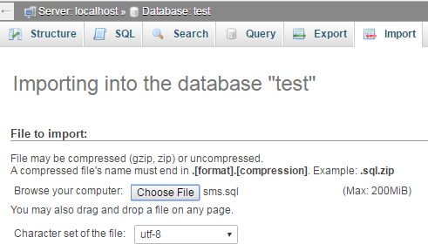
Import

Slide 5
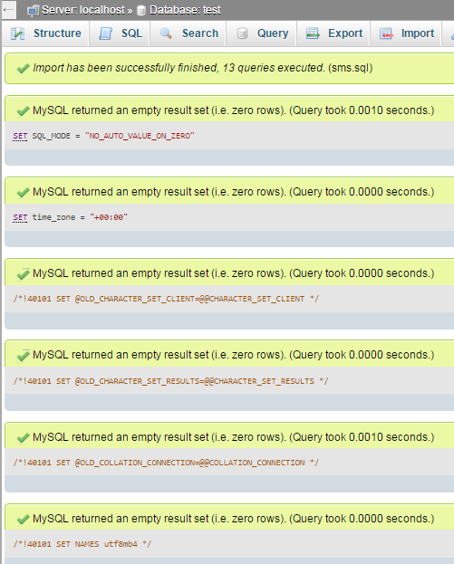
Import successfully

