Slide 1
Professional Diploma in Commercial Web Design
Lesson 10
MySQL
By Raymond Tsang in Fevaworks

Slide 2
PhpMyAdmin
AppServe: localhost:8080/phpmyadmin
AppServe: root / password
XAMPP: localhost/phpmyadmin
XAMPP: root / (no password)

Slide 3
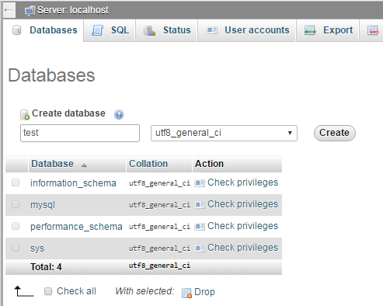
Database
If no “test” database, then create one “test” database first.

Slide 4
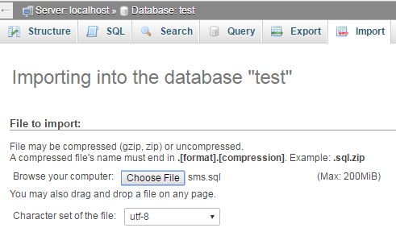
Import
Then import the sms table by Choose File “sms.sql”

Slide 5
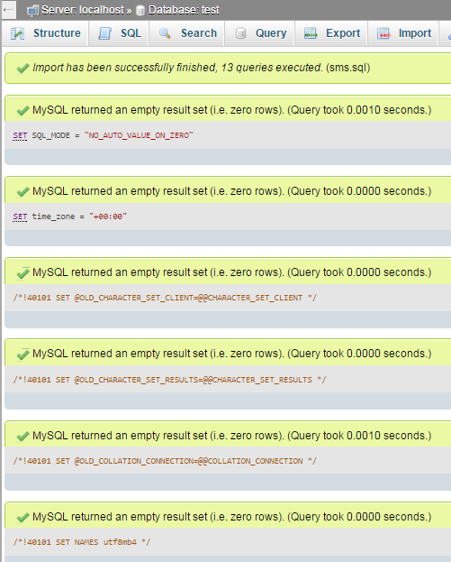
Import successfully
Check means import successfully.

Slide 6
Classwork
Import the products table “products.sql”

Slide 7
CRUD
Create, Read, Update and Delete
Facebook, Whatsapp

Slide 8
CRUD
Operation | SQL | User Interface
Create | INSERT | New
Read | SELECT | Browse
Update | UPDATE | Edit
Delete | DELETE | Remove

Slide 9
db.php
<?php
//db.inc.php
$db_hostname="localhost";
$db_username="root";
$db_password="password";
$db_database="test";

Slide 10
db.php
$mysqli=new MySQLi($db_hostname, $db_username, $db_password, $db_database);
if ($mysqli->connect_errno>0){
die($mysqli->connect_error);
}
//print_r($mysqli);
?>

Slide 11
db.inc.php
<?php
require_once('db.inc.php');
?>

Slide 12
Read all
sms_readall.php

Slide 13

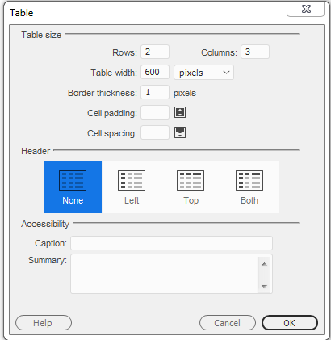
Add table

Slide 14
SQL
You can copy SQL from phpmyadmin

Slide 15
Read one
sms_readone.php

Slide 16
Create
sms_create.php
sms_create_sql.php

Slide 17
Delete
sms_delete.php
sms_delete_sql.php

Slide 18
Update
sms_update.php
sms_update_sql.php

Slide 19
Files
db.inc.php
sms_readall.php
sms_readone.php
sms_create.php
sms_create2.php
sms_delete.php
sms_delete2.php
sms_update.php
sms_update2.php
sms.sql

Slide 20
Next lesson
Bring Fevaworks notes lesson 24 and 26.

Slide 21
QUESTIONS

