Slide 1
Professional Diploma in Commercial Web Design
Lesson 4
PHP
By Raymond Tsang in Fevaworks

Slide 2
Overview
What is a form
How to create a form
Getting input from users
Generate a result

Slide 3
What is a form
It’s a section of a document containing normal content, markup, special elements called controls (checkboxes, radio buttons, menus, etc.), and labels on those controls
Users "complete" a form by modifying its controls before submitting the form to an agent for processing
Notes:
Who is agent?

Slide 4
Client side (html)
Obtain information from a web user
Whole web page or part web page, but not a form in a form
For this course, put form in html only, don’t combine in one PHP.
JavaScript (jQuery)
No need to save data in local machine

Slide 5
Security
Secure data by encryption
Cipher
MD5(32), sha1(40), sha256(64)
HTTPS (SSL)
Cert
RSA

Slide 6
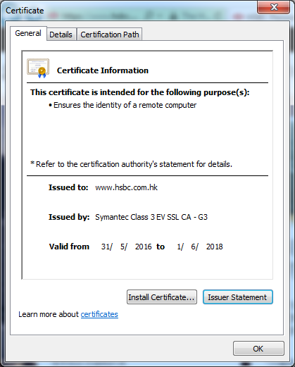
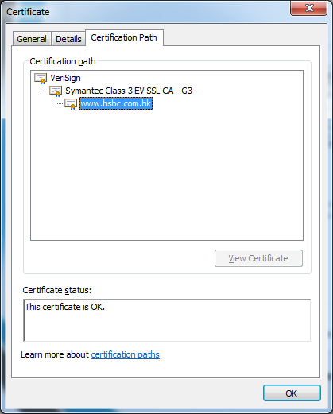
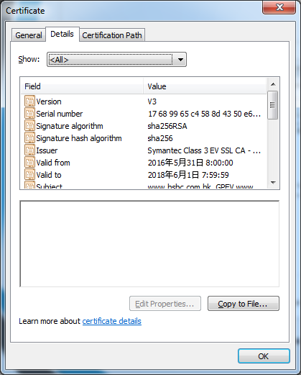

Slide 7
Website example
hsbc.com, paypal.com
gmail.com, mail.yahoo.com, hotmail.com, zaturday.com/webmail
hkpl.gov.hk, edit.php.net

Slide 8
Encryption
MD5 is considered cryptographically broken and is unsuitable for further use.
The SHA1 algorithm might not be secure enough for ongoing use. It is recommended not to use SHA1.
SHA224: SHA224 produces a 224-bit (28-byte) hash value, typically rendered as a hexadecimal number, 56 digits long.
SHA256: SHA256 produces a 256-bit (32-byte) hash value, typically rendered as a hexadecimal number, 64 digits long.

Slide 9
Encryption
SHA384: SHA384 produces a 384-bit (48-byte) hash value, typically rendered as a hexadecimal number, 96 digits long.
SHA512: SHA512 produces a 512-bit (64-byte) hash value, typically rendered as a hexadecimal number, 128 digits long.
RIPEMD160: RIPEMD160 produces a 160-bit (20-byte) hash value, typically rendered as a hexadecimal number, 40 digits long.

Slide 10
hash
雜湊(Hash)演算法越來越多，PHP 直接做了 hash() 來用，直接指定要用哪個雜湊演算法即可。
hash.php

Slide 11
Password
Strong password
PassPhase

Slide 12
Server side programming
PHP
CGI (Perl)
ASP / ASPX
JSP
Ruby
Node.js
Python
Cold Fusion

Slide 13
Server side (PHP)
Save data – server side
Database (MySQL)
?name=ray&password=123

Slide 14
Usage
Usually used for collecting data
Registration
Login
Search
Guest book
Research
Vote

Slide 15
Form components
Text Fields
Radio buttons
Check boxes
List/menus
Buttons
Hidden

Slide 16
The First Step
Tell your computer what to do with your form
Insert -> Form -> Form

Slide 17
Text box
If we do not know what is the availability of the result, we insert a textbox for user to input the data.
EG. Username, Address, etc..
Insert -> Form -> Text box
Set the field name same as the left-hand-side. EG. username (lowercase)
<input name="username" type="text" id="username" size="20" maxlength="10" />

Slide 18
Password
Since what we typed will be shown on the screen, so we better hide the characters.
EG. Yahoo mail.
Insert -> Form -> Text box
Type: password
Set the field name same as the left-hand-side. EG. password (lowercase)
<input name="password" type="password" id="password" size="20" maxlength="10" />

Slide 19
Text Area - comment
two types of controls that allow users to input text. INPUT element creates a single-line input control and the TEXTAREA element creates a multi-line input control
<textarea name="comment" rows=6 cols=40>default words </textarea>

Slide 20
Radio buttons
They are on/off circle switches that may be toggled by the user
They are mutually exclusive: when one is switched "on", all others with the same name are switched "off"
Since user usually select from more than one,
<input type="radio" name="radio group name" value="button name">

Slide 21
Radio buttons story
But why are they called radio buttons?!
The reason is that they act as the radio buttons used in older car radios. When you pushed one, the dial moved. When you pushed another, the first choice was dropped and the dial moved again.

Slide 22
Checkboxes
They are on/off square switches that may be toggled by the user
Only "on" checkbox controls can become successful
Allow users to select several values for the same property
<input type="checkbox" name="name" value="button name">

Slide 23
Select (Menu/List)
Menus offer users options from which to choose where the choices are too long to display in a browser
Two types of menus – pull down menu, list menu
Pull down menu – select one from a drop list
List menu – select one or multiple items from a list menu. By pressing Ctrl key, you can select multiple selection

Slide 24
Menu example
<select name="country" id="country">
<option selected="selected"> </option>
<option value="hk">Hong Kong</option>
<option value="us">United State</option>
<option value="tw">Taiwan</option>
<option value="cn">China</option>
<option value="kr">Korea</option>
<option value="jp">Japan</option>
<option value="mo">Macau</option>
</select>

Slide 25
Buttons
three types of buttons – submit, reset, push
Submit button - when activated, it submits a form
Reset button - when activated, it resets all controls to their initial values
Push button - each push button may have client-side scripts associated with the element's event attributes

Slide 26
Buttons example
<input type="submit" name="submit" id="submit" value="Submit" />
<input type="reset" name="reset" id="reset" value="Reset" />

Slide 27
Hidden controls
controls that are not rendered but whose values are submitted with a form
<input name="from" type="hidden" value="web" />

Slide 28
Finally!
To send the input data back to server, make sure have an action.
<form action="file.php">
Make sure you end your page with this:
</form>

Slide 29
Style
You can add a table to tidy a form.
Or use <dt>left</dt><dd>right</dd> + CSS
Or use <div></div> + CSS

Slide 30
Create a birthday form
Let user input the data from a form
Name each field with the name
Insert a submit button and a reset button
Save as bday.htm
Set the form action to the same bday.php
Eg. <form action="bday.php">

Slide 31
Getting input from users
Download birthday.php
Open birthday.php and save as bday.php
All the results are stored in variables
Change the constant variable to user’s input
$birthday="19900427";
change to=>
$birthday = $_POST['year'].$_POST['month'].$_POST['day'];

Slide 32
Generate a result
In IE, open http://localhost/bday.html
Testing it by input some data
Result will be displayed by bday.php

Slide 33
Get and Post
Get data is displayed in the location bar
Get is used for requesting information, like a particular record from a database or the results of a search. (search always use get)
Post usually handle large data
Post is used when an action is required, as when a database record will be updated or email should be sent
Post is usually used in nowadays

Slide 34
Variable
$username – short form, not recommended in PHP4 since register_globals is turned off in /etc/php.ini
$HTTP_GET_VARS["username"], $HTTP_POST_VARS["username"]
$_GET["username"], $_POST["username"]

Slide 35
Exercise 6
Try to write out a form in html for user to input a number
Save as square.html
Create a new php file
Find the square of the number
Save as square.php and test the page

Slide 36
Exercise 7
Try to write out a form in html for user to input two numbers
Save as multiple.html
Create a new php file
Find the product of the numbers
Save as multiple.php and test the page

Slide 37
Exercise 8 – Body Mass Index
Find the bmi for yourself
bmi = weight(kg)/height(m)/height(m)
If I am 70kg and 1.74m, what is my bmi?
<18.5 underweight, 18.5-25.0 normal, >25.0 overweight
Write a form that can let user to input his/her height and weight
See bmi.php

Slide 38
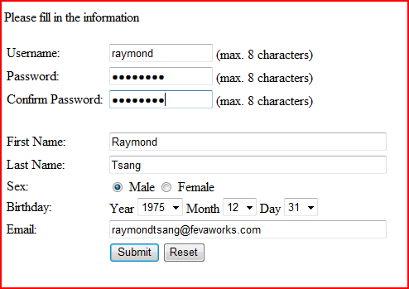
Getting info from a web page

Slide 39
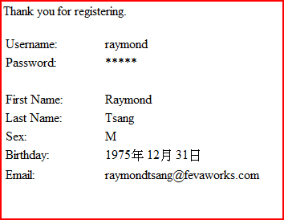
Getting correct information

Slide 40
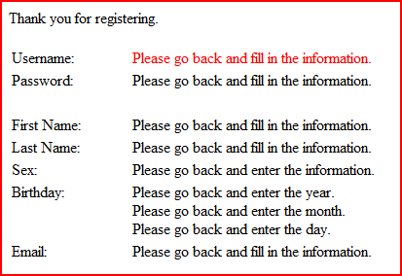
Error in a web page

Slide 41
Getting info from a web page
Create a form by Dreamweaver to collect username and password for login
Send the information to the php
Create a php page
Test the html page
Result can be seen by the php page
login.html
login.php

Slide 42
Homework
www.zaturday.com/homework/login.html
Lesson 23
If username is blank, display "Please input your username".
If password is blank, display "Please input your password".
If password is wrong, display "wrong password".
If password is correct, display " welcome, username ".

Slide 43
QUESTIONS

