Slide 1
Professional Diploma in Commercial Web Design
Lesson 7b
Object - game
By Raymond Tsang in Fevaworks
t-raymond.tsang@fevaworks.com

Slide 2
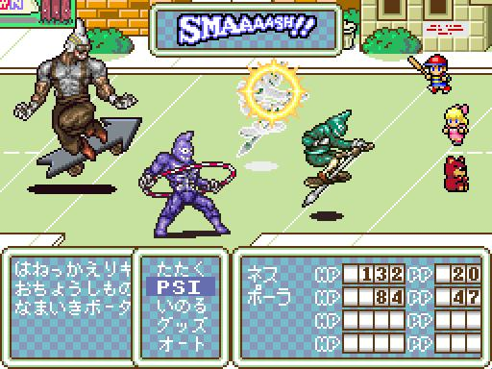
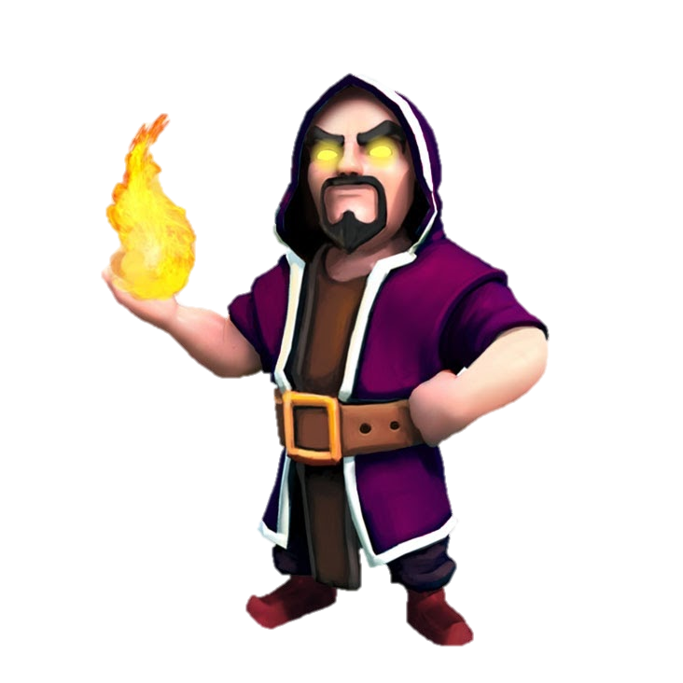
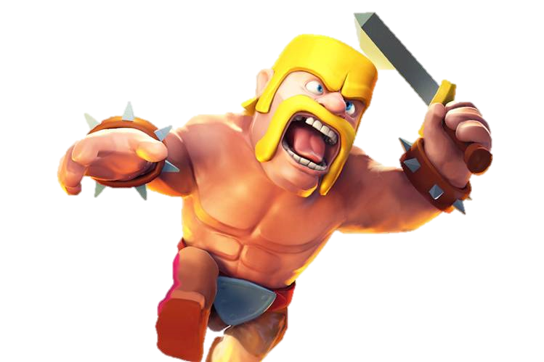
Objective
Understand object in game example
Create character and enemy object

Slide 3




Character
hero
Enemy
pig
wolf
Boss
dragon

Slide 4
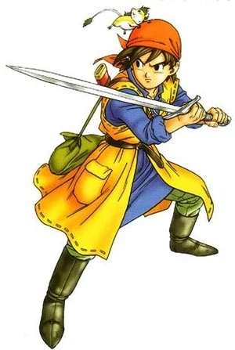
The Makings of a Hero (1)
Lets make a hero character!
Create a class called “Character” and an object called “$hero”.(game01.php)
Every character will have properties such as “name”, “hp” and “atk”. Define them inside class. (game02.php)

Slide 5
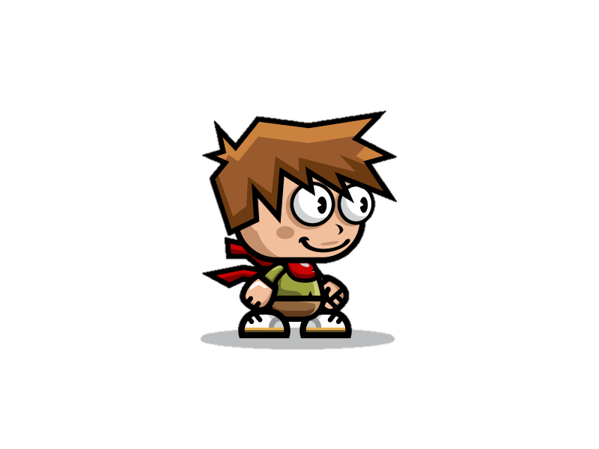


The Makings of a Hero (2)
Use a constructor in class and fill in the name, hp and atk of the hero. (game03.php)
Display the properties of the hero. (game04.php)

Slide 6

Character losing health
If the hero got hit by a monster, he/she will lose health. Create a method “hit” to show this game mechanic.
function hit($hit){}
game05.php

Slide 7

If health(hero) = zero,
If the hero’s HP is zero, he/she will die and it will be game over. Expand the method “hit”.
game06.php, game07.php

Slide 8
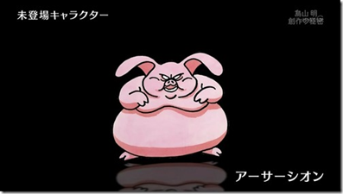
Define Enemies (1)
Now we create an enemy pig character.
Since it is a character, it will have properties (name, hp, atk) and methods from the “Character” class. Yet there will also be enemy-exclusive methods. Thus we create a child class named “Enemy”. (game10.php)
In this case, the child class will contain a method that echoes “Enemy is coming”. (game11.php)

Slide 9
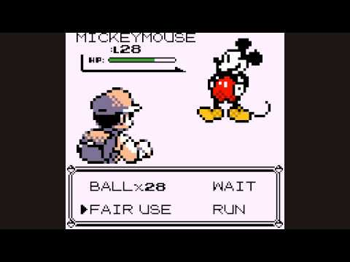
Hero vs. Enemy
Supposedly, the hero is fighting the enemy pig. The pig is faster and strikes first.
$hero->hit($pig->attack); (game12.php)
$pig->hit($hero->attack); (game13.php)

Slide 10
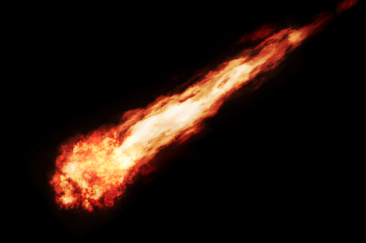
Fire Attack
Some enemies may have stronger special attacks. We can include them by creating a method in the child class “Enemy” only. Here is the method of fire attack: (game14.php)
function fireAttack(){
$hit=$this->attack*2;
echo "FIRE ATTACK: ".$hit."<br>”;
return $hit;
}

Slide 11
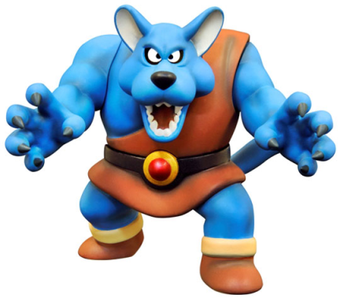
Define Enemies (2)
Now we are going to make a wolf type enemy. Wolves are defined to be stronger than pigs. They use fire attacks against the character.
The wolves are similar to pigs other than differences in property values.
Again, the enemy strikes first.
game15.php

Slide 12
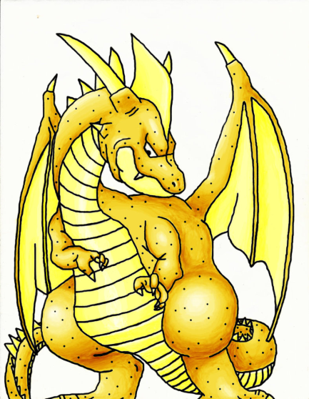
Define Boss
Now to create the boss of this game – the dragon.
The boss is a character, and an enemy. Yet only the boss can attack with ice. Hence we create another child class “Boss” extending from “Enemy”.
Include a method named “iceAttack” in “Boss”, which will be similar to the method “fireAttack”.
game16.php, game17.php

Slide 13


GG
When hero hp is less than 0, then game over.

Slide 14
QUESTIONS

