Slide 1
Professional Diploma in Commercial Web Design
Lesson 10
MySQL
By Raymond Tsang in Fevaworks

Slide 2
Products

Slide 3
Download from share
products.css
products.sql
db.inc.php
sms_readall.php
sms_readone.php
images folder

Slide 4
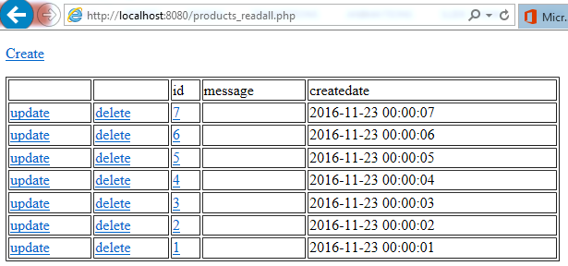
Readall
Open sms_readall.php. Save as products_readall.php
Ctrl+H replace sms to products

Slide 5
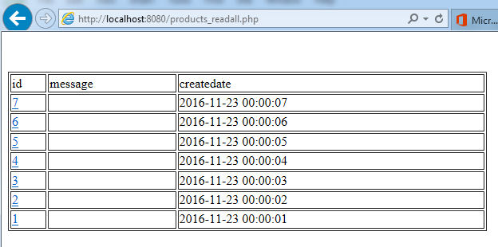
Remove useless links
Remove Create link
Remove Update and Delete column

Slide 6
Change field
Change message to name and createdate to price in both table header and PHP code

Slide 7
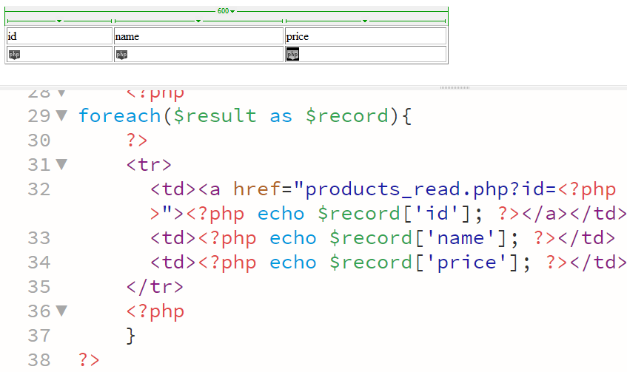
code

Slide 8
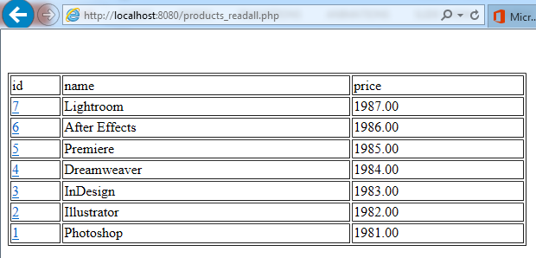
Result

Slide 9
HTML Layout
div.products_list>div.product>div.product_image+div.product_name+div.product_price

Slide 10
PHP
Move PHP code outside div.product.
<?php
foreach($recordset as $record){
?>
[…]
<?php } ?>

Slide 11
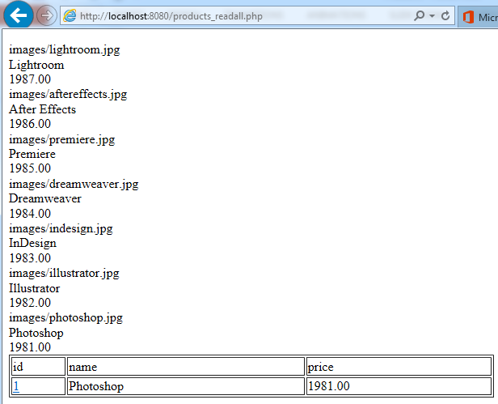
Result

Slide 12
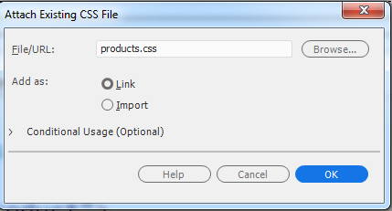
CSS
Attach products.css
File -> Attach Style Sheet

Slide 13
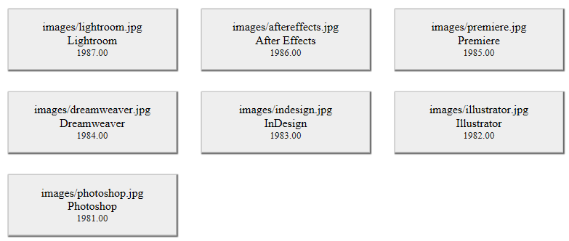
Result

Slide 14
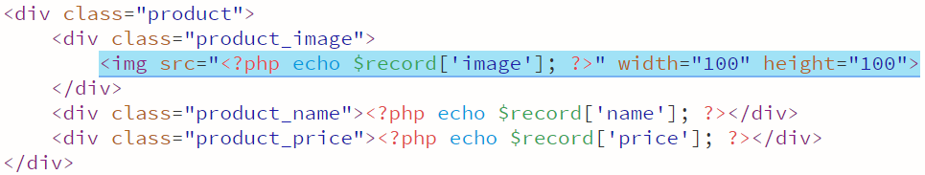
Image
<img src="">
Move <?php echo $record['image']; ?> inside src
width="100" height="100"

Slide 15
Link
Move link HTML code outside div.product.
<a href="products_read.php?id=<?php echo $record['id']; ?>">
[…]
</a>

Slide 16
Dollar sign
Add a dollar sign before the price.

Slide 17
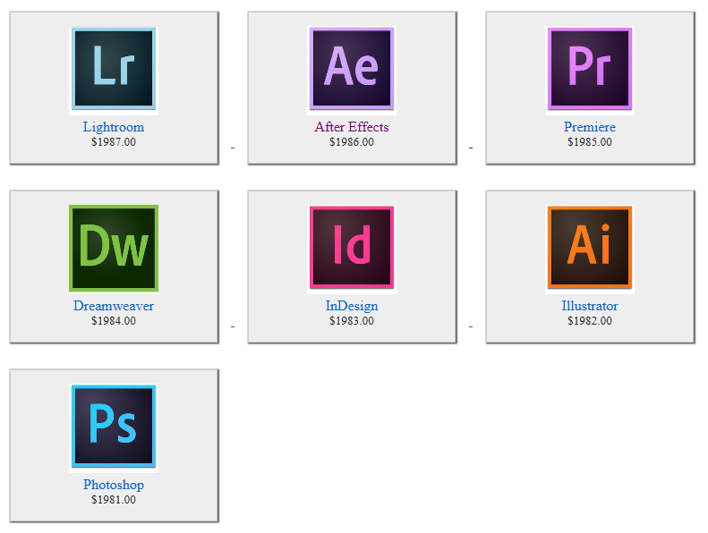
Result

Slide 18
Readone
Open sms_readone.php. Save as products_read.php
Ctrl+H replace sms to products

Slide 19
Add fields
Add all db fields to the table
<tr>
<td>name</td>
<td><?php echo $record['name']; ?></td>
</tr>

Slide 20
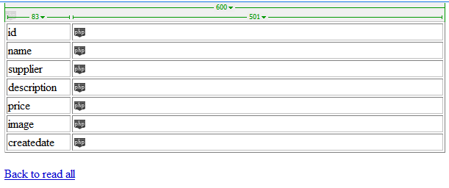
Design view

Slide 21
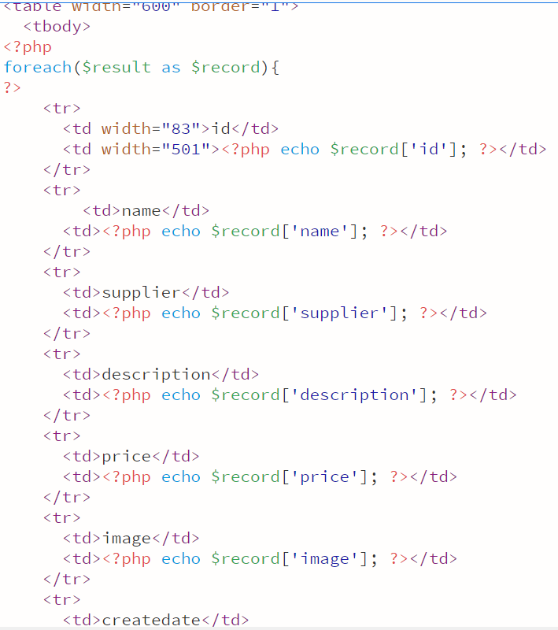
Code

Slide 22
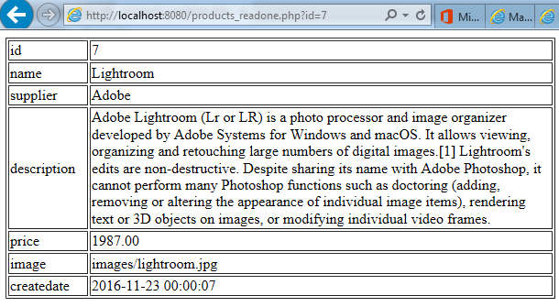
Result

Slide 23
Classwork
Add dollar sign
Change image file name to image

Slide 24
QUESTIONS

