Slide 1
Professional Diploma in Commercial Web Design
Lesson 10
MySQL
By Raymond Tsang in Fevaworks

Slide 2
Agenda
PhpMyAdmin
CRUD

Slide 3
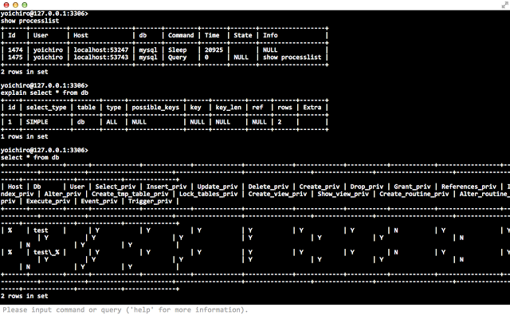
Console

Slide 4
No more console
Hard to learn all syntax
Typing error
Hard to edit
Screen size limit
Not a real life usage

Slide 5
PhpMyAdmin
phpMyAdmin is a free software tool written in PHP, intended to handle the administration of MySQL over the Web.
phpMyAdmin supports a wide range of operations on MySQL and MariaDB.
Frequently used operations (managing databases, tables, columns, relations, indexes, users, permissions, etc) can be performed via the user interface, while you still have the ability to directly execute any SQL statement.

Slide 6
PhpMyAdmin login
AppServe: localhost:8080/phpmyadmin
AppServe: root / password
XAMPP: localhost/phpmyadmin
XAMPP: root / (no password)

Slide 7
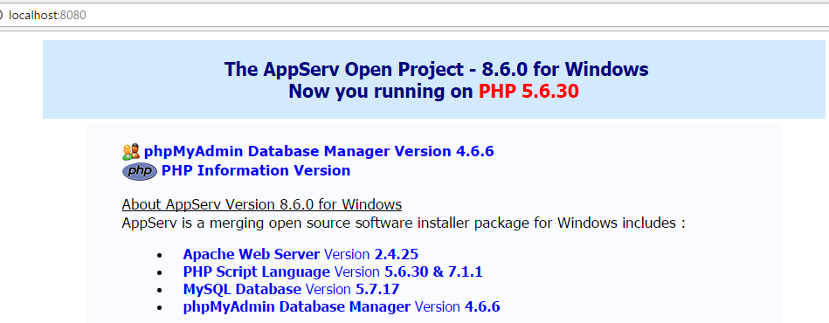
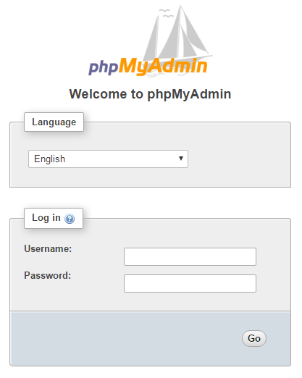

Slide 8
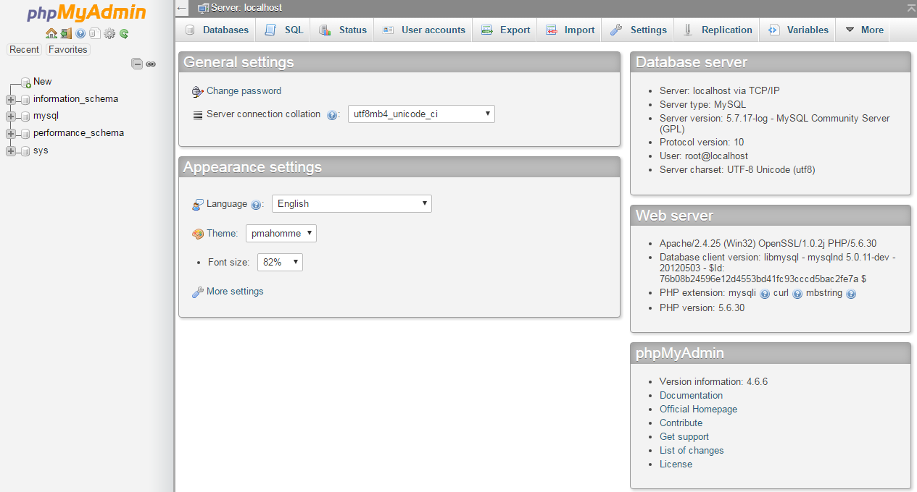

Slide 9
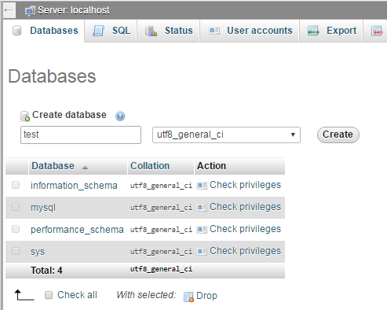
Database
If no “test” database, then create one “test” database first.

Slide 10
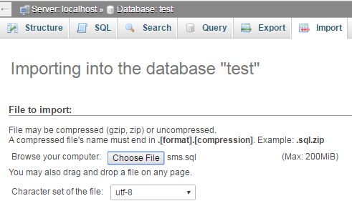
Import
Then import the sms table by Choose File “sms.sql”

Slide 11
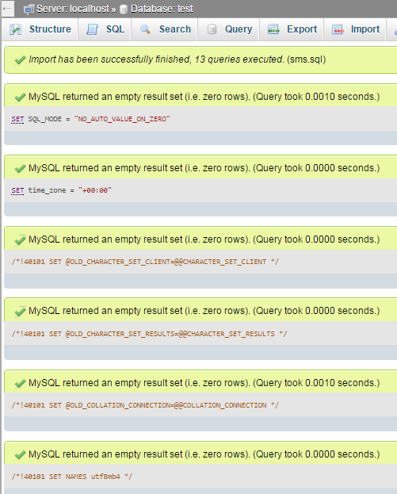
Import successfully
Check means import successfully.

Slide 12
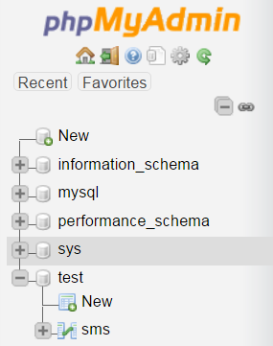
sms table
Then you find the sms table under test database on the left nav bottom

Slide 13
Classwork
Import the products table “products.sql”

Slide 14
CRUD
Create, Read, Update and Delete
Facebook, Whatsapp

Slide 15
CRUD
Operation | SQL | User Interface
Create | INSERT | New
Read | SELECT | Browse
Update | UPDATE | Edit
Delete | DELETE | Remove

Slide 16
Open Excel file
Turn on the computer
Input username
Input password
Open the excel file

Slide 17
db.inc.php
<?php
//db.inc.php
$db_hostname="localhost";
$db_username="root";
$db_password="password";
$db_database="test";

Slide 18
db.inc.php
$mysqli=new MySQLi($db_hostname, $db_username, $db_password, $db_database);
if ($mysqli->connect_errno>0){
die($mysqli->connect_error);
}
//print_r($mysqli);
?>

Slide 19
db.php
<?php require_once('db.php'); ?>
[…]
<?php $mysqli->close(); ?>

Slide 20
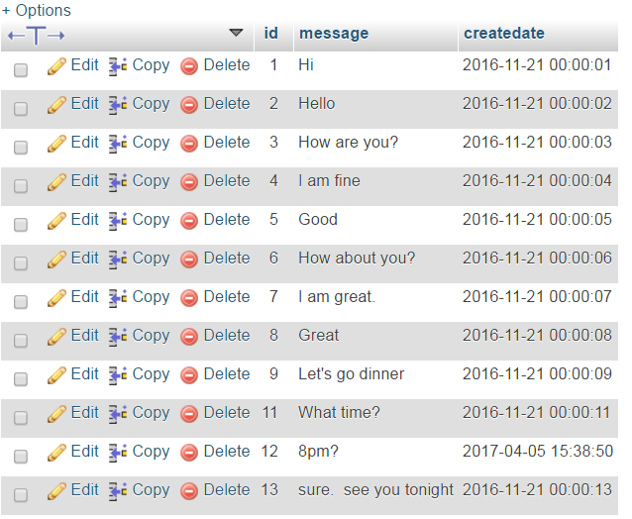
Browse

Slide 21
Read all
Open db.php. Save as sms_readall.php
sms_readall.php

Slide 22
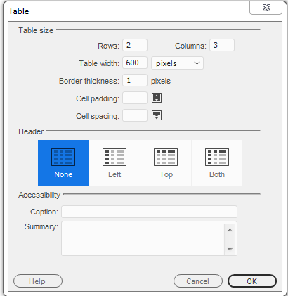

Slide 23
SQL
You can copy SQL from phpmyadmin

Slide 24
Read one
sms_readone.php

Slide 25
Create
sms_create.php
sms_create_sql.php

Slide 26
Delete
Open sms_readone.php, save as sms_delete.php
sms_delete.php
sms_delete_sql.php

Slide 27
Update
Open sms_create.php, save as sms_update.php
Add hidden field
sms_update.php
sms_update_sql.php

Slide 28
Files
db.inc.php
sms_readall.php
sms_readone.php
sms_create.php
sms_create_sql.php
sms_delete.php
sms_delete_sql.php
sms_update.php
sms_update_sql.php
sms.sql

Slide 29
Next lesson
Bring Fevaworks notes lesson 24 and 26.

Slide 30
Homework
www.zaturday.com/homework/news/

Slide 31
QUESTIONS

