Slide 1
Professional Diploma in Commercial Web Design
Lesson 10
MySQL
By Raymond Tsang in Fevaworks

Slide 2
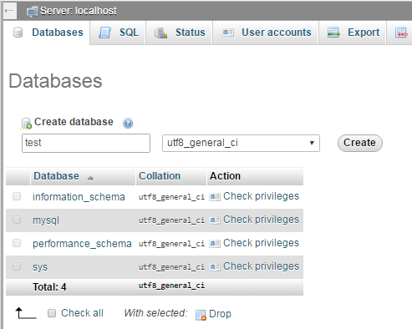
Database
If no “test” database, then create one “test” database first.

Slide 3
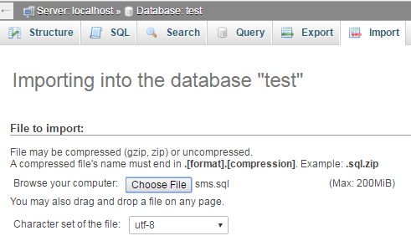
Import
Then import the sms table by Choose File “sms.sql”

Slide 4
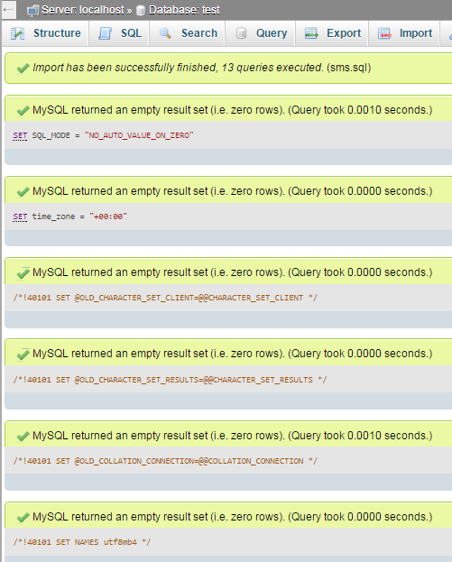
Import successfully
Check means import successfully.

Slide 5
CRUD
create, read, update and delete
Facebook, Whatsapp

Slide 6
CRUD
Operation | SQL | User Interface
Create | INSERT | New
Read | SELECT | Browse
Update | UPDATE | Edit
Delete | DELETE | Remove

Slide 7
db.php

Slide 8
db.inc.php

Slide 9
Read all
sms_readall.php

Slide 10
Files
db.inc.php
sms_readall.php
sms_read.php
sms_create.php
sms_create2.php
sms_delete.php
sms_delete2.php
sms_update.php
sms_update2.php

Slide 11
SQL
You can copy SQL from phpmyadmin

Slide 12
Next lesson
Bring Fevaworks notes lesson 24 and 26.

Slide 13
QUESTIONS

