Slide 1
Professional Diploma in Commercial Web Design
Lesson 10
MySQL
By Raymond Tsang in Fevaworks

Slide 2
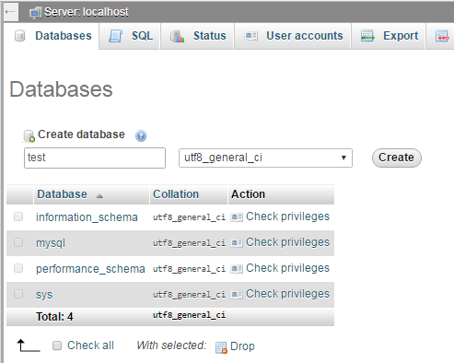
Database
If no “test” database, then create one “test” database first.

Slide 3
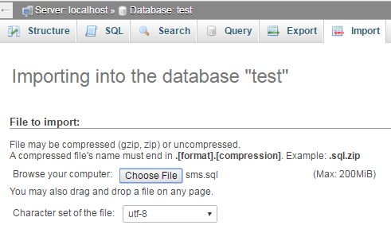
Import
Then import the sms table by Choose File “sms.sql”

Slide 4
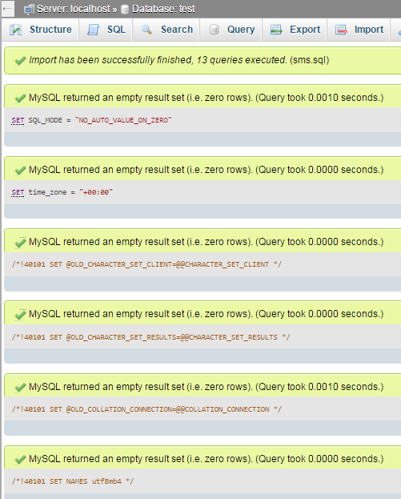
Import successfully
Check means import successfully.

Slide 5
QUESTIONS

