Slide 1
Professional Diploma in Commercial Web Design
Lesson 1
PHP
By Raymond Tsang in Fevaworks
t-raymond.tsang@fevaworks.com

Slide 2
Overview
What is PHP
History
Who is using PHP
Platform
What is PHP for
Why do we use PHP
Strengths

Slide 3
LAMP

Slide 4
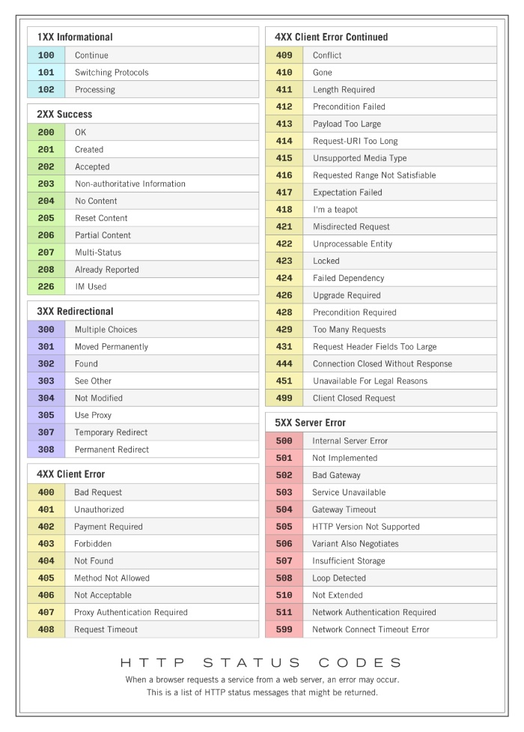

Slide 6
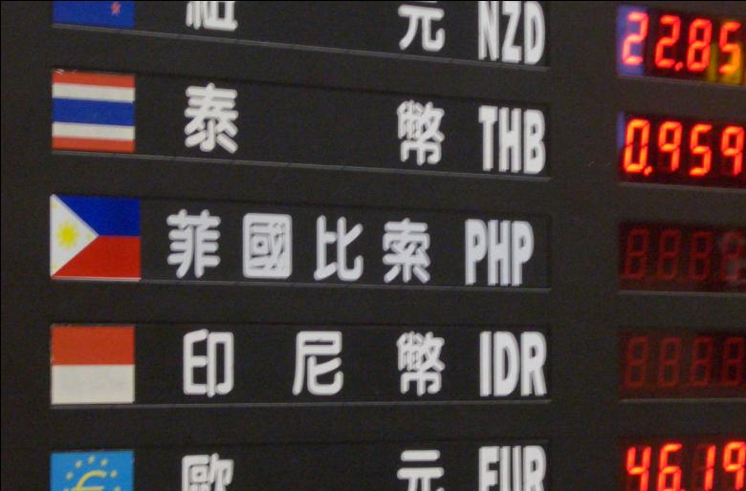
What is PHP

Slide 7
What is PHP
Widely-used general-purpose scripting language that is especially suited for Web development and can be embedded into HTML.
A server side scripting language designed for creating dynamic web pages
Written in C
Open Source and Freeware
Official Name: PHP: Hypertext Preprocessor
Stand for Personal Home Page

Slide 8
History
Conceived in 1994 by Rasmus Lerdorf for simple set of Perl scripts for tracking accesses to his online resume
Personal Home Page / Forms Interpreter 2.0 in 1997
PHP Hypertext Preprocessor 3.0 in 1998
Rewrite the core engine for PHP 4.0
PHP 5.6 then 7.0. No PHP 6.0
Newest version is PHP 7.x now
http://php.net/manual/en/history.php.php

Slide 9
What‘s new in PHP5
Real Object-oriented programming (OO)
Exceptions – procedures that happen when something goes wrong with unexpected error.
Try/Catch/Throw
Namespace
Improved MySQL Extension

Slide 10
What’s new in PHP6
Planned to support unicode in code
The project closed down because of the bad performance.

Slide 11
What’s new in PHP7
Up to 100% faster without rewrite PHP
Constructors with name same as class
Change in password_hash() function
Calling static methods
https://codingsec.net/2016/05/php-cheatsheet-upgrade-php7-5/

Slide 12
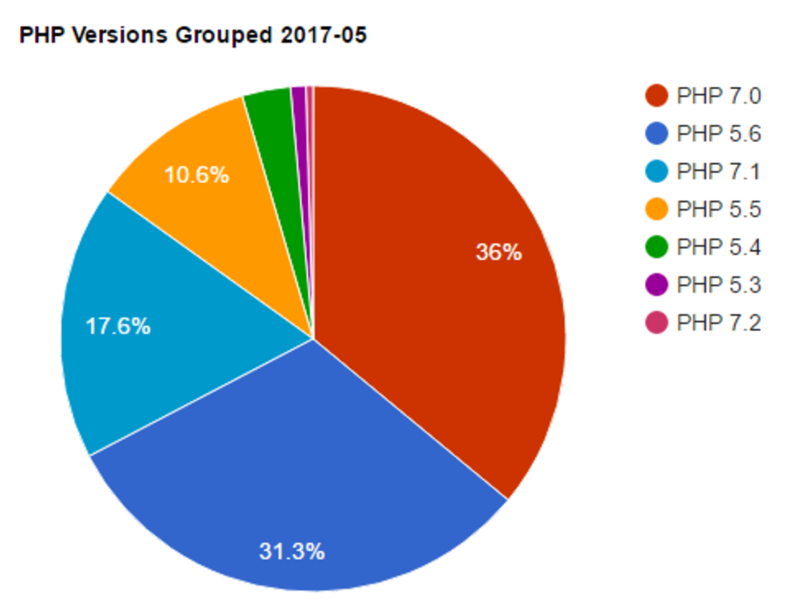
PHP usage statistics

Slide 13






Who is using PHP
Yahoo! – 3.5 billion/day
Flickr, Facebook, Friendster, Second life, iStockPhoto, Tumblr, Mailchimp, SourceForge, Alibaba, Baidu, Hong Kong Art Festival
Magento, WordPress, Joomla, Drupal, Discus

Slide 14
PHP usage statistics
https://w3techs.com/
https://wappalyzer.com/applications/php
http://www.php.net/usage.php
https://www.google.com.hk/trends/explore#q=php
http://trends.builtwith.com/framework/PHP

Slide 15
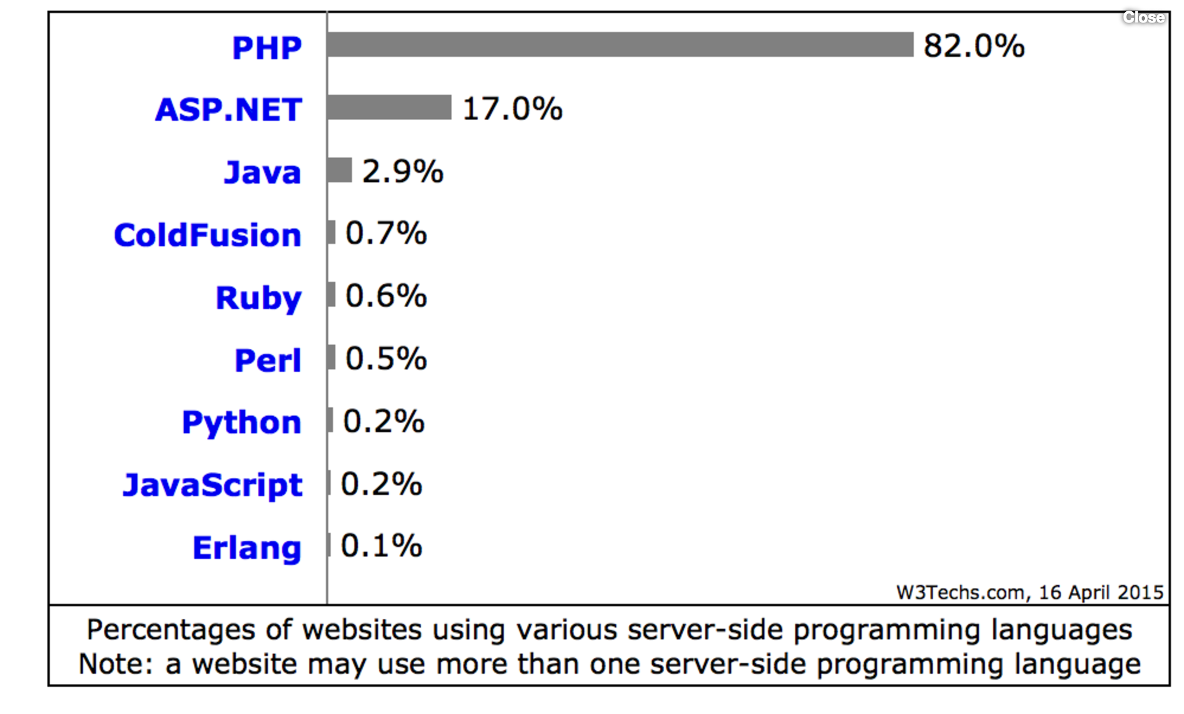

Slide 16



















Who is using Zend

Slide 17







Platform
Compatible for Linux, Mac OS X and Windows
Android
Best work with Apache, Ngnix
Also work on IIS

Slide 18
Using PHP for
User authentication and personalization
Shopping carts
Content management systems
Web-based email
Mailing list managers
Web forums
Document generation

Slide 19
Why do we use PHP
Similar to html
Script – no need to compile
Using programming syntax

Slide 20


Strengths
High performance
Interfaces to many different database systems
Built-in libraries for many common web tasks
Many free out-of-the-box system ready to use
Low cost
Ease of learning and use
Portability

Slide 21
Overview
How to upload
phpinfo();
echo
Function
Variables
Operands
pre- & post-increment

Slide 22
First html
Open Dreamweaver -> New Document -> HTML
Type your name
Save it to C:\AppServ\www
Save as index.html
http://localhost:8080/index.html

Slide 23
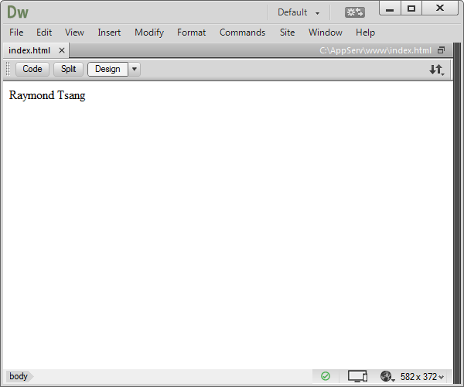
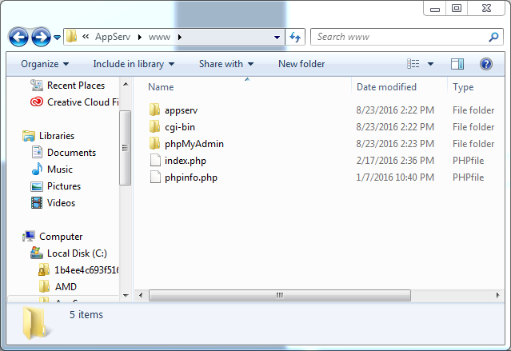
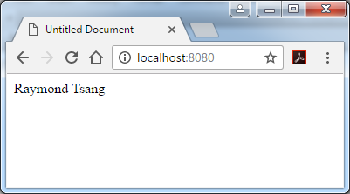

Slide 24
First PHP page
Dreamweaver -> File -> new -> Dynamic page -> PHP
<?php
phpinfo();
?>
phpinfo.php

Slide 25
phpinfo();
Outputs information about PHP's configuration
Commonly used to check configuration settings
Usually used for testing the PHP engine on the web server

Slide 26
PHP style
<? phpinfo(); ?> - short style
<?php phpinfo(); ?> - XML style
<script Language=‘php’> phpinfo(); </script> - script style
<% phpinfo(); %> - ASP style

Slide 27

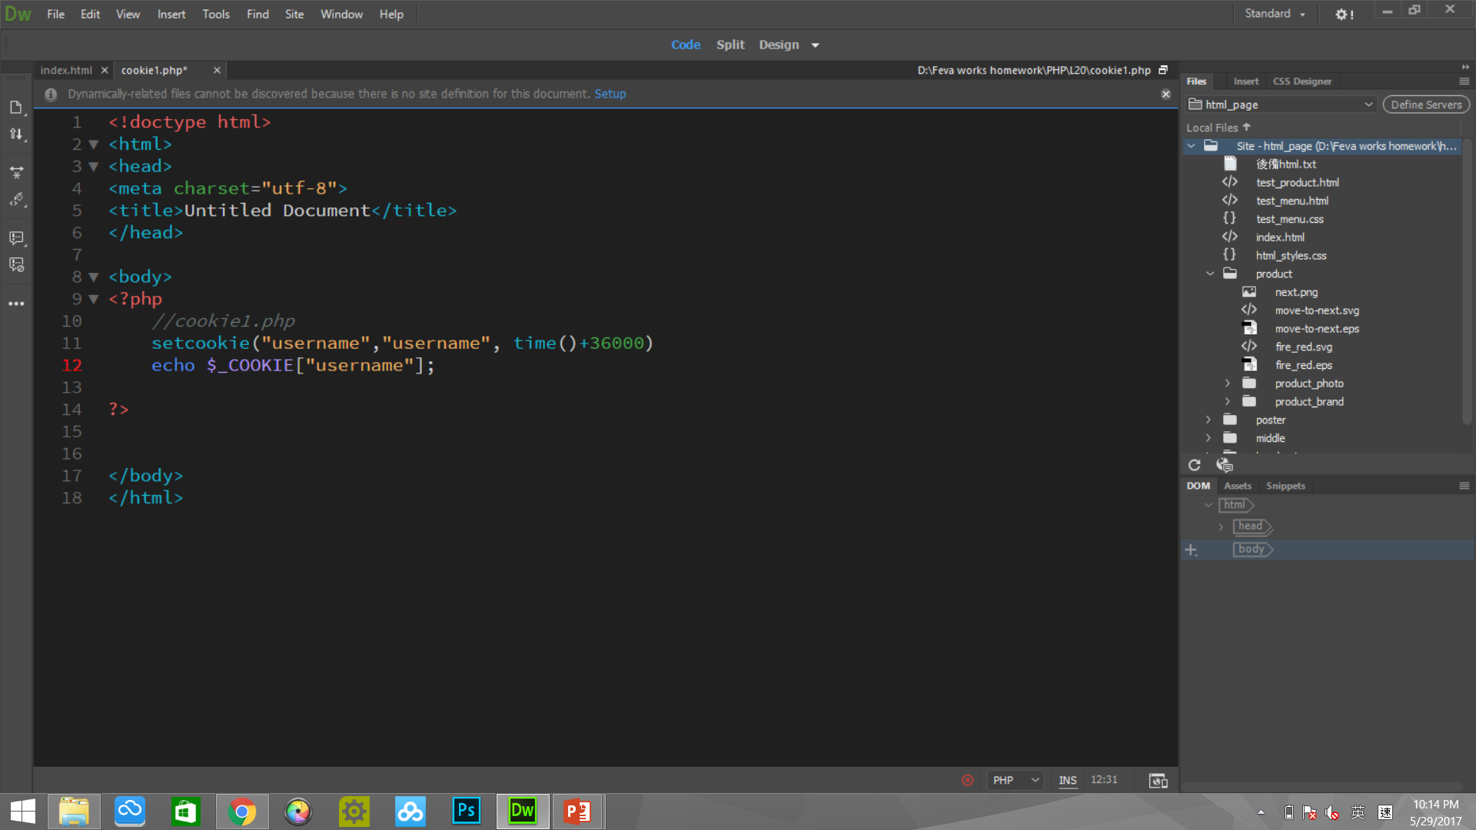
Statements
Tell the PHP interpreter what to do
Ends with a semicolon;
Without a semicolon, you will see an error page indicating the line with an error

Slide 28
White space
White space include new line, spaces, tabs
Browsers ignore white spaces in both html and PHP
Encourage to use white space for readability – usually one statement per line

Slide 29
Comments
Notes for reading the code
Usually used to explain the purpose of the script, when it was last modified
/* Author:Ray */ - multiline comment
// Author:Ray - single line comment (programming style)
# Author:Ray - single line comment (shell style)

Slide 30
Echo
Outputs all parameters
echo "Hello, this is my first php page";
echo.php

Slide 31
Print
Similar to echo, it also outputs all parameters.
Print returns a value of 1 and has precedence so that it can be used in the middle of a longer expression. However, the need for this is rare, and the fact that is returns a value makes it ever so slightly slower than echo. So we use echo.
Using with <<<, it prints all html
print.php

Slide 32
html in PHP
Nothing to change for the html code
Encapsulate PHP code before and after html code
echo "Hello<br />";

Slide 33
Classwork
Open a new php file and save as "birthday.php"
Echo your name in PHP
Browse http://localhost:8080/birthday.php

Slide 34

Install PHP + MySQL
Download XAMPP from http://www.xampp.org
Install to c:\(Windows) or /Application/(MAC)
Open XAMPP Control Panel, start Apache, MySQL
Test Apache http://localhost
Test PHP. Save your php files under c:\xampp\htdocs\(Windows) /Application/XAMPP/htdocs/(MAC)
Test your web page: http://localhost/filename.php

Slide 35
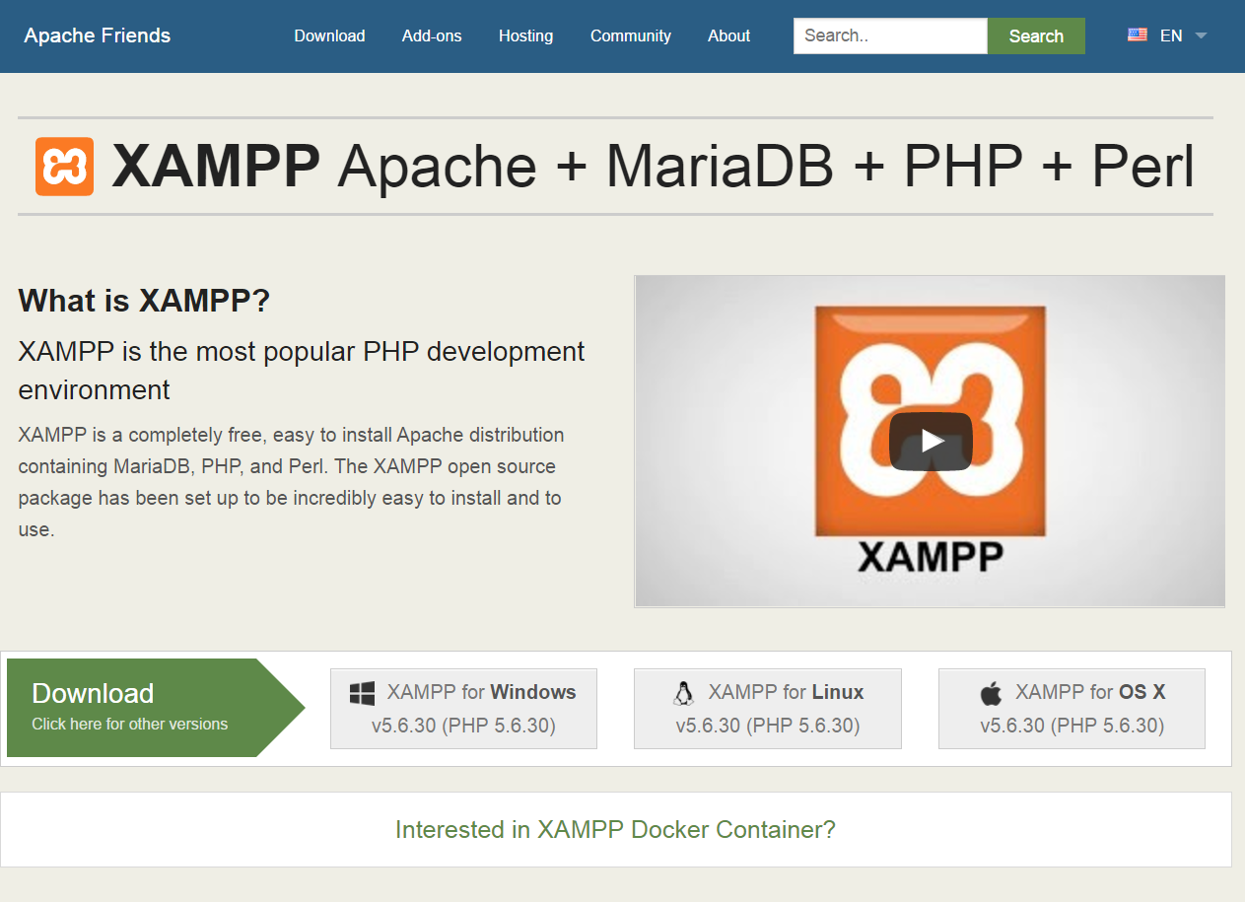
Download XAMPP
Download

Slide 36
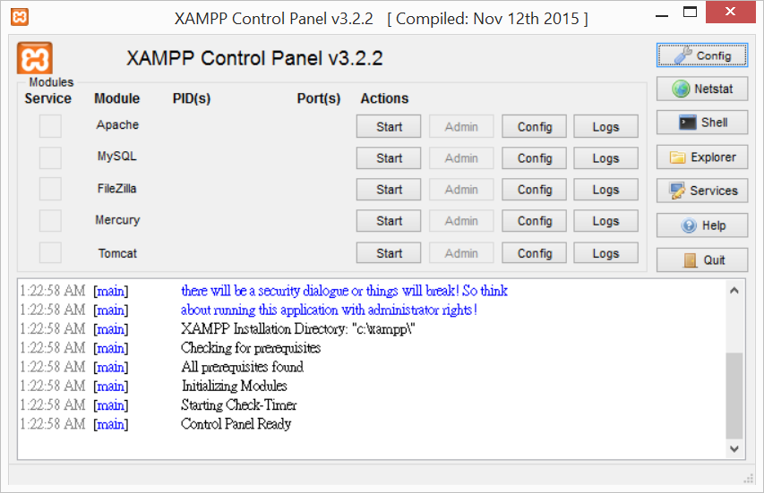
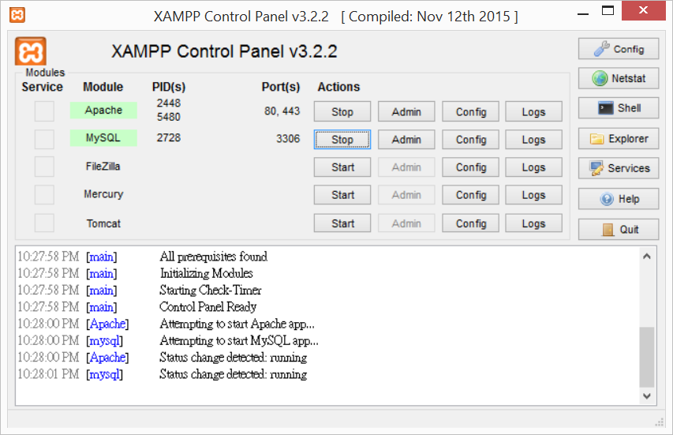

Slide 37
Functions
echo date("H:i, jS F");
echo date("l dS \of F Y h:i:s A");
Case sensitive
date.php
gmdate('H:i:s', time()+8*3600);
date_default_timezone_set('Asia/Hong_Kong');
http://hk2.php.net/manual/en/function.date.php

Slide 38
Classwork
Open birthday.php
Echo your birthday as YYYYMMDD format.
EG. (31-Dec-2000) echo ”20001231";
Echo today date as YYYYMMDD format
EG. echo date("xxx");

Slide 39

Functions
Find an integer of a decimal number
echo round(3.4);
echo round(3.5);
echo floor(3.4);
echo floor(3.5);
roundFloor.php
Q: How to find the next integer value?

Slide 40

Variable I
Each variable start with a dollar sign ($)
PHP is case sensitive $car<>$Car
Hello.php

Slide 41
Variable II
"\" is used for special command or character
" \n " is next line in email, same as <br> in html
" \r " = carriage return
" \t " = tab
" \$ " is printing the $ sign
" \\ " is printing the \ sign
" \" " = ?

Slide 42
Variable III
Examples of valid variables names are: $total, $_cell1, $length_of_string
Examples of invalid variables names are: $1_total, $2_length, $!total
$oneTwoThreeFour
$thisIsVariable

Slide 43
Variable Types
Integer – whole number, "1"
Double – real number, "1.00"
Character – "A", "B" .. "z"
String – strings of characters, "Hello"
Boolean – true or false, 1 or 0
Array – multiple data types items, "$car[I]", array.php
Object – instances of classes, "$car->tire=good"

Slide 44
Classwork
Open birthday.php
Store your name in variable $name
Store your birth year in $birthday
Store today date in $today
Echo the value in the variables so people can see your name and date of birth in the web page.

Slide 45
Operands I
+, -, *, /, %
$a=7; $b=3;
$sum=$a+$b;
$difference=$a-$b;
$product=$a*$b;
$quotient=$a/$b;
$mod=$a%$b;
operand.php

Slide 46
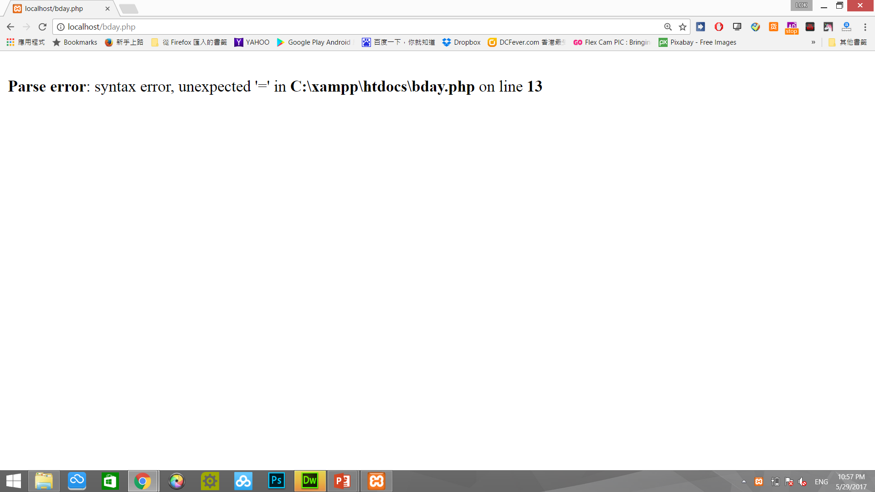
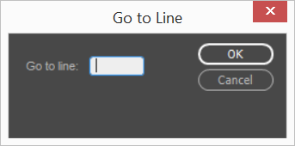
Errors
Errors will be shown in the page with line number
Ctrl+G to go the line

Slide 47
Debug
Ctrl+backspace - Delete a word on the left
Ctrl+Delete - Delete a word on the right

Slide 48
Exercise
Find out your age
Age = this year – your birth year
Use date function to find out this year in the format (yyyy). EG. 2017
Calculate your age.
Display your age.
2017
-2000
17

Slide 49
More Exercise
Open birthday.php
Find your age by $age=$today-$birthday
How to remove the last four digit?
How to cut off the decimal places?
20170131
-20001231
168900

Slide 50
Best hosting server
http://www.zaturday.com

Slide 51
Sites (eng)
http://www.php.net
http://www.phpbuilder.com
http://www.phpfreaks.com/
http://phpnuke.org
http://www.phpbuddy.com
http://www.php-security.org/

Slide 52
Sites (eng) 2
http://www.devshed.com
http://px.sklar.com/
http://www.phpgroupware.org
http://www.phpclasses.org

Slide 53
Sites (eng) 3
https://github.com/ziadoz/awesome-php
http://www.phptherightway.com/
https://packagist.org/

Slide 54
Sites (中文)
http://www.phpini.com/
http://www.csie.sju.edu.tw/cm/course/phpteach.htm
http://www.twhappy.com/index.php?action=blog&category=6

Slide 55
Download Server
http://www.apache.org/
http://www.php.net
http://www.mysql.com/
http://www.phpmyadmin.com
http://www.appservnetwork.com/
http://www.apachefriends.org
http://www.xampp.org

Slide 56
Facebook
http://www.facebook.com/groups/teachonetofish/
http://www.facebook.com/teachonetofish/

Slide 57
QUESTIONS

