Slide 1
Professional Diploma in Commercial Web Design
Lesson 2
PHP
By Raymond Tsang in Fevaworks
t-raymond.tsang@fevaworks.com

Slide 2
Operands II
String operators
Use a period(.) to combine a variable and a string
$a="mary";$b="chan";
$name=$a.$b
Operands2.php

Slide 3
Classwork
greeting.php
Rephrase the sentence

Slide 4
Operands III
Assignment operators
$a=000;
$b="000";
operand3.php

Slide 5
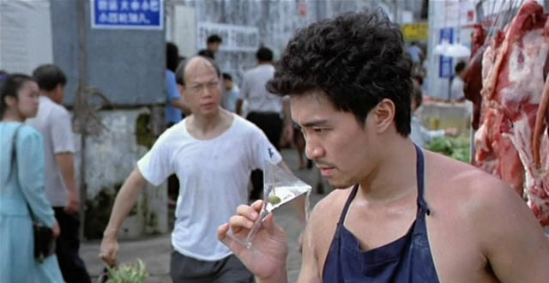
quotation
$jamesbond=007;
echo $jamesbond;
$jamesbond="007";
echo $jamesbond;

Slide 6
Operands IV
and, && – both true
or, || – either true
! – not, opposite
!=, <> - not equal
xor
&, |, ~(not), ^(xor), >>, <<(move left/right) - for bit checking

Slide 7
Operands V
 | Case 1 | Case 2
Yes | ✓ | ✓ | true
No | ✗ | ✗ | false
And | ✓ | ✗
✓ | ✓ | ✗
✗ | ✗ | ✗
OR | ✓ | ✗
✓ | ✓ | ✓
✗ | ✓ | ✗
NOT | !
✓ | ✗
✗ | ✓

Slide 8
Combination Assignment Operators
$a += $b; same as $a=$a+$b
$a -= $b; same as $a=$a-$b
$a *= $b; same as $a=$a*$b
$a /= $b; same as $a=$a/$b
$a %= $b; same as $a=$a%$b
$a .= $b; same as $a=$a.$b
Pre.txt

Slide 9

Classwork

Slide 10
Classwork
cart.php
Buy 1x Huawei P10, 2x Ranababy JA-F1M, 3x utalife E02 watch
What is the total price?

Slide 11
Pre- and Post-Increment and Decrement
$a=1;
echo ++$a; same as $a+=1;
echo --$a; same as $a-=1;
echo $a++; same as $a+=1;
echo $a--; same as $a-=1;
incremental.txt

Slide 12
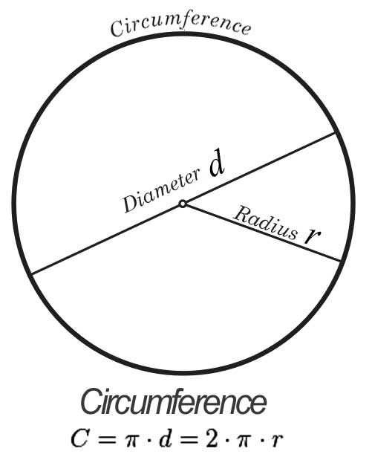

Circumference
$C=2πr$
$A=πr^{2}$
$π$ = 3.1415926535897932384626

Slide 13
Constants
Value that cannot be changed after setup
Usually use all upper-case letter to distinguish from function name
No dollar sign
constant.php

Slide 14
Predefined Constants
Some constants has already been predefined in PHP.
predefindedConstant.php

Slide 15

Break
Array is coming next…

Slide 16
Overview
The uses of arrays
What are arrays
How to declare arrays
Multidimensional array
Inspecting array

Slide 17
Variable
Array
$name
$name1
$name2
$name3
Dave
1
Dave
John
Mary
John
2
Mary
3

Slide 18
The uses of arrays
Store many variables in one variable name
No difference in data entry, but save a lot of time in generating a result
How to write that in PHP?

Slide 19
What are arrays
an orderly arrangement
indexed collection of data values
A series of variables (or objects) that are of the same size and type

Slide 20
How to declare arrays
$array[0]="first thing";
$array[1]="second thing";
$array['green']="john";
Array key is 0, 1 green
Array value first thing, second thing, john

Slide 21
Exercise
Set student info to an array from student.php
student.php

Slide 22
Student data
student number | name | marks
1 | dave | 90
2 | john | 50
3 | mary | 66
4 | sue | 72
5 | ada | 55
6 | jack | 97
7 | jay | 82
8 | leo | 88
9 | ben | 62
10 | cindy | 100

Slide 23
Multidimensional array
Usually use two dimensional array but no limit of x-dimensional array
Two dimensional array $multi_array['A'][1]="dumping";
Three dimensional array $multi_array['sheet1']['A'][1]="dumping";
car.xls

Slide 24
Overview
If statement
While loop
Do while loop
For loop

Slide 25
If statement
For a special condition, use if for making a decision
if only
if {} else {}
if {} elseif {} else {}

Slide 26
If statement
if (condition){
statement;
}
if ($marks==100){
echo "you get full marks";
}
if ($marks<60){
echo "you are fail";
}

Slide 27
If statement
if (condition){
statment1;
}else{
statment2;
}
if ($marks>=60){
echo "you are pass";
} else {
echo "you are fail";
}

Slide 28
If statement
if (condition1){
statment1;
}elseif(condition2){
statment2;
}elseif(condition3){
statement3;
}

Slide 29
If statement
if (condition1){
statment1;
}elseif(condition2){
statment2;
}elseif(condition3){
statement3;
}else{
statement4;
}

Slide 30
If statement
if ($marks==100){
echo "you get full marks";
} elseif ($marks>=60){
echo "you are pass";
} else {
echo "you are fail";
}

Slide 31
Classwork
100="full marks"
>90="A"
>80="B"
>70="C"
>=60="D"
<60="fail

Slide 32
Operands V
symbol | meaning
== | equal
!= | not equal
< | less than
> | greater than
<= | less than or equal to
>= | greater than or equal to
=== | same type

Slide 33
White spacing
Easier for dubugging
Usually use tab for under each blanket
Highlight the code
Use "Ctrl+Shift+>" or "Ctrl+Shift+<" for formatting

Slide 34
While loop
Also relies on a condition, but it executes repeatedly for as long as the condition is true
See while.php
Loop forever if this has been setup incorrectly
$num=6;
If loading for over 5 seconds, Browser -> Stop

Slide 35
Do while loop
Very similar to while loop, but it executes at least once before checking the condition
See dowhile.php

Slide 36
For loop
Similar to while loop. Also relies on a condition, but we set a counter to begin.
Initialize a counter
Set condition
At the end of each iteration, we modified the counter

Slide 37
For loop
for (init; condition; update){
statement;
}
for ($num=1; $num<=5; $num++) {
echo $num."<br>";
}

Slide 38
Classwork
find all numbers from 11-20 //fora.php
find all odd numbers from 1-10 //forb.php
find all even numbers from 1-10 //forc.php
find all multiple of 5 numbers from 1-100 //ford.php

Slide 39
Homework
Show multiple of 7 within 100 and 200
fore.php
Show 1-100 for 10 numbers in one row
forf.php
1 | 2 | 3 | 4 | 5 | 6 | 7 | 8 | 9 | 10
11 | 12 | 13 | 14 | 15 | 16 | 17 | 18 | 19 | 20
21 | 22 | 23 | 24 | 25 | 26 | 27 | 28 | 29 | 30

Slide 40
QUESTIONS

