Slide 1
Professional Diploma in Commercial Web Design
Lesson 5
PHP
By Raymond Tsang in Fevaworks
t-raymond.tsang@fevaworks.com

Slide 2
Overview
Quotations
Require
Include
Function
Cookie
Session

Slide 3
Single quotation and double quotation
' ' – for exact value
" " – for dynamic value
See quotation.php

Slide 4
Require
includes and evaluates a specific file
Work only once in a loop
Using as a template
When the require file cannot be found, it display an error and stop the script
See require.php and require.inc

Slide 5
require.php
require.inc

Slide 6
Require .inc security
Since if you type filename.inc can download the file, people can download your id/password. So for security reason, you should only use filename.inc.php
require2.php
require.inc.php

Slide 7
Require menu
www.sony.com.hk
hk.yahoo.com
sicav.chinaamc.com
Create home.php aboutus.php contactus.php
+ header.inc.php footer.inc.php

Slide 8
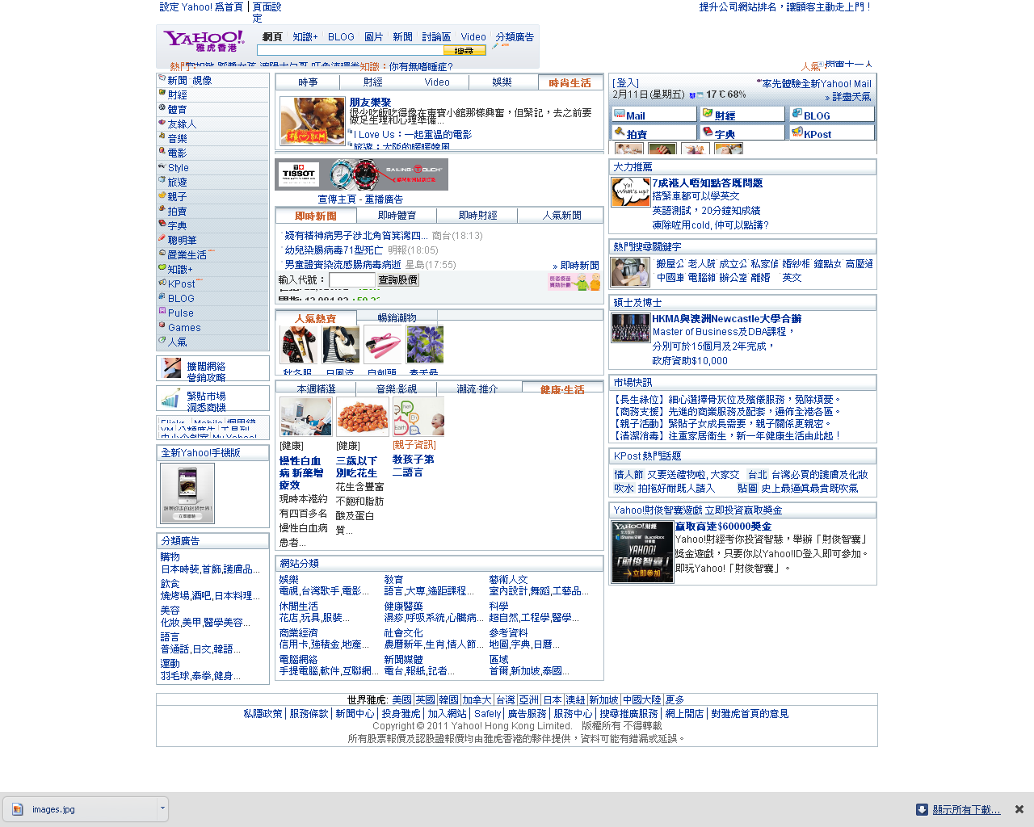

Slide 9
Include
identical in every way with require() except how they handle failure. include() produces a Warning but not stop the php while require() results in a Fatal Error and stop the php
Include() can be used in a loop for repeating the function
See include.php, a.inc, b.inc, c.inc
Template folder

Slide 10
Include_once and require_once
_once only call another file one time. If it has been called before, the main php does not recall the same file again
require_once is better since it checks if the file is present; otherwise, php halted. Also better for security.

Slide 11
Break
Function is coming……

Slide 12
Function
A procedure defined by user for his own uses
Pos for using functions. Reuse, easy debug
Many existing built-in functions
See function1.php
See function2.php
See function3.php

Slide 13
Function example
Copy from others and no need to understand the coding. Just need to know how to use.
https://gist.github.com/eagleon/1702129
function4.php

Slide 14
Check Function
To test if a function exist, use function_exists(function_name);
See function_exists.php

Slide 15
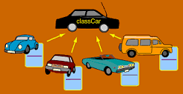
Object Oriented
Since we do not only want functions to be reused, we also want variables to be reused. So we use object.
Will be in details in next lesson/ powerpoint.

Slide 16
Cookie
Built-in PHP environment variables are in the form of arrays, eg. $_COOKIE
Most database functions transport their info via arrays
Passing entire sets of html form arguments from one page to another

Slide 17
Set Cookie
setcookie(”variable", "value", expiry_second);
cookie1.php
cookie2.php

Slide 18

Remove Cookie
setcookie("name", "", time()-10);
cookieReset1.php

Slide 19
Session
A random number generated by the server to check user concurrent connection
Similar to cookie, but the information stored on server
sessionstart.php, session2.php, sessiondestroy.php

Slide 20
Create snippet
For those you use it repeatedly, you may want to save it as a snippet to load the code by one click.
Highlight the codes, right click, "Create New Snippet", name it, OK
Windows -> Snippet -> double click to load

Slide 21
Assignment
www.zaturday.com/homework/login.html
Lesson 24
Save the username in cookie. (login.php)
Display the cookie username. (login2.php)
Logout to remove cookie. (logout.php)
Display the cookie username again (no more username).

Slide 22
QUESTIONS

