Slide 1
Professional Diploma in Commercial Web Design
Lesson 6
PHP
By Raymond Tsang in Fevaworks
t-raymond.tsang@fevaworks.com

Slide 2
Overview
Sorting an array
Associative array
Randomized array
Counter
Upload File

Slide 3

Sorting an array I
Sort an array into ascending order
1<2<3<…
A<Z<…<a<z
sort.php

Slide 4
Sorting an array II
asort() – sort the value
ksort() – sort the key
rsort(), arsort(), krsort() – reverse sorting order
sort2.php

Slide 5
Classwork 1
Download sortstudent.php from share
Sort student name in ascending order without class number (sort)
Display the result by print_r
Sort student name in ascending with class number (asort)
Display the result by print_r

Slide 6
Classwork2
Sort student mark (sort or asort or ksort?)
Display the result by print_r
Display the result by for loop
Display the name and mark in one line for each student

Slide 7
Randomized array
shuffle() randomly reorders the elements of an array
Eg. Large number of products in stock and want randomly select one item to show on a page
hk.yahoo.com
Copy the images folder to www from share
shuffle.php

Slide 8
Random
Randomly give you a number between min to max;
rand(min,max);
rand.php

Slide 9

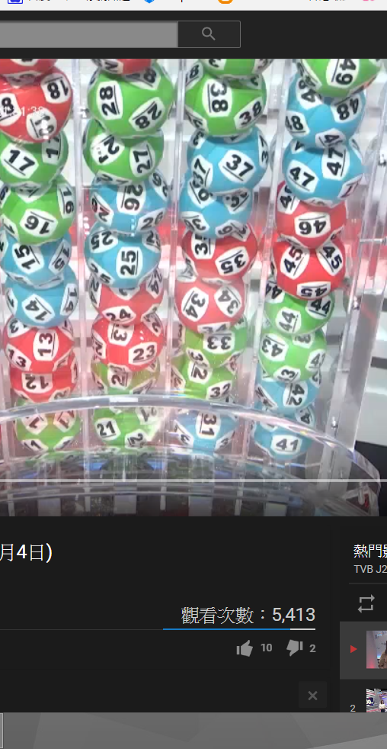
Classwork
Write a mark 6 php program
Use rand, sort and for loop
https://www.youtube.com/watch?v=8toTPxg1sKU&feature=youtu.be&t=1m33s
mark6.php

Slide 10

Classwork
It may has repeated numbers
Use while to check repeat numbers or use shuffle
mark6NoRepeat.php

Slide 11


Break

Slide 12
File
Read files/directory from the current directory on the server
fopen() – open a file
fclose() – close an opened file
fgets() – read file content
fwrite() – write data to the file
w - 寫入
a - 附加在檔案後面
r - 只有讀取

Slide 13

Read a file
fopen(filename, attribute)
fclose($filePointer)
fgets($filePointer)
fwrite($filePointer, data)
fgets.php, text.txt
fwrite.php, write.txt

Slide 14
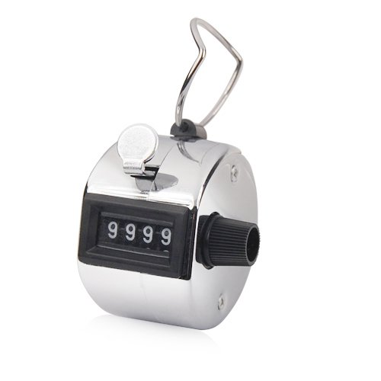
Counter
Update hit counter
fopen() – open the file
fgets() – read file data
fwrite() – write data to the file
fclose() – close the opened file
hitscounter.php, counter.txt

Slide 15
Read a remote server content
file_get_contents(“site”);
fgets3.php

Slide 16
fgetss
Gets line from file pointer and strip HTML tags
fgetss.php

Slide 17
Upload file
Upload a file from a web page
Eg. Attach a file to your email
Open a new html file
Create a form with file field
Save as upload.html

Slide 18
Upload folder
Usually we will create a folder to store the upload files in case they upload a “index.html” to hijack our website.
In www, right click -> New -> Folder -> Create an “upload” folder.

Slide 19

Upload file php
Create a php file
$tmpfile=$_FILES["fileField"]["tmp_name"];
$uploadfile="upload/".$_FILES["fileField"]["name"];
move_uploaded_file($tmpfile, $uploadfile)
Save as upload.php
If no file uploaded, check LINUX/MAC PERMISSION!

Slide 20

Check uploaded file
Check file type (upload_1.php)
Check file max size (upload_2.php)
Check file min size (upload_3.php)

Slide 21
Caution
Require user authentication, no anonymous uploads
Do not host uploaded files that have not been verified
Use caution when opening uploaded files
Limit maximum upload size
Limit allowable file formats, file extensions

Slide 22
Caution
Require user authentication, no anonymous uploads
Do not host uploaded files that have not been verified
Use caution when opening uploaded files
Limit maximum upload size
Limit allowable file formats, file extensions

Slide 23
You should
Relocate temp file to a secure location
Location should not be occupied by another file
Use unique names or unique directory names
Upload folder should not be public

Slide 24
php.ini
file_uploads=true
upload_tmp_dir = “/www/tmp”
upload_max_filesize = “2M”
max_file_uploads=20
post_max_size=“8M”

Slide 25
File path
basename
dirname
pathinfo
realpath
path.php

Slide 26
Homework
Create a product page layout like products-example.png by using include and for loop with these files.
products-design.php
products-header.inc.php
products.css
products-array.inc.php

Slide 27
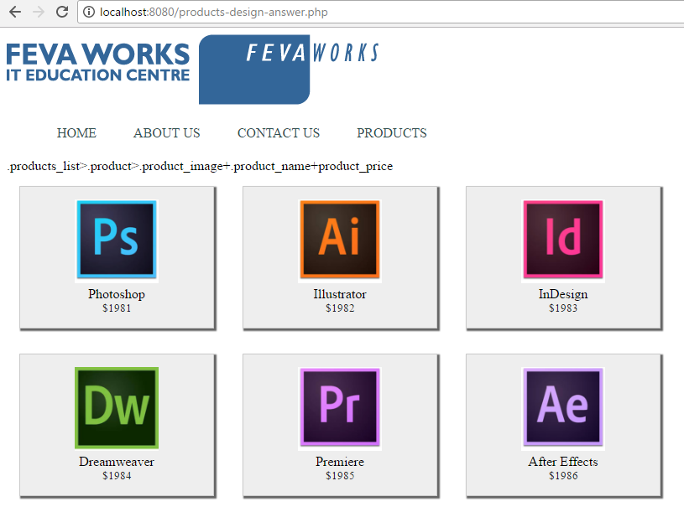
Final result

Slide 28
QUESTIONS

