Slide 1
Professional Diploma in Commercial Web Design
Lesson 7a
Object - TV
By Raymond Tsang in Fevaworks
t-raymond.tsang@fevaworks.com

Slide 2

Objective
Understand object in real life example
Create TV object

Slide 3
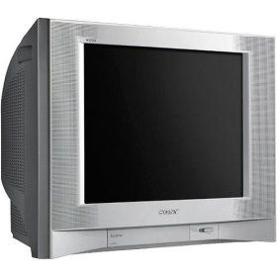


What is object
You can turn-on/ turn-off a TV
If Sony is a TV, then you can turn-on/turn-off a Sony.
TV is an object, turn-on/turn-off is a function.
Everything you say is a TV, you can turn-on/turn-off.

Slide 4
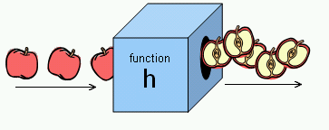

Why do we need object
We want to reuse functions, also want to reuse variables.
Everything is stored in “class”
You do not need to know how it works inside, but you need to know what to input and what is the output
Free memory

Slide 5
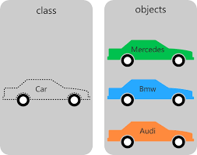
Concept
Class – The blueprints for an object and the actual code that defines the properties and methods
Object – running instances of a class that contain all the internal data and state information needed for your application to function
$object=new Class();
tv01.php

Slide 6
Create an object and instance
class Classname{} – define object
$object_var=new Classname(); - create object

Slide 7
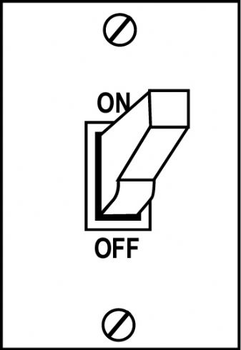
Method
Function in an object is called method.
Methods can be created more than one
tv02.php

Slide 8

Method
Add a new turnOff method in TV class
Turn off $sony
tv03.php

Slide 9


Classwork
Add a new volumeUp and volumeDown method in TV class
echo “volume up<br>”;
tv04.php

Slide 10
Property
Variable in an object is called property
Properties can be declared with var $var;
Set variable to the class by $this->var = value;
tv05.php

Slide 11
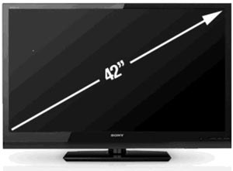
Constructor
Initialization in a class is called constructor. It is defined by creating a method that named function _ _construct(){}
We need to know the size before we make a TV.
tv06.php

Slide 12
Constructor
How to add 2 variables to constructor?
We also need to know the brand name.
tv07.php

Slide 13

Classwork
Now Philips ask you to create a new TV for 32”.
Test getName, turnOn, turnOff, volumeUp, volumeDown, getPlug methods
Tell me the size of Philips.
tv08.php

Slide 14

Classwork
Your boss want to add a new “color” property for each TV.
Before you create a new TV, you need to tell me what is the TV color.
Sony is “black” and Philips is “silver”.
Show us each TV color
tv09.php

Slide 15

Inheritance
Inheritance is based around the concept of parent classes and child classes
When you create a child class, it inherits all the properties and methods of the parent. The child class can then include additional properties and methods, thereby extending the functionality of the parent class.
Dragonball example
EG. LCD is a kind of TV. LCD can do everything TV can do.

Slide 16
Inheritance
class ChildClass extends ParentClass {
}
$child_object=new ChildClass();

Slide 17

Inheritance
class LCD extends TV{
}
$samsung=new LCD();
tv11.php

Slide 18

Over parent
Child class can have new methods which parent class does not have.
EG. New iPhone has new function that more than old iPhone.
tv12.php

Slide 19

Classwork
Add dolbyOff method
$samsung->dolbyOff();
tv13.php

Slide 20
Parent method
You may use methods from Parent class
parent::turnOff()
tv14.php

Slide 21
Static method
Static means the method or variable is accessible through the class definition and not just through objects
public static function insurance(){}
TV::insurance();
tv15.php

Slide 22
Static method
Different class can has some static method name but different function
LCD::insurance();
tv16.php

Slide 23
Public, Private, Protected
Class properties must be defined as
Public
Private
Protected

Slide 24
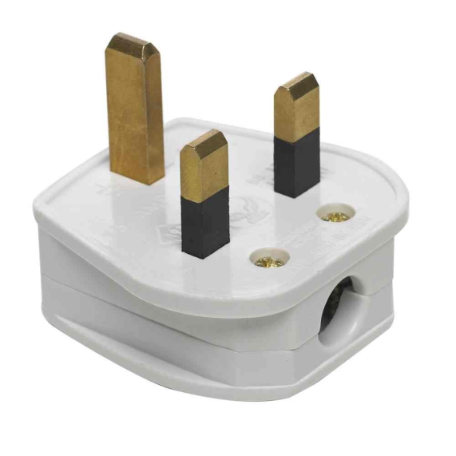
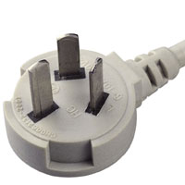
public
By default, all class members are public . If properties declared using var, the property will be defined as public.
You can change public variable at anytime.
public $plug="UK";
$sony->plug="CN";
tv17.php

Slide 25

private
Access is limited to the declaring class only. No external access whatsoever is allowed.
It is a good practice to protect from outsider giving invalid value. Always check input value before setting the new value.
$sony->voltage=110; (Error)
tv18.php

Slide 26
Change private variable
Encapsulation – the ability of an object to protect access to its internal data
getter and setter
We need a setter to change the private variable
tv19.php

Slide 27
Validate private variable
Since we can validate the value before we change the private variable, private variable are more secure than public variable.
tv20.php

Slide 28

protected
To access a parent method or property from a child class
Like the private keyword, protected methods and properties are available only to the class that created them. But unlike private, protected methods and properties are visible from a parent class.
SetMethod from child
tv21.php

Slide 29


Concept 2
Interfaces – a way of specifying that an object is capable of doing something without actually defining how it is to be done (EG. a dog and a human are “things that walk” but they are different)
Abstract – similar to Interface, but it can contacts method content

Slide 30
Interface
An interface is similar to a class except that it cannot contain code. An interface can define method names and arguments, but not the contents of the methods. Any classes implementing an interface must implement all methods defined by the interface. A class can implement multiple interfaces.
Delete any method will cause error.
tv22.php

Slide 31
Abstract
An abstract class is a mix between an interface and a class. It can define functionality as well as interface (in the form of abstract methods). Classes extending an abstract class must implement all of the abstract methods defined in the abstract class.
tv23.php

Slide 32
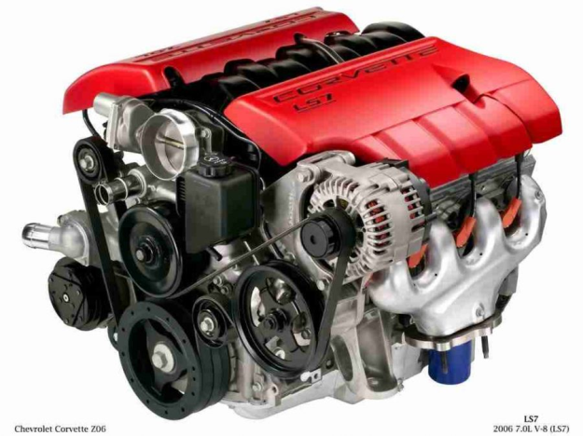


Concept 3
Polymorphism – allows a class to be defined as being a member of more than one category of classes (EG. a car is “a thing with engine” and also “a thing with wheels”)

Slide 33

Example
Search 農曆 php
https://gist.github.com/eagleon/1702129
cal.php

Slide 34

Example
Search php pdf
http://www.fpdf.org/
pdf.php

Slide 35
References
http://newaurora.pixnet.net/blog/post/190301967-static%E8%AE%8A%E6%95%B8%E3%80%81public%E8%AE%8A%E6%95%B8%E3%80%81private%E8%AE%8A%E6%95%B8%E3%80%81protected%E8%AE%8A

Slide 36
QUESTIONS

