Slide 1
Professional Diploma in Commercial Web Design
Lesson 7b
Object - game
By Raymond Tsang in Fevaworks
t-raymond.tsang@fevaworks.com

Slide 2
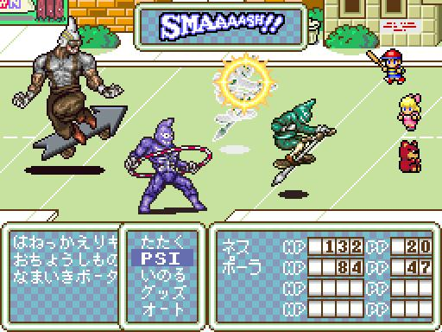
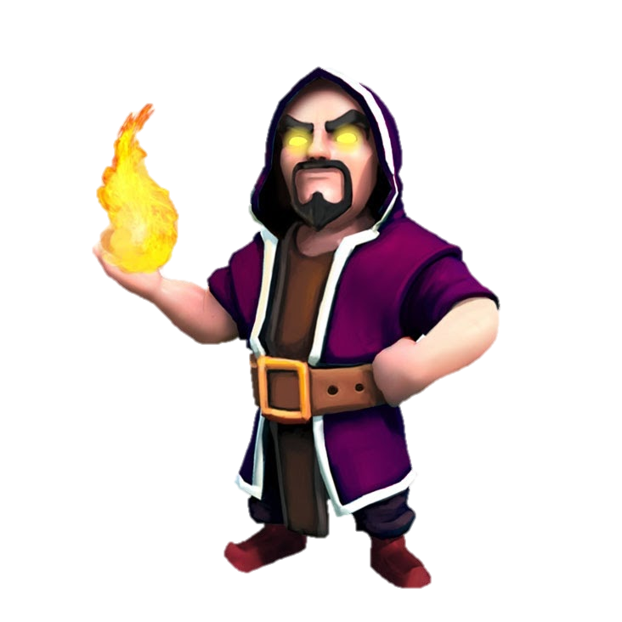
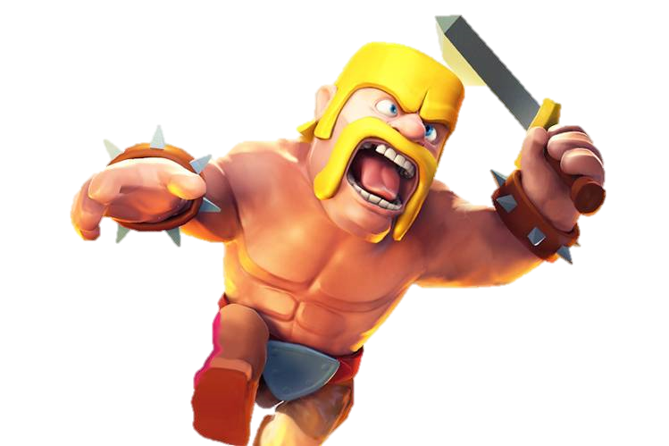
Objective
Understand object in game example
Create character and enemy object

Slide 3




Character
hero
Enemy
pig
wolf
Boss
dragon

Slide 4
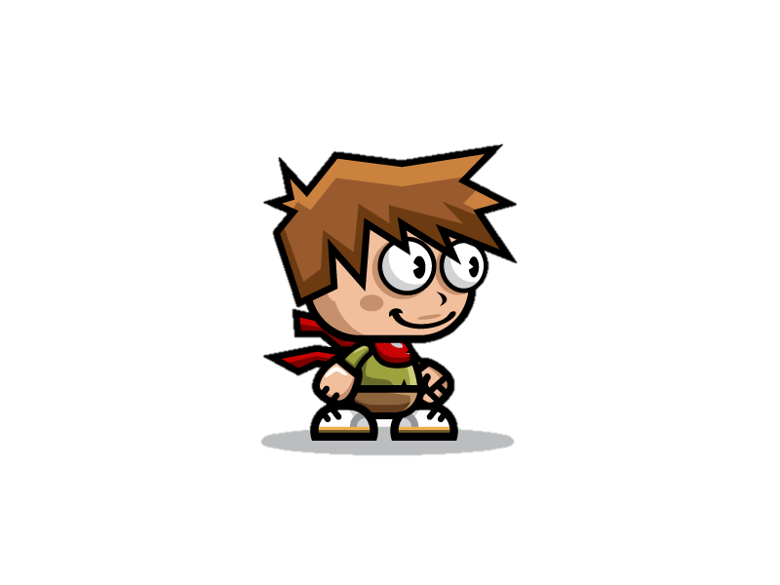


Define playable character
Each character class has hp and atk property when created
Create yourself as the character
game01.php, game02.php, game03.php, game04.php

Slide 5
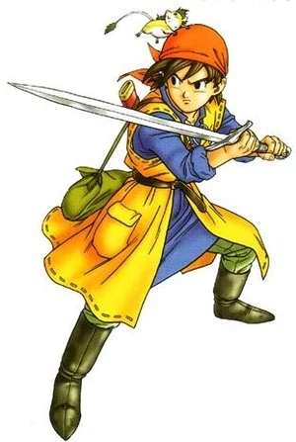


Character losing health
If the playable character has been hit by a monster, he/she will lose health.
game05.php

Slide 6

If health(hero) = zero,
If the playable character’s HP falls to zero, he/she will die and the game will be over.
game06.php, game07.php

Slide 7
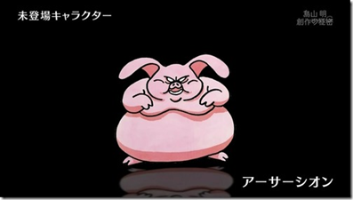
Define Enemies (1)
Now that we have created our character, we are going to make enemies for our little character to fight.
In this example, we will create an enemy pig.
game10.php, game11.php, game12.php, game13.php, game14.php

Slide 8
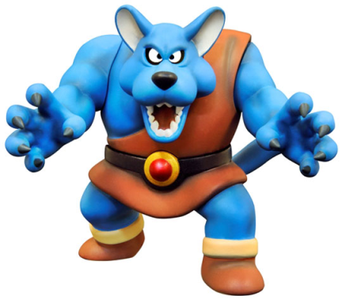
Define Enemies (2)
We are going to make a wolf type enemy.
Wolves are defined to be stronger than pigs. They use fire magic attacks against the character.
game15.php

Slide 9
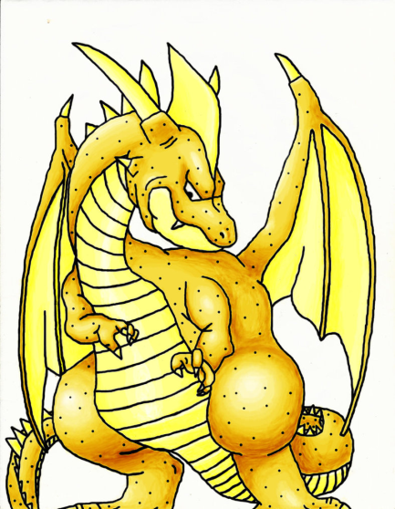
Define Boss (3)
The boss in this game would be a dragon. The boss would be much stronger than the normal enemies and more health. It uses ice magic attacks.
game16.php, game17.php

Slide 10
QUESTIONS

