Slide 1
PCAT measure @ 3Dslicer

Slide 2
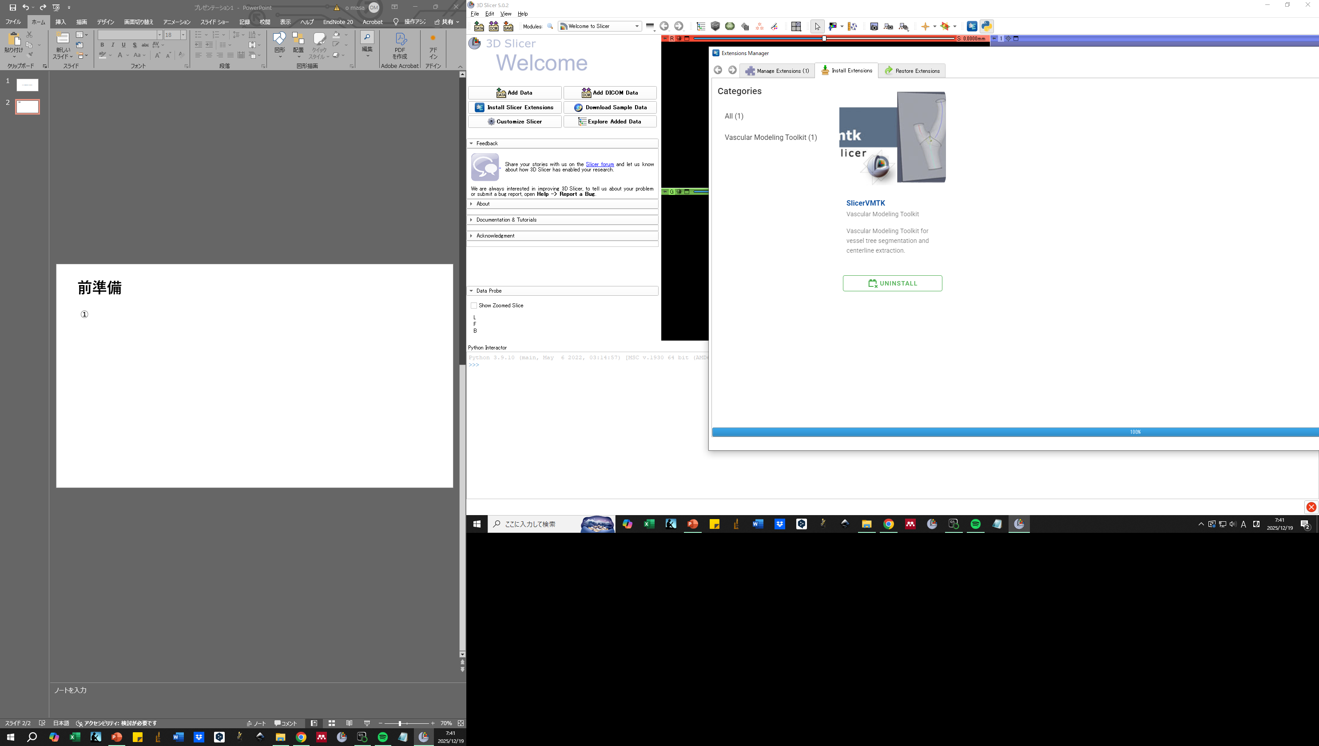
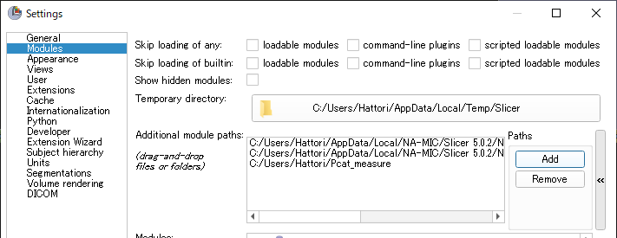
setup
①Install “SlicerVMTK” and Restart 3Dslicer
② Edit
⇒ Application setttings
⇒ Modules
⇒ Additional module paths
⇒ Add Pcat_measure directory paths
⇒ Restart 3D slicer

Slide 3
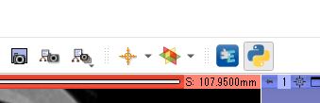
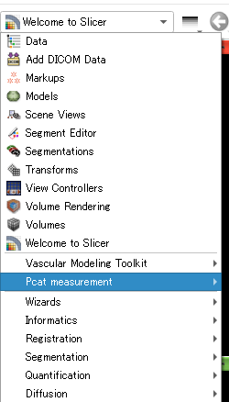
setup
④The python interactor is ON for error checking.
③If it appears in the module list, it's successful

Slide 4
Setup error
If “ Pcat measurement “ does not appear in the module list.
・When Slicervmtk is installed but an error appears in the python log stating that vmtk is missing
The slicer version may not be compatible.
Please install 5.0.2 to 5.4.0 from the URL below.
https://slicer-packages.kitware.com/#collection/5f4474d0e1d8c75dfc70547e/folder/5f4474d0e1d8c75dfc705482
If the error still occurs, there may be conflicts between multiple installed 3Dslicers.
Delete all slicer folders in “C:\Users\user\AppData\Local\NA-MIC” and reinstall This directory is an example, please refer to the 3Dslicer installation folder.

Slide 5
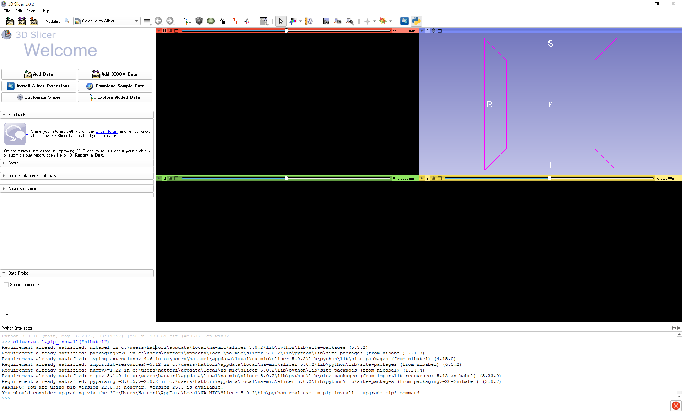
Setup error
“ nibabel “ not installed error
・Install from python interactor
slicer.util.pip_install(“nibabel”)

Slide 6
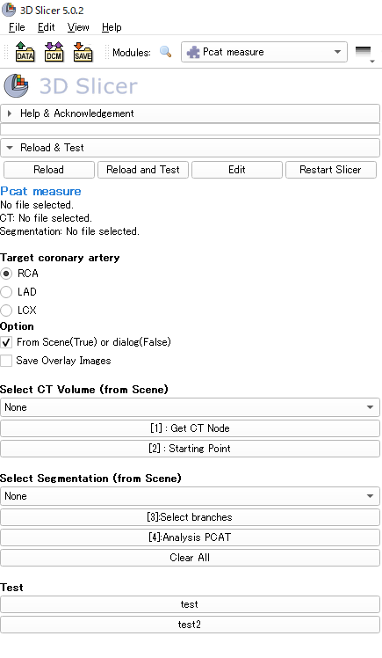
Screen Description
Developer mode only
File information
Target artery button
You can either use data already loaded in 3Dslicer, or open a file dialog to select the data.
(default : True)
Select CT data from scene
Load CT
Save the overlay of the CT image and PCAT region as a png file (default False)
Setting the starting point
Select Segmentaion data from scene
Select target artery ID
Delete all CT and segmentation data from 3Dslicer
Calculate Pcat attenuation

Slide 7
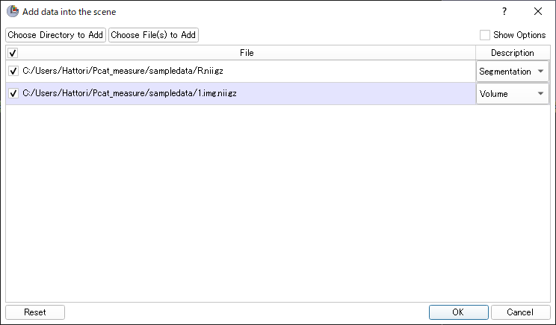
How to use (Loading from a Scene True)
① Drag and drop CT and Segmentation into 3Dslicer.
② Load CT and Segmentation data with Description set to Volume and Segmentation respectively.

Slide 8
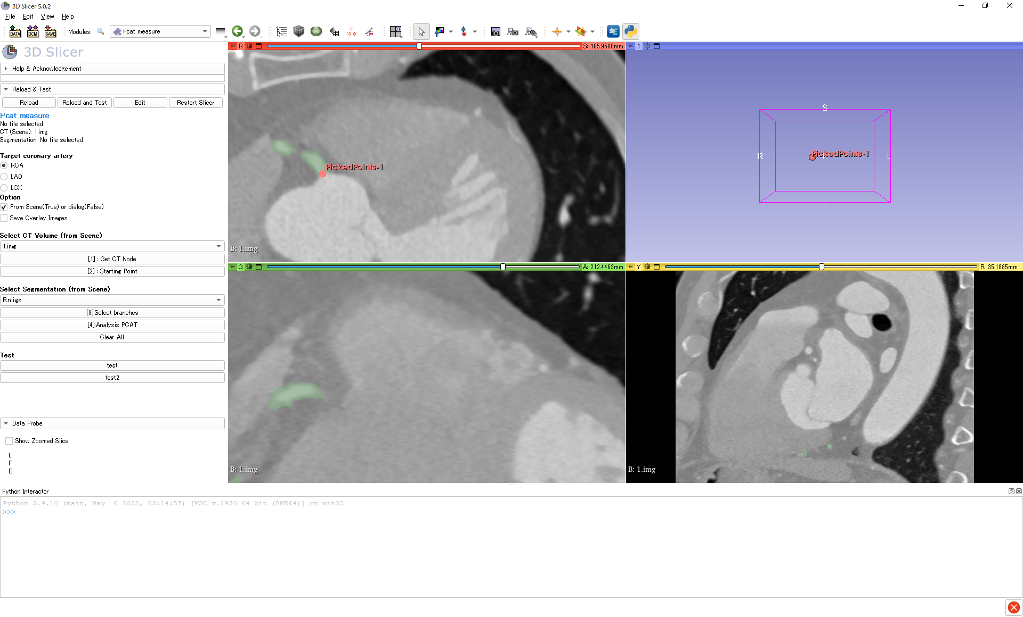
How to use (Loading from a Scene True)
③ Check the target artery to analyze
④ Select CT volume name (ex:1.img)
⑤ Click “ [1]: Get CT Node ”
⑥ Click “ [2]: Starting Point ” and place picked Points
⑦ Select Segmentation name (R.nii.gz)

Slide 9
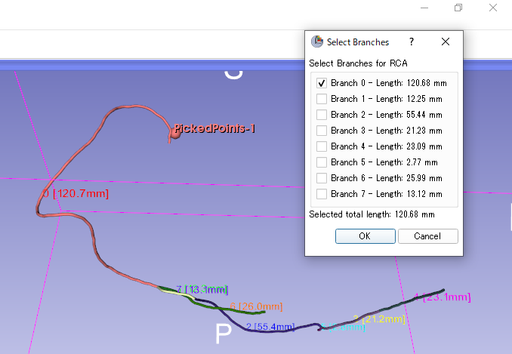
How to use (Loading from a Scene True)
⑧ Click “ [3]: Select branches ”
Check the centerline, ID, and length of the blood vessel in the 3D view.
In the case of RCA, the branch ID required for PCAT measurement is checked initially to some extent automatically.
Currently, LCA is prone to failure, so please manually check the branch ID required for analysis.
Please make sure that the selected total length is 400 mm or more.
⑨ Click “ OK ”
⑩ Click “ [4]: Analysis PCAT ”
PCAT value is displayed in python log. (It is also saved in .csv.)

Slide 10
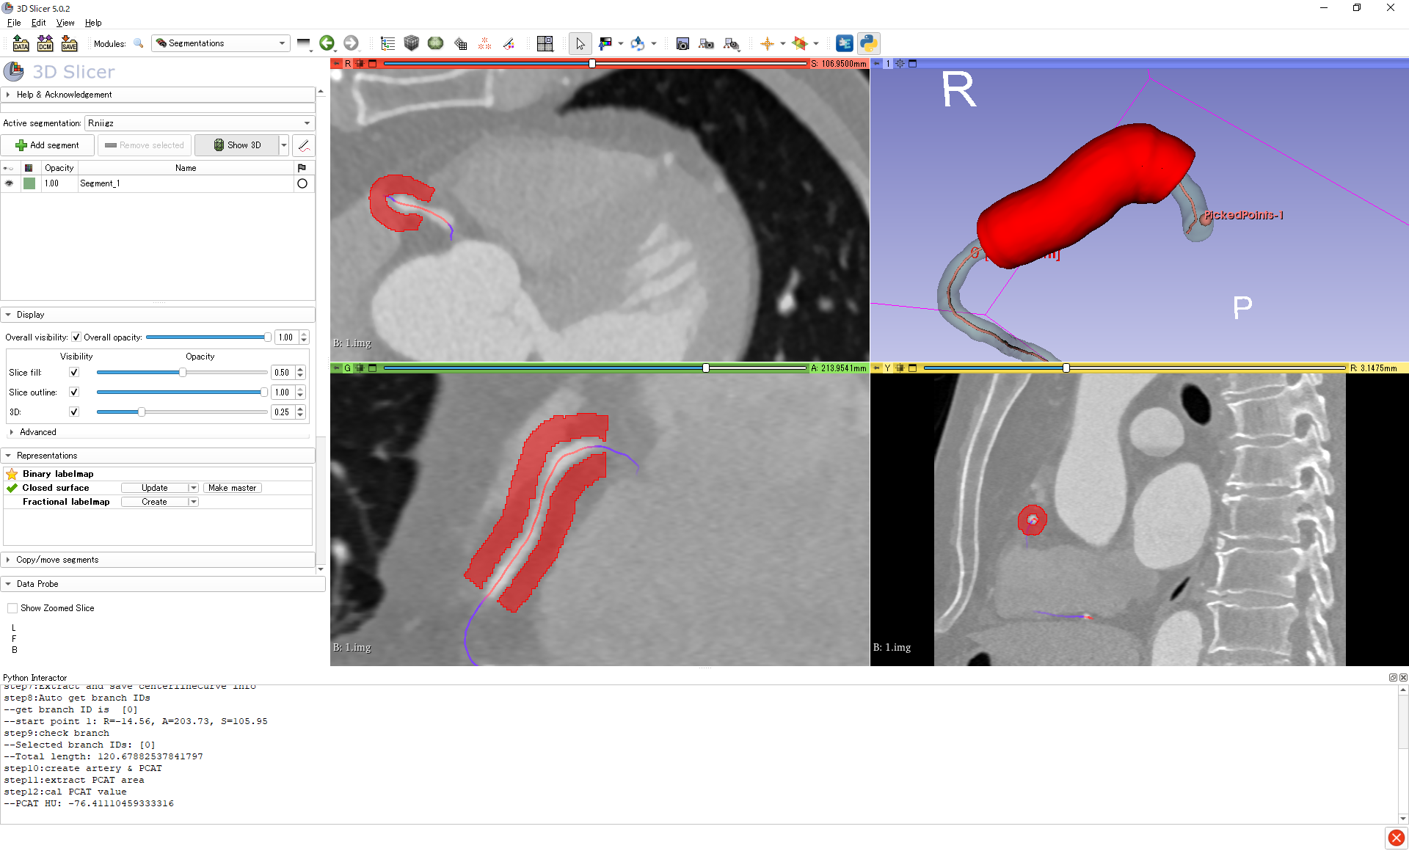
How to use (finished)

Slide 11
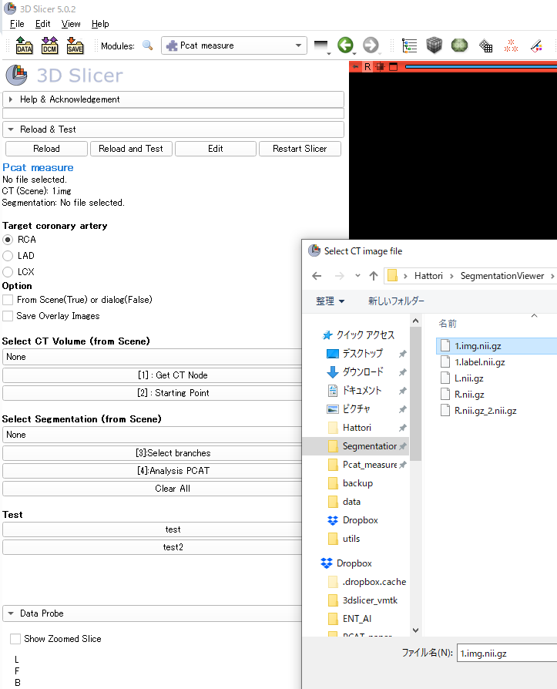
How to use (Loading from a file dialog False)
① Check the target artery to analyze
② Uncheck “ From Scene(True) or dialog(False) “
③ Click “ [1]: Get CT Node ” and select CT file data (.nii.gz)
④ Click “ [2]: Starting Point ” and place picked Points
⑤ Click “ [3]: Select branches ” and select segmentation file (.nii.gz)
※ ComboBox is OK with None
⑥ The rest is the same as for Scene.

