Slide 1

GROUP 9;
TEJAS
HARSHIT
KUSHAL
RAJKUMAR
SHELDON
ADMISSION REPORT USING PYTHON

Slide 2


STEP 1 & 2
STEP 3
STEP 4
STEP 5
STEP 6
STEP 7
TEJAS
HARSHIT
KUSHAL
RAJKUMAR
SHELDON
ALL
Design and implement a welcome message, a password validation system, and functionality to allow the user to input and validate the number of students.
Create functionality to prompt the user to input and store the names of the specified number of students.
Build functionality to prompt the user to input and record the grades for each student.
Implement functionality to calculate the GPA for each student based on their grades and print in a report format.
Develop logic to assign students to schools based on their GPA.
Collaborate to design and implement a system to generate and print detailed reports.

Slide 3
STEP 1

Slide 4
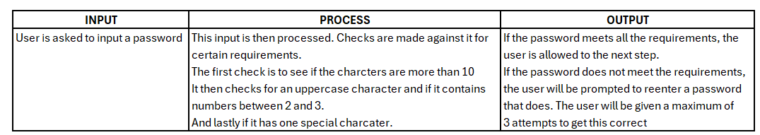
IPO METHODOLOGY

Slide 5
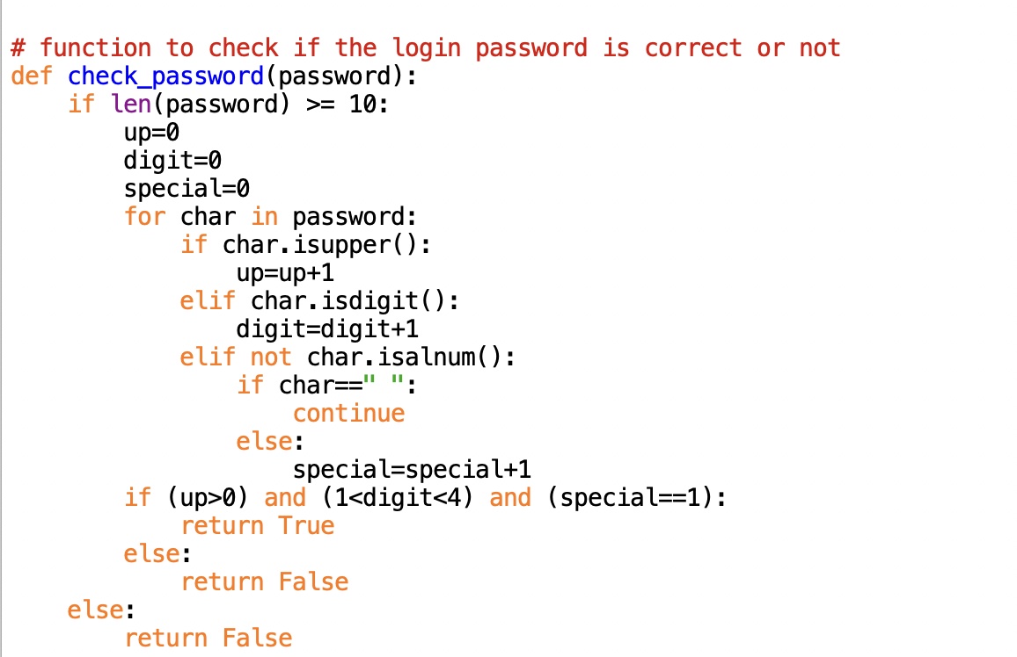

Slide 6






Welcome message
Password does not meet the length requirements
Password does not have an upper-case character
Password does not have 2 or 3 numeric value.
Password only have 1 numeric value. 2 or 3 is required.
Password does not have a special character.
Program terminates because password was entered 3 times incorrectly.
Password meets ALL requirements.

Slide 7
STEP 2

Slide 8
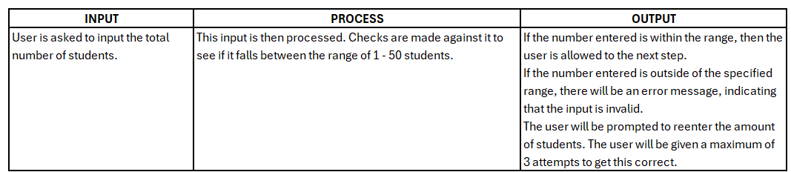
IPO METHODOLOGY

Slide 9
Number of Students entered should be between 1 and 50. 0 is an invalid input.
Number of Students entered should be between 1 and 50. 51 is an invalid input.
Number of Students entered should be between 1 and 50. 52 is an invalid input. Program terminates after 3 failed attempts.
Valid input is entered. Program moves on to ask for the number of students.

Slide 10
STEP 3

Slide 11
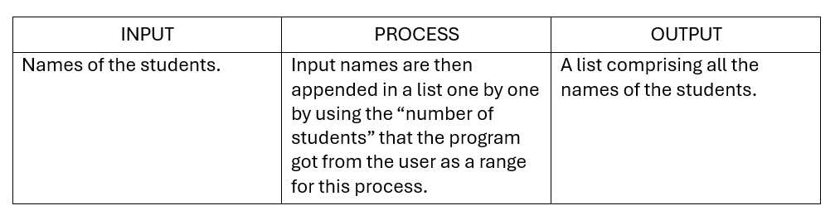
IPO METHODOLOGY

Slide 12
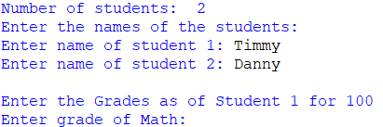
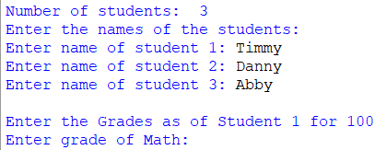
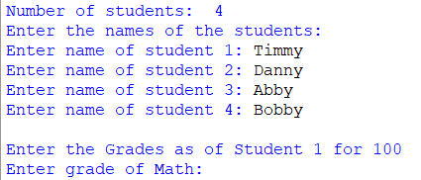
Program asks to enter the student’s name for the number of students inputted.

Slide 13
STEP 4 & 5

Slide 14
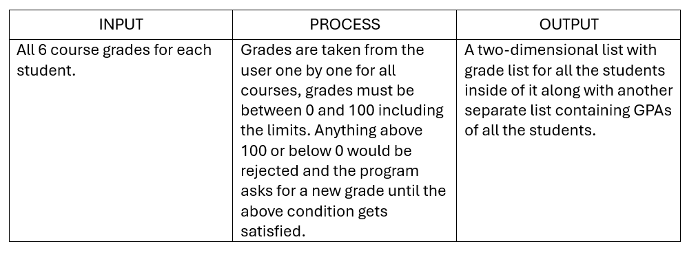
IPO METHODOLOGY

Slide 15
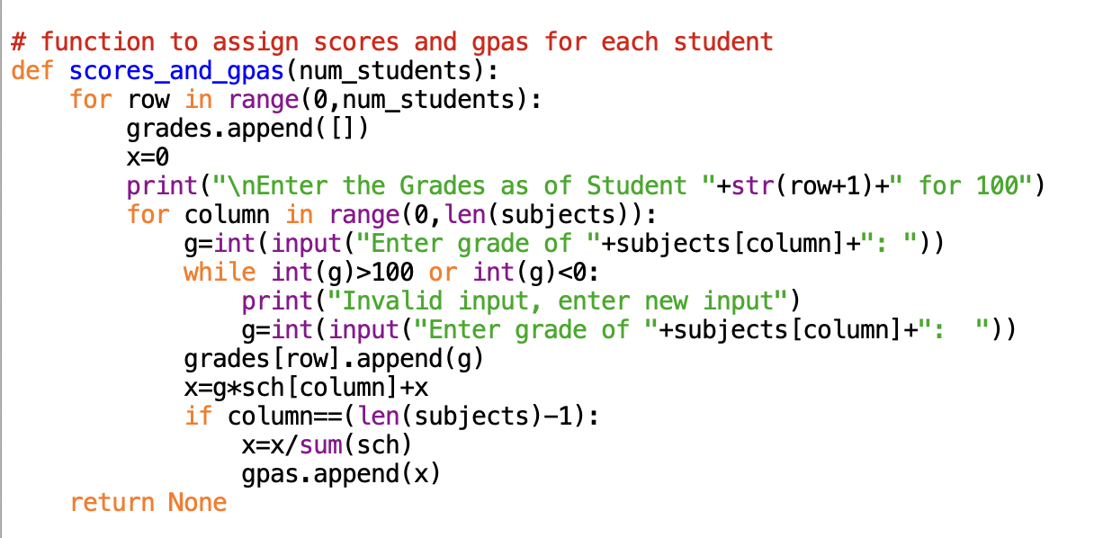

Slide 16
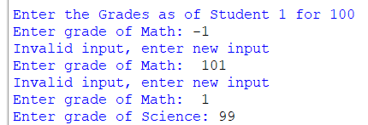
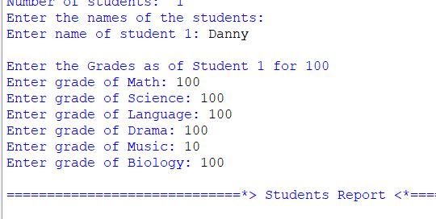
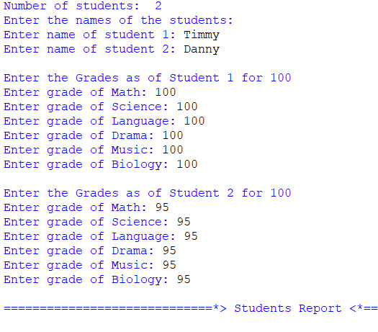
While entering grades, numbers below 0 or greater than 100 is invalid.
Grades for 6 subjects are entered for the number of student that was inputted. Program moves forward to printing reports.

Slide 17
STEP 6

Slide 18
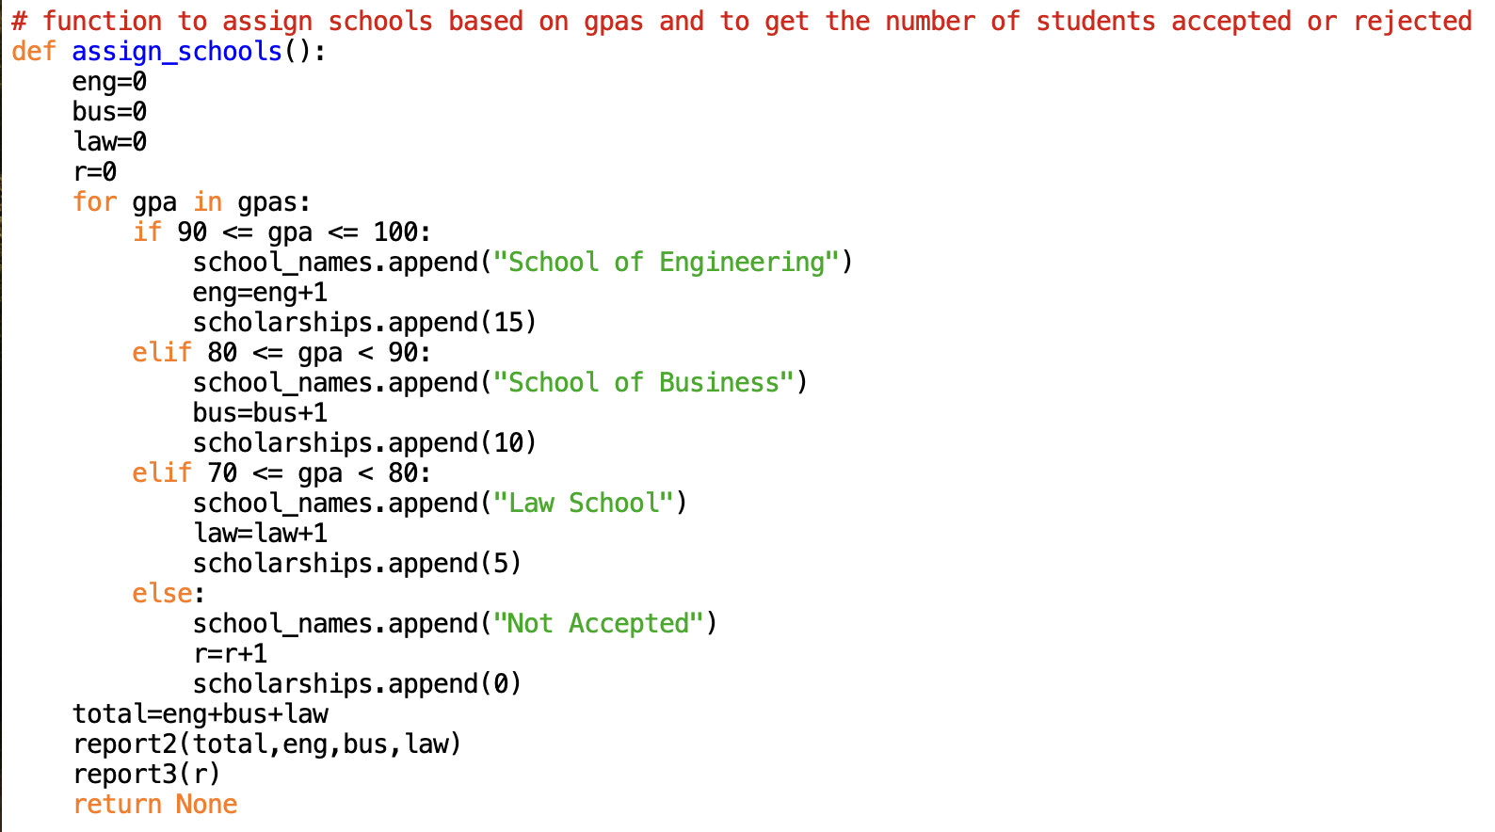

Slide 19
STEP 7

Slide 20
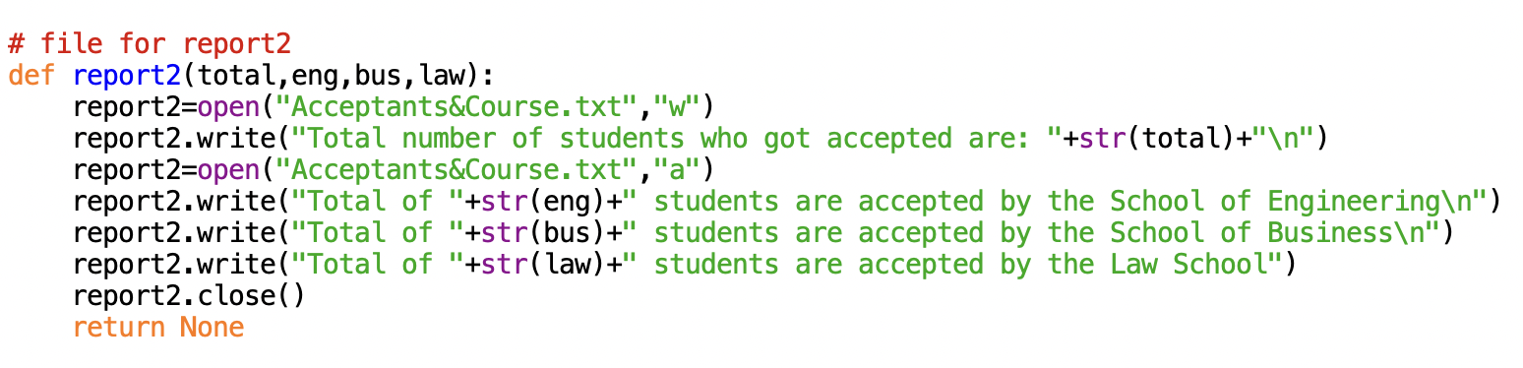

Slide 21
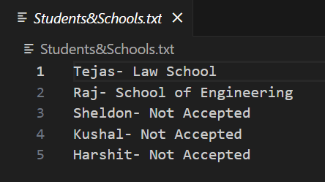
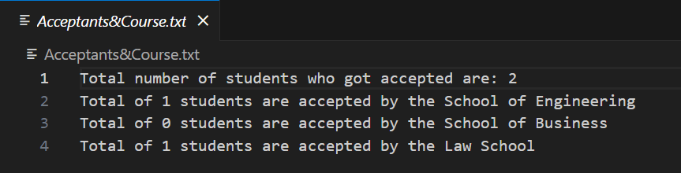
REPORT1
REPORT2

Slide 22
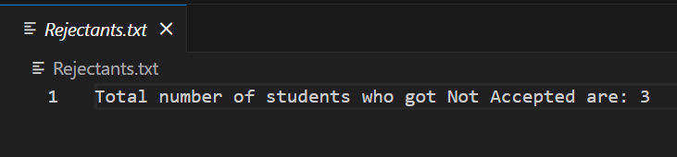
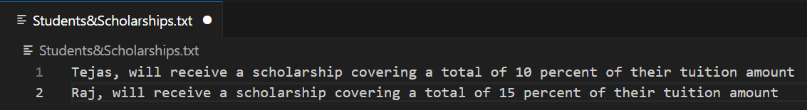
REPORT3
REPORT4

Slide 23
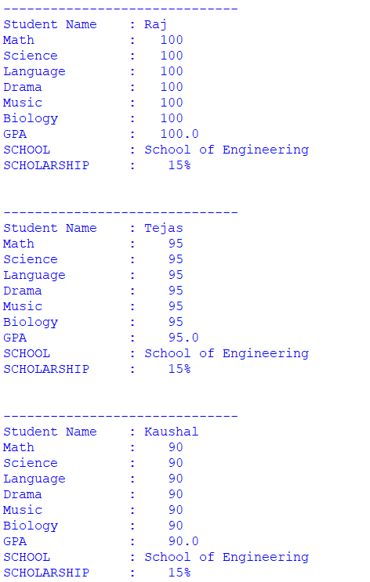
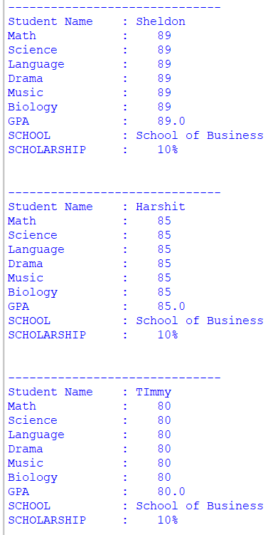
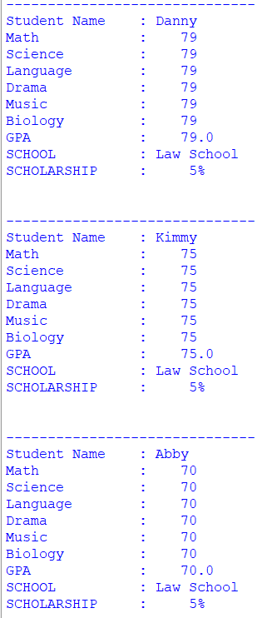
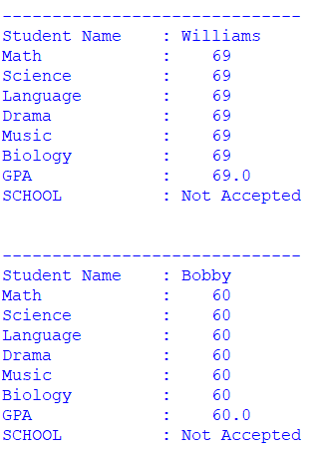
MODEL OUTPUT FOR DIFFERENT GRADES AND GPAS
NOT ACCECPTED
SCHOOL OF ENGINEERING
SCHOOL OF BUSINESS
LAW SCHOOL

Slide 24
THANK YOU

