Slide 1
World Agricultural Outlook Board Data Research
Final Assignment
Ismail Ismail, Rajkumar Ramu

Slide 2
Identifying the problem
Regional Production
Regional Exports
Regional Imports
Analyzing regional production trends helps identify which countries are driving output, supporting food security, and influencing global trade flows.
Identify export-dependent nations and monitor their trade consistency Evaluate shifts in global demand and trade competitiveness Understanding export dynamics is critical for forecasting market prices and ensuring reliable food distribution.
Spot vulnerabilities in food-insecure regions Anticipate geopolitical or climate-driven trade imbalances This insight supports international coordination and the stabilization of global food systems.

Slide 3
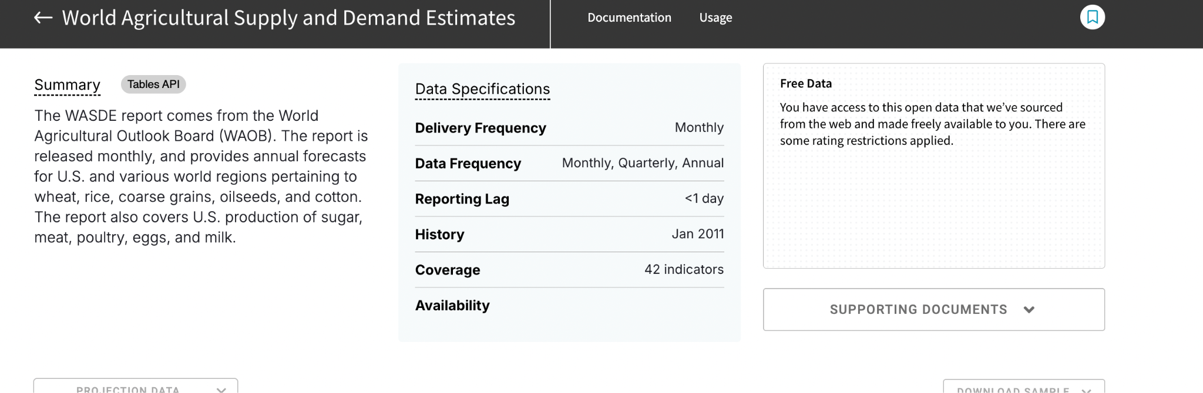
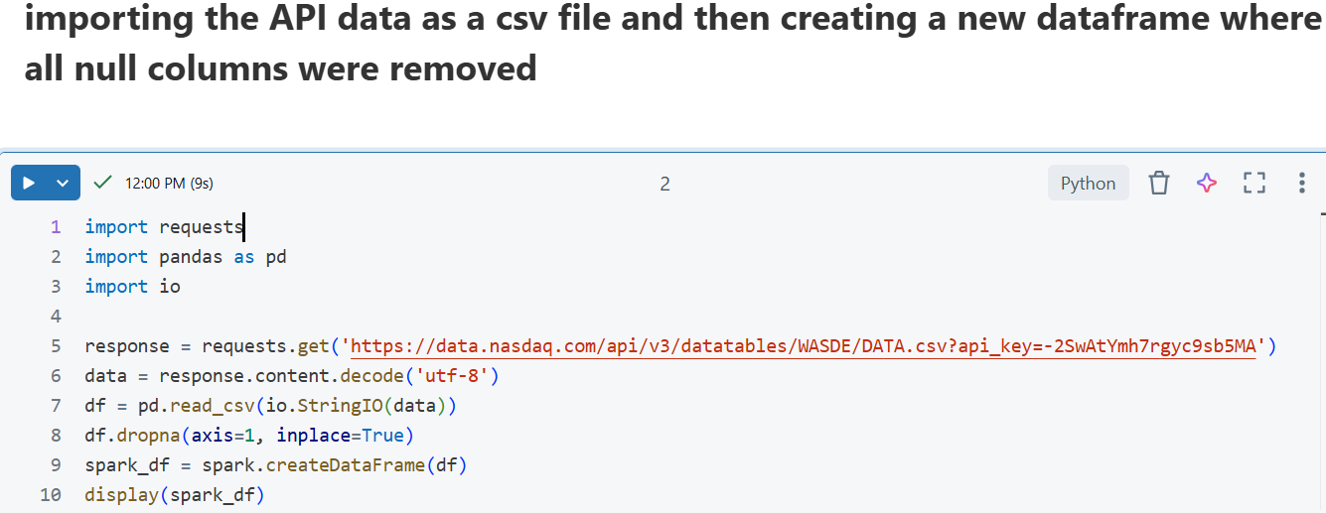

Data Collection Process
Accessed WASDE data from Nasdaq
2)
3)

Slide 4
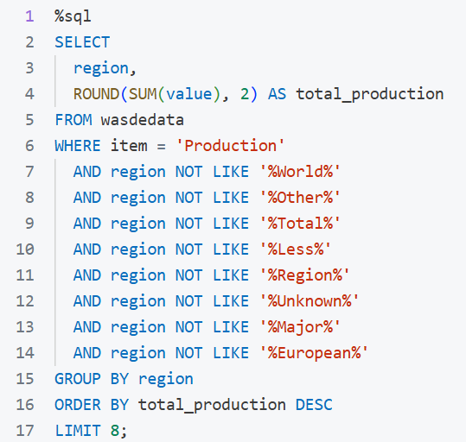
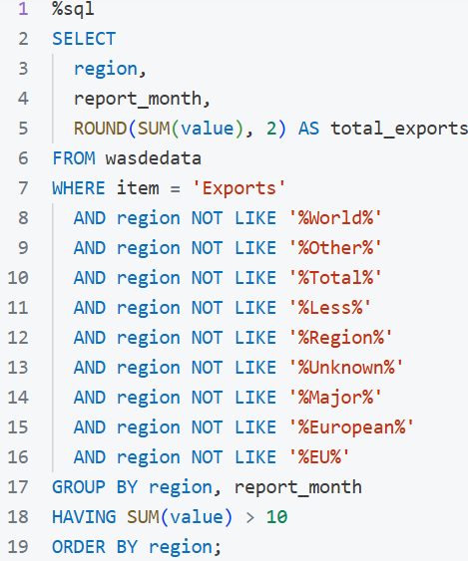
4) code for finding total wheat production in top 8 countries ignoring the regions that are not countries
5) code for finding average total wheat exports in countries with total average greater than 10 ignoring the regions that are not countries

Slide 5
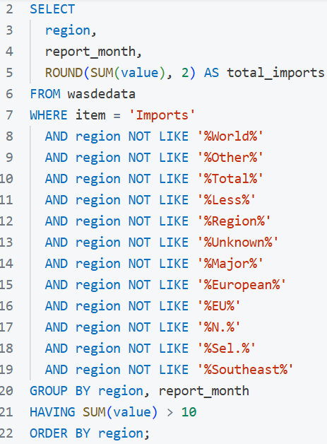
6) code for finding average total wheat imports in countries with total average greater than 10 ignoring the regions that are not countries

Slide 6
Regional Wheat Production:
Which of the major countries produce the most wheat?

Slide 7
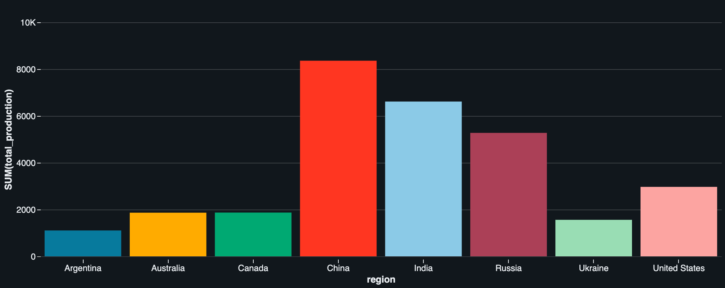
Regional Wheat Production Analysis
Observations
China stands out as the top producer by a significant margin, contributing over 8,000 units in total production.
India and Russia follow as major contributors, each surpassing 5,000 units, showcasing their substantial role in global supply.
United States, Canada, and Australia also appear as consistent mid-level producers.

Slide 8
Implications
China leads global production, making it the most influential country in terms of supply impact. Any disruption would have global consequences.
India and Russia rank closely behind, reinforcing their importance in food security and trade dynamics.
The U.S., Canada, and Australia show strong output and play vital roles as stable exporters to global markets.

Slide 9
Regional Wheat Exports:
Which Countries/Regions export the most wheat per month?

Slide 10
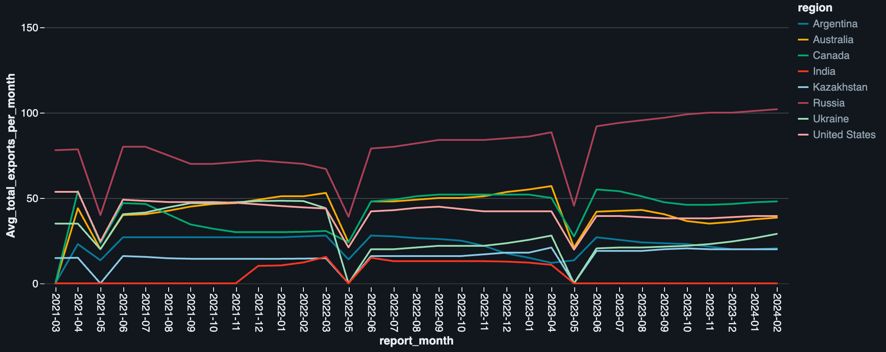
Regional Wheat Export Analysis
Observations
Russia exports the most wheat overall, with exports rising steadily since mid-2022.
Australia, Canada, and the U.S. have steady export levels, with Australia and Canada leading the group.
Most countries saw export drops around May 2021, June 2022, and April 2023.

Slide 11
Implications
Russia's dominance may impact global wheat prices and food security in import-dependent nations.
India's irregular exports suggest domestic demand or seasonal challenges.
Ukraine's volatility exposes global supply chains to geopolitical risks.
Australia and Canada offer reliable, stable wheat exports.
Synchronized export drops hint at global trade or climate disruptions.

Slide 12
Regional Wheat Imports:
Which Countries/Regions import the most wheat per month?

Slide 13
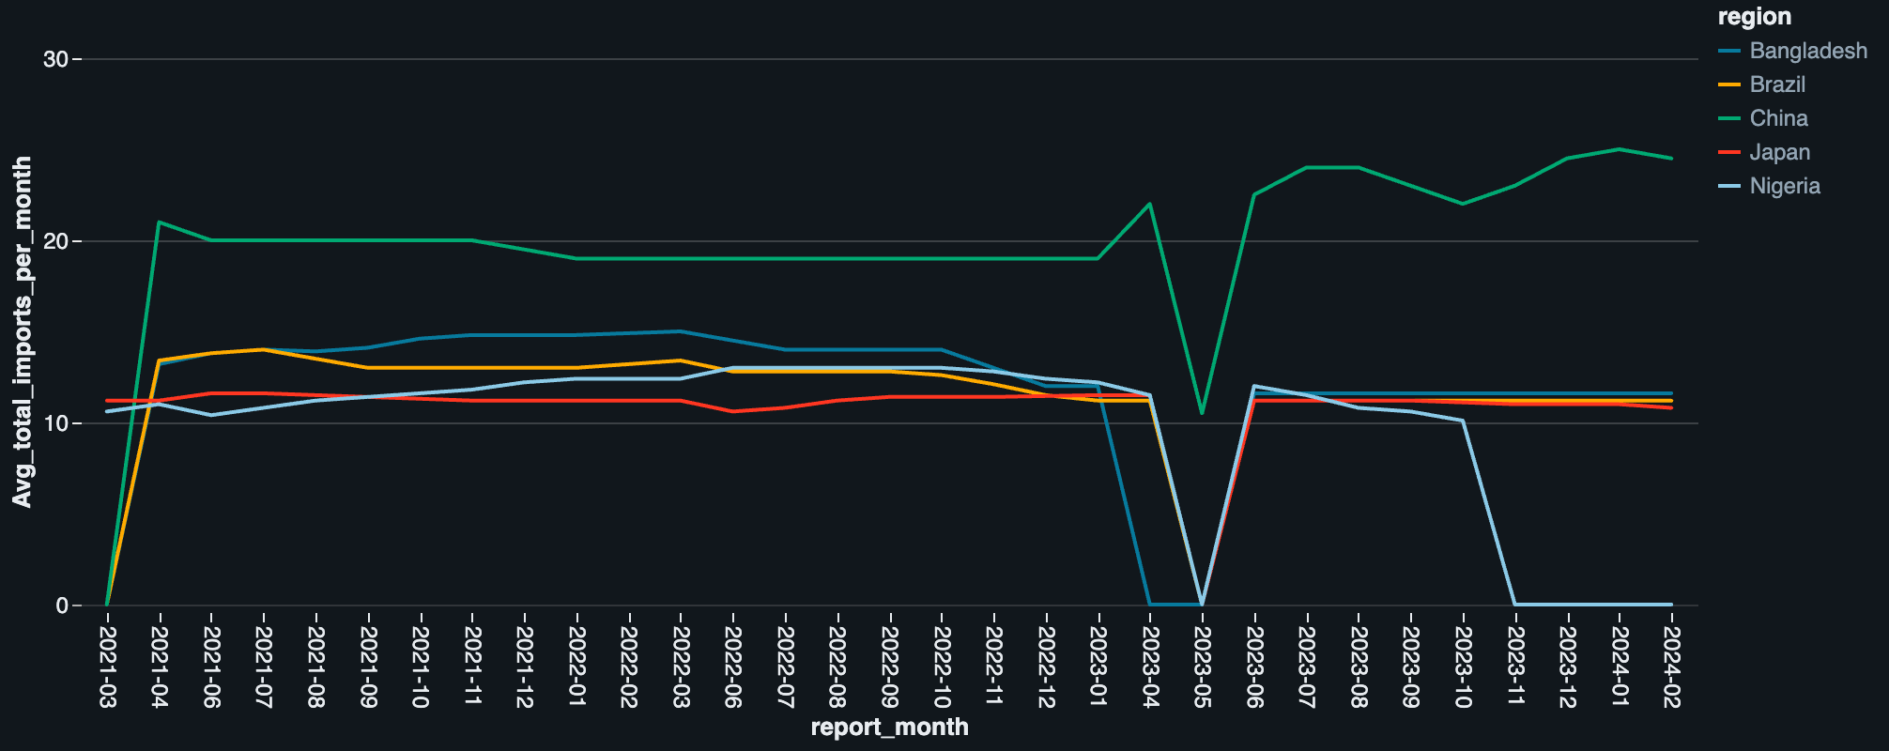
Regional Wheat Import Analysis
Observations
China consistently had the highest wheat imports.
Bangladesh, Brazil, Japan, and Nigeria had similar, moderate import levels.
All regions except China saw a sharp drop to zero in May 2023, with a quick recovery in June.
Nigeria dropped to zero again from Nov 2023 to Feb 2024.

Slide 14
Implications
May 2023 Drop indicates a global disruption—likely in shipping, trade policy, or major exporter supply.
China’s strong recovery suggests resilient demand and diversified supply chains.
Nigeria’s prolonged halt may point to economic or policy challenges.
Japan’s consistent imports reflect a stable, contract-driven system less affected by global shocks

Slide 15
Final Thoughts
Trend 2: Export and Import Patterns Are Sensitive to Global Events
Drops in monthly exports and imports align with likely trade, climate, or geopolitical disruptions.
WAOB should invest in early warning systems and maintain real-time monitoring of key flows.
Trend 1: Global Wheat Supply is Highly Concentrated
A few countries—especially China, India, and Russia—dominate wheat production.
WAOB must prioritize monitoring these key producers for climate, policy, or conflict-related risks.

Slide 16
Thank You!
Any Questions?

