Slide 1
V2X Sensor-Sharing for Cooperative and Automated Driving
SAE J3224資訊整理

Slide 2
文件意義 & Scope
文件意義
RSU及V2X車輛可正確掌握道路狀況：正確的道路狀況、障礙物及使用者資訊為RSU 及 V2X車輛做出正確決定的必要條件
定義V2X訊息架構及必要資訊：定義出RSU或V2X車輛偵測物件及環境之V2X訊息架構及必要資訊為達到相關應用之必要條件
Scope
提供Sensor Sharing Service (SSS)之操作概念、使用案例、資料流
使RSU及V2X車輛可分享自身的運行環境
定義偵測到物件之訊息架構、車聯網需求、訊息元素允許感測器分享

Slide 3
Scope

Slide 4
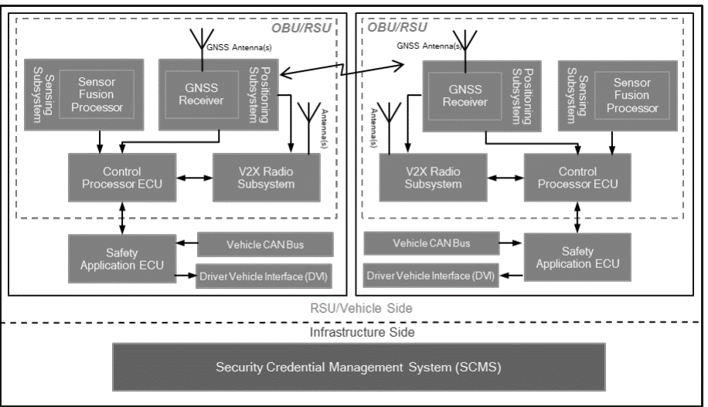
Sensor Sharing Service系統說明
將車輛或RSU偵測到的物體資訊透過V2X傳送到其他V2X物件上
可將偵測物件之大小、位置、動態經由J2735定義之Sensor Data Sharing Message (SDSM)分享
訊息可包含多個偵測物件資訊
J3224架構涵蓋
不為J3224涵蓋
融合感測器資訊判斷物件狀態
感測器，提供周邊環境訊息
含GNSS接收，提供定位、方向、速度、時間資訊
軟體，依據標準產生SSS訊息
傳輸/接收SSS訊息
提供車輛狀態訊息
透過視覺、聽覺或震動呈現警示訊息
訊息之安全認證

Slide 5
SSS利用情境 (RSU偵測分享)

Slide 6
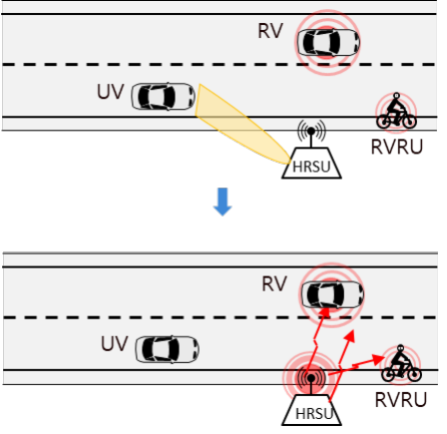


偵測到非V2X車輛

Slide 7
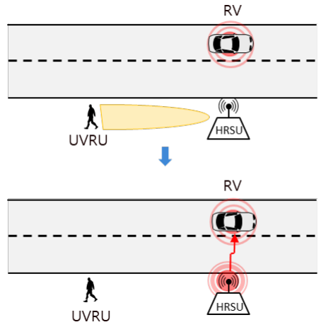


偵測到UVRU

Slide 8
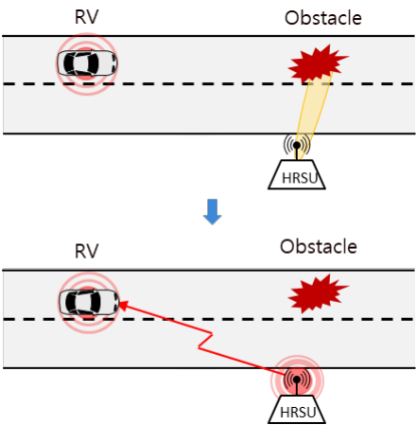
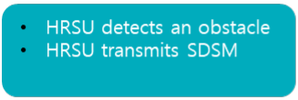

障礙物偵測

Slide 9
SSS利用情境 (V2X車輛偵測分享)

Slide 10
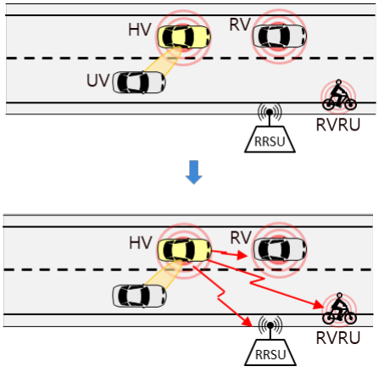
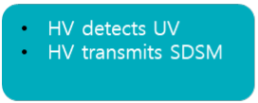

偵測到非V2X車輛

Slide 11
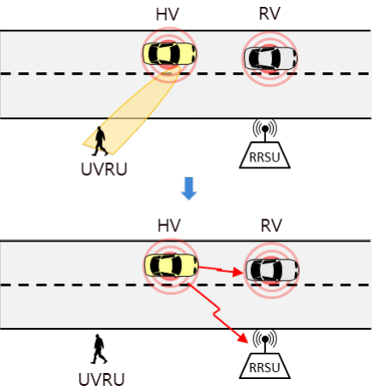
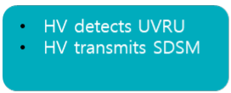

偵測到UVRU

Slide 12
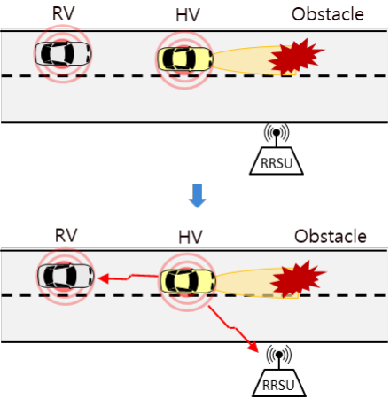
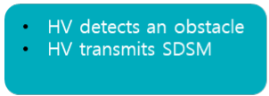

障礙物偵測

Slide 13
HD Data Sharing (需透過不同頻道傳輸，尚開發中，無標準)

Slide 14
專有名詞
High-Definition Data (HDD)
High-Definition Subscription Message (HDSM)
High-Definition Sensor Sharing (HDSS)
HDSS: 車輛或RSU可透過訂閱模式可取得HDD訊息

Slide 15
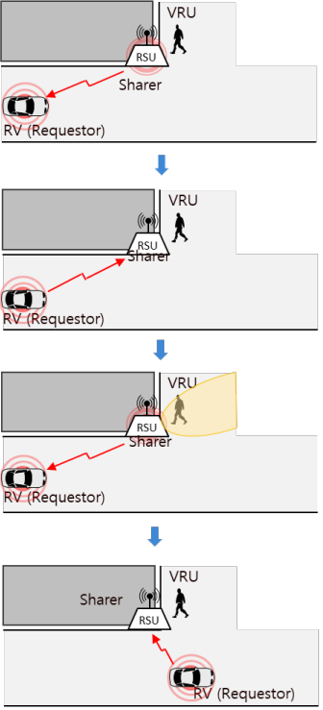

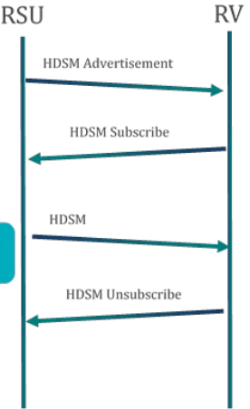
HDSS應用: 盲點偵測 (V2I)
RSU advertises its ability to share HDD and the field of view of its sensors.
RV sends a request to RSU to subscribe to its HDD stream and optionally indicates its Region of Interest.
RSU periodically transmits its HDD that covers that RV’s Region of Interest to RV. If no Region of Interest was indicated, the RSU transmits HDD that includes its sensors’ entire field of view.
After some time, RV notifies RSU that it wishes to unsubscribe from the HDD stream. RSU stops HDD transmission to RV.

Slide 16
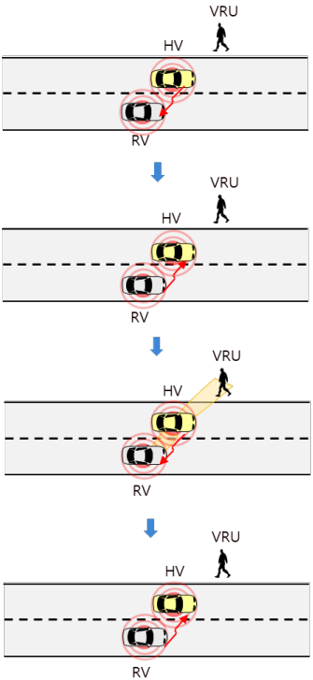

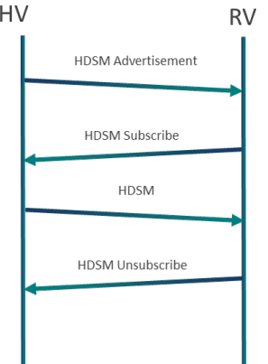
HDSS應用: 隱形車 (V2V)
HV advertises its ability to share HDD and the field of view of its sensors.
RV sends a request to HV to subscribe to its HDD stream and, optionally, its Region of Interest.
HV periodically transmits its HDD that covers that RV’s Region of Interest to RV. If no Region of Interest was indicated, the HV transmits HDD that includes its sensors’ entire field of view.
After some time, RV notifies HV that it wishes to unsubscribe to the HDD stream. HV stops HDD transmission to RV

Slide 17
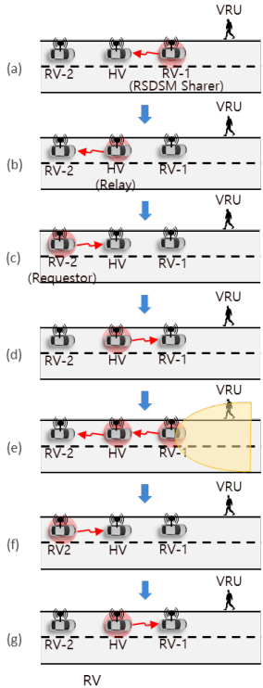
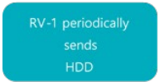
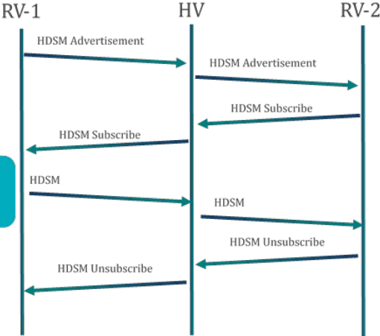
HDSS應用: 隱形車資料中繼 (V2I)
RV-1 advertises its ability to share HDD and the field of view of its sensors.
HV advertises its ability to relay RV-1’s HDD and the field of view of RV-1’s sensors.
RV-2 sends a request to HV to subscribe to RV-1’s HDD stream and, optionally, its Region of Interest.
HV sends a request to RV-1 to subscribe to RV-1’s HDD stream using RV-2’s Region of Interest.
RV-1 periodically transmits its HDD that covers RV-2’s Region of Interest to HV. If no Region of Interest is indicated, RV-1 transmits HDD that includes the entire field of view.
HV retransmits RV-1’s HDD to RV-2.
After some time, RV-2 notifies HV that it wishes to unsubscribe from RV-1’s HDD stream. h. HV notifies RV-1 that it wishes to unsubscribe from RV-1’s HDD stream. RV stops HDD transmission.

Slide 18
專有名詞
Host Vehicle
Host RSU
Remote Vehicle
Remote RSU
Remote VRU
Unequipped Vehicle
Unequipped VRU

Slide 19
*SAE：美國汽車工程師學會/國際自動機工程師學會，負責美國自駕車及車聯網相關標準制定，自駕車訂定出SAE J2735訊息標準，定義出多元訊息格式 (Message Set)及資料架構 (Data Frames)……等
SAE J2735訊息格式包含31項，列舉如下：
 | 應用內容 | 核心資料
Basic Safety Message (BSM) | 交換車輛狀況相關的安全資訊 | 訊息數量、ID、秒數、經緯度、高度、定位準確度 車輛傳動狀態 (停等、空檔、往前、倒檔) 速度 (單位0.02m/s) 行進方向 (方位角) 轉向角度 (方向盤) 四向加速度 煞車狀態 (ABS…) 車輛大小
Personal Safety Message (PSM) | 播送弱勢用路人如行人、自行車、工程人員、動物的動態 | 類型 (行人、自行車…) 歷史路徑 (GNSS) 路徑預測 穿越道路需求 (True/False) Cluster size (小2-5、中6-10、大10+)
Signal Phase and Timing (SPAT) | 傳達號誌化路口現下狀態，結合Mapdata，接收者可掌握下個時相出現時間 | DF_IntersectionState: 單一路口現下及未來資訊，包含道路資訊、路口行駛方向訊息 (包含時相狀態)、操作協助訊息 (車隊長度、道路容量…)
MapData (MAP) | 傳達地理資訊，包含路段細節、車道數、彎道曲度…
Signal Request Message (SRM) | 車輛優先通行 | 號誌要求包裹:
Signal Status Message (SSM) | RSU於號誌化路口發送之現下號誌狀態及優先要求資訊
Traveler Information Message (TIM) | 旅行建議及道路資訊提供
Sensor Data Sharing Message (SDSM) | 預留未來使用

