Slide 1

Breast Cancer Group-III
Presented by :
KOMALPREET KAUR (0733909)
SEOUNG KYOUNG RYU (0725164)
GURTEJ SINGH UBHI (0734821)

Slide 2
Introduction
In the field of healthcare, there is a variety of datasets that ranges from text data to huge image data files.
Analyzing them and reaching to valuable conclusion is always challenging in terms of technicalities and aspects of viable solution.
As the volume of healthcare data grows there has been great impact on its critical cost, security and performance issues.
Breast cancer is a group of diseases in which cells in breast tissue change and divide uncontrolled, typically resulting in a lump or mass

Slide 3
Objective
Predicting the nature of cancer and classifying whether it is benign or malignant.
Training models in such a way that they yield optimised accuracy.

Slide 4
About Data
The data set has been selected from Kaggle.
The features are computed from a digitized image of a fine needle aspirate of a breast mass and they describe characteristics of the cell nuclei present in the image.
There are 32 columns and 569 rows(patients).
The volume of data is low due to privacy impacts from health organizations.
The data is classified into two categorical values which are benign and malignant.

Slide 5
Features
ID number
Diagnosis (M = malignant, B = benign)
Ten real-valued features are computed for each cell nucleus:
a) radius (mean of distances from center to points on the perimeter) b) texture (standard deviation of gray-scale values) c) perimeter d) area e) smoothness (local variation in radius lengths) f) compactness (perimeter^2 / area - 1.0) g) concavity (severity of concave portions of the contour) h) concave points (number of concave portions of the contour) i) symmetry j) fractal dimension ("coastline approximation" - 1)
The mean, standard error(se) and worst (mean of three largest values) of these features were computed for each image.

Slide 6
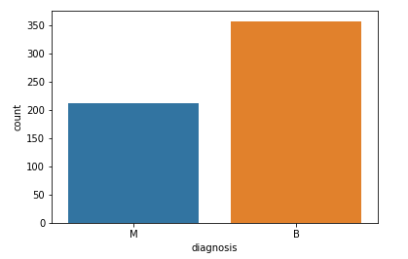
Analysis
From the analysis, there are more number of benign when malignant tumor.
So it can be said that, instead of focusing on malignant cancer, measures can be taken to cure benign cancer. Because benign is the type of cancer that do not spread in the body and therefore can be cured.

Slide 7
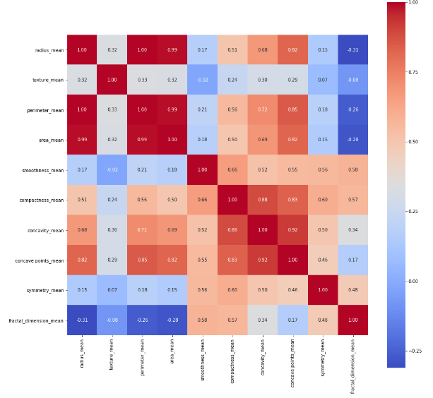
Cont......
Here correlation graphs are used so that we can remove multi collinearity (i.e. the columns that depend on each other) because using same columns twice is not useful.
The heat map depicts the relationship between various features on the basis of mean.
The diagonal has the value 1 (dark color) and each variable shows strong correlation to itself.
On the other hand, higher the number and darker the color shows higher correlation between the variables.

Slide 8
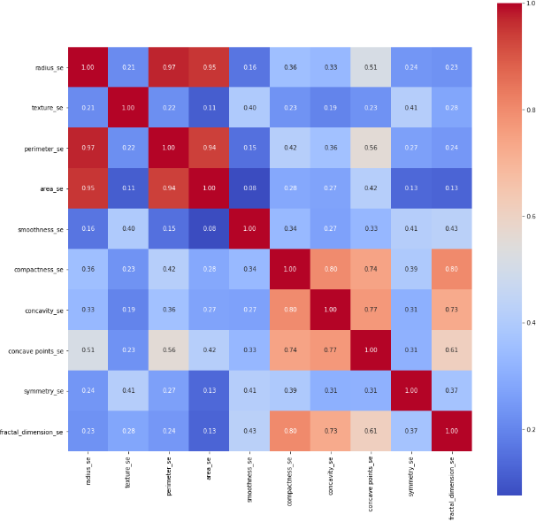
Cont......
The heat map depicts the relationship between various
features on the basis of standard error.

Slide 9
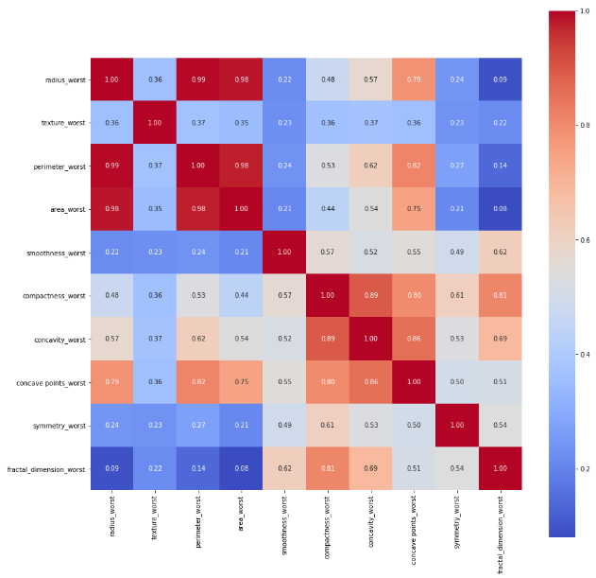
Cont......
The heat map depicts the relationship between various
features on the basis of worst.

Slide 10
Feature Selection
From above graphs, it is quite clear that mean features shows high correlation as compared to standard error and worst features.
Following set of features shows strong correlation with each other:
radius_mean, perimeter _mean and area _mean
compactness _mean, concavity _mean and concave points _mean
Therefore, following features are selected to train our models:
'radius_mean','texture_mean’, 'compactness_mean’, 'symmetry_mean’ , 'smoothness_mean’.

Slide 11

Splitting Criteria
We have splitted the dataset into train and test set with the ratio of 75:25.
After splitting data
Training set shape:(426, 31)
Test set shape:(143, 31)
We have employed various classification models to carry out our analysis and are shown below:

Slide 12

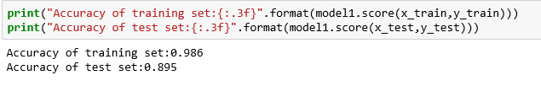
Classification Models
Random Forest Classifier
It is supervised learning algorithm that creates a set of decision trees from randomly selected subset of training set. It then collect the votes from different decision trees to decide the final class of the object.

Slide 13

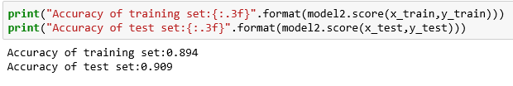
Cont……
Logistic Regression
It is a machine learning statistical model. It falls under the category of predictive analysis and works on the concept of probability.

Slide 14

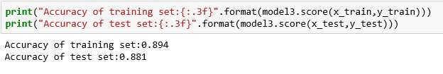
Cont……
K Nearest Neighbors
It is a supervised machine learning algorithm that depends on labeled input data to learn a function that generates an appropriate output when given new unlabeled data.

Slide 15

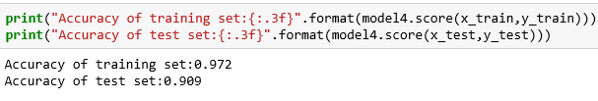
Cont……
Decision Tree
It is a supervised machine learning algorithm that helps to take decision in the form of if-else. It is a tree-like graph with nodes representing the place where we pick an attribute and ask a question; edges represent the answers to the question; and the leaves represent the actual output.

Slide 16
Multi Layer Perceptron
MLP is multilayer perceptron which is a class of feed forward artificial neural network.
It uses supervised machine learning technique known as back propagation for training.
It distinguish the data that is not linearly separable.
It has three layers: input layer, hidden layer and output layer.
MLP add weights to balance input and output and for better optimization.
Sigmoid function is an activation function that produces output between 0 and 1 and is used on output layer.
We have used tanh() function on hidden layer instead of sigmoid function because it gives more centred values.

Slide 17
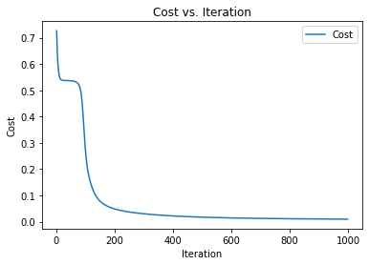
Analysis with MLP
As we have created the algorithm, to check whether it is working or not. We should see a declining learning curve with iteration, which eventually flattens out.
This will help us determine an appropriate number of iterations to run to determine the appropriate parameters.

Slide 18
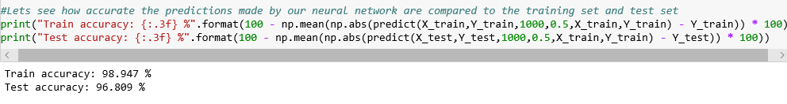
Cont……
In the above code, iterations are 1000 and 0.5 is alpha. Alpha is learning rate parameter that refers to the change in values of coefficients on each update.

Slide 19
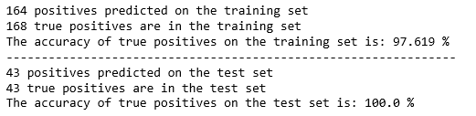
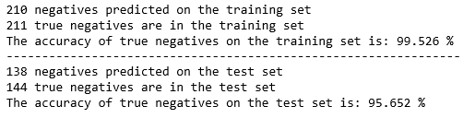
Cont……
Confusion Matrix
Positive
Negative
Positive
TP | FP
FN | TN
Negative

Slide 20
Conclusion
From all the five models used above, MLP has the highest test accuracy (i.e. 96.81%) as compared to other models.
Since we are dealing with healthcare field, our model should be at least 95% accurate.
Therefore, it can be concluded that, MLP predicts better.

Slide 21
References
Breast Cancer Wisconsin (Diagnostic) Data Set. (2020). Retrieved 18 February 2020, from https://www.kaggle.com/uciml/breast-cancer-wisconsin-data.
https://pbs.twimg.com/media/EGwL1Q4VAAAdxCB.jpg

Slide 22

Thank You

