Slide 1

CUSTOMER
SEGMENTATION
hauct

Slide 2
Contents
Customer360 (CRM)
RFM model
Customer Segmentation

Slide 3
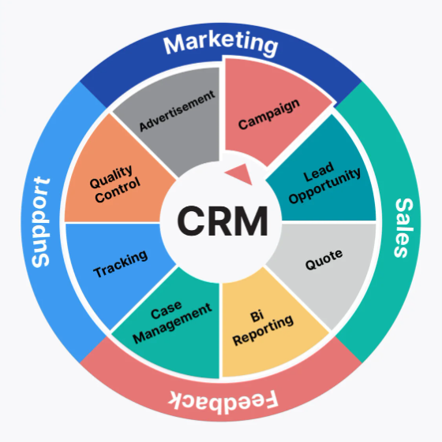
Customer360 (CRM)
Q: What and how helpful is it?
A: Definition: A system for managing and optimizing relationships between businesses and their customers.
Advantages:
Complete Overview: Offer holistic view of customers, preventing data fragmentation.,
Efficiency Data centralization on one platform enhances work efficiency and collaboration.
Interaction Full data allows for clear customer segmentation and personalized experiences

Slide 4
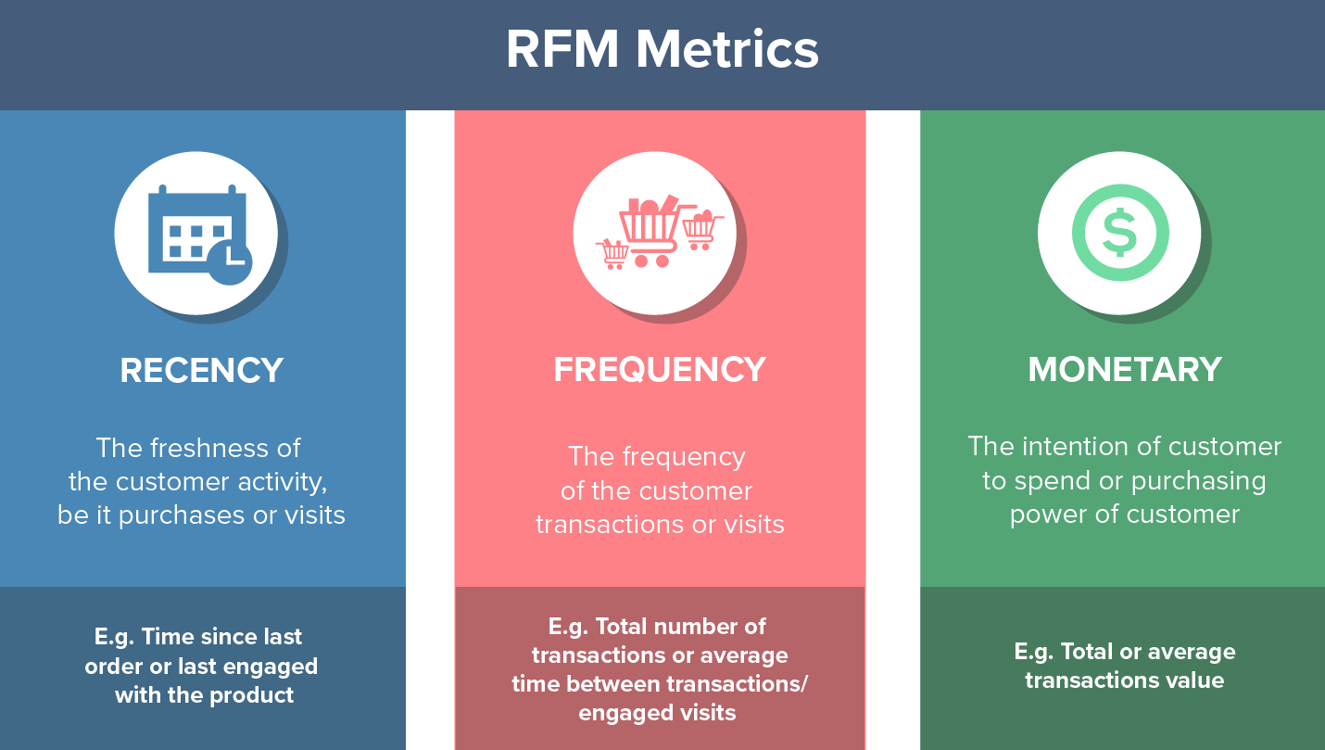
RFM Model
Q: What is it?
A: Recency, Frequency, and Monetary are three crucial factors in quantifying customer behavior and their interaction with the business, where Frequency and Monetary determine the Customer Lifetime Value, and Recency influences Customer Retention.

Slide 5
RFM Model
Q: How helpful is it?
A:
Identify high-values customer:
Ex: How many types of customers do we have, base on revenue, active? What is the core one, that contribute most revenue…? How many of them?
Detect and improve retention:
Ex: How many days does it take on average for a customer to repurchase the product? What is the difference between types of customer?
Develop personalized marketing campaigns:
Ex: What type of campaigns for customers who buy a lot but don’t do it often? How can we target churn customer?
Optimized pricing prices:
Ex: Do we need to adjust the price or add more discounts for customers who often buy but just small amount of product?

Slide 6
RFM score
Q: How one customer is scored?
Customers are scored on three factors: Recency, Frequency (F), and Monetary value (M), each rated from 1 to 4, with 1 being the lowest and 4 the highest. These scores are then combined into a single RFM index for customer segmentation.

Slide 7
Customer groups | Description | RFM Combination
Champions | VIP. Those who spend a lot, use the service frequently, and have recently used the service. | 444, 443, 434, 344
Loyal Customer | Those may not spend as much as VIPs, but they frequently use the service and have used it recently. | 442, 441, 432, 431, 433, 343, 342, 341
Potential Loyalist | Those with the potential to become loyal may use the service less frequently, but they have a high spending level. | 424, 423, 324, 323, 413, 414, 343, 334
Promising | Customers spend less than loyal ones, but use the service quite frequently and quite recently | 333, 332, 331, 313
New Customer | New customers have recently used the service; they haven’t had many opportunities to purchase, so their spending is not yet significant or frequent. | 422, 421, 412, 411, 311, 321, 312, 322
Price Sensitive | Customers spend frequently, however, their spending level is low, possibly due to their frugality or careful spending habits. | 131, 132, 141, 142, 231, 232, 241, 242
Needs Attention | Customers have spent a lot and used the service frequently in the past, however, it has been a while since they last used the service. | 244, 234, 243, 233, 224, 214, 213, 134, 144, 143, 133
About to sleep | Customers have used the service before, but they haven’t spent much, haven’t used it frequently or recently, although it hasn’t been too long. | 223, 221, 222, 211, 212, 124
Lost Customer | Customers have used the service but have not returned. | 111, 112, 113, 114, 121, 122, 123

Slide 8
Customer Segmentation
Q: What is the overview situation?
A:
From June 1, 2022, to September 1, 2022 (6 months), the company had 936,660 customers, generating nearly 82.8 billion in revenue.
On average, a customer spends 88,359 VND, with a return time of 1.1 days per purchase. As of today (September 1, 2022), the average number of days since the customer’s last purchase (churn days) is 60 days.

Slide 9

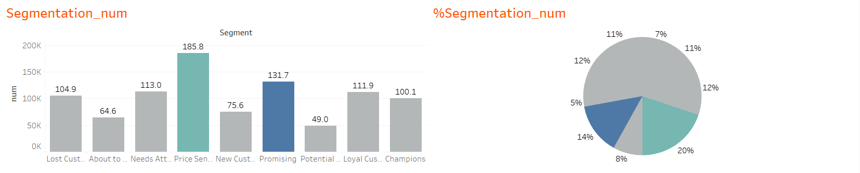
Q: How has situation of number of customer purchase been over the past six months?
Price Sensitive and Promising are the two largest customer segments in the past six months, accounting for a total of 35%. This means that most customers who made purchases during this period are those with high purchase frequency, regular purchases, and they are particularly concerned about high prices. We see that the number of customers has decreased at the adjacent points, proving that the selling price has had an inverse effect on the shift to higher customer segments, so it is necessary to consider a price adjustment campaign to better retain this customer group

Slide 10

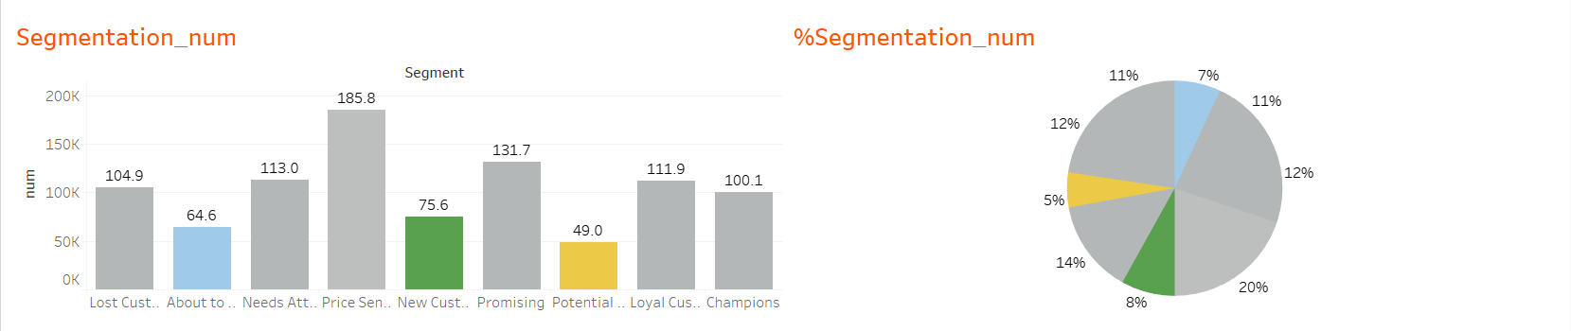
Q: How has situation of number of customer purchase been over the past six months?
There are three lowest customer segments in the past six months, accounting for a total of 20%:
About to Sleep: These customers have used our service before but haven’t spent much or used it frequently recently. This could indicate dissatisfaction or the presence of alternatives. We may need to investigate why they’re not returning and improve accordingly.
New Customers: These customers have recently started using our service. Their spending isn’t significant yet due to fewer opportunities. This indicates we’re attracting new customers, but need to focus on converting them into regular or loyal customers.
Potential Loyalists: These customers may use our service less frequently, but they spend a lot. This indicates they value our service or product and are willing to spend more than other customers. We may need to strengthen our relationship with this group to convert them into loyal customers.

Slide 11

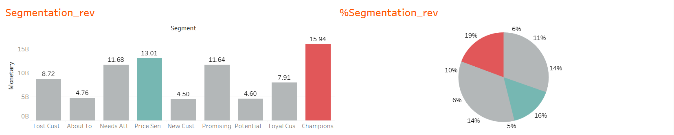
Q: How has situation of revenue been over the past six months?
There are two customer segments that contribute most revenue in the past six months, accounting for a total of 35%:
Price Sensitive: These customers spend frequently, but their spending level is low, possibly due to their frugality or careful spending habits. This suggests that while these customers are regulars, they may not contribute significantly to our revenue due to their lower spending. It might be beneficial to explore strategies to encourage higher spending from this group, such as targeted promotions or loyalty programs.
Champions: These are VIP customers who spend a lot, use the service frequently, and have recently used the service. This group is likely our primary source of revenue. Maintaining their loyalty and satisfaction should be a priority, as they are likely to continue contributing significantly to our revenue. Personalized services or rewards could be effective strategies for this group.

