Slide 1

CUSTOMER
SEGMENTATION
hauct

Slide 2
Contents
Customer360 (CRM)
RFM model
Customer Segmentation

Slide 3
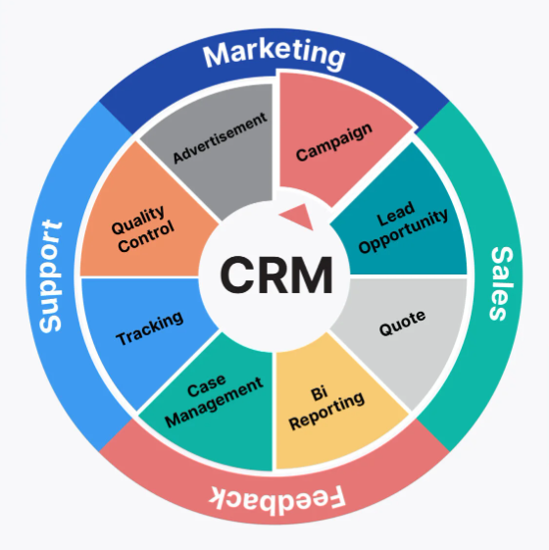
Customer360 (CRM)
Q: What and how helpful is it?
A: Definition: A system for managing and optimizing relationships between businesses and their customers.
Advantages:
Complete Overview: Offer holistic view of customers, preventing data fragmentation.,
Efficiency Data centralization on one platform enhances work efficiency and collaboration.
Interaction Full data allows for clear customer segmentation and personalized experiences

Slide 4
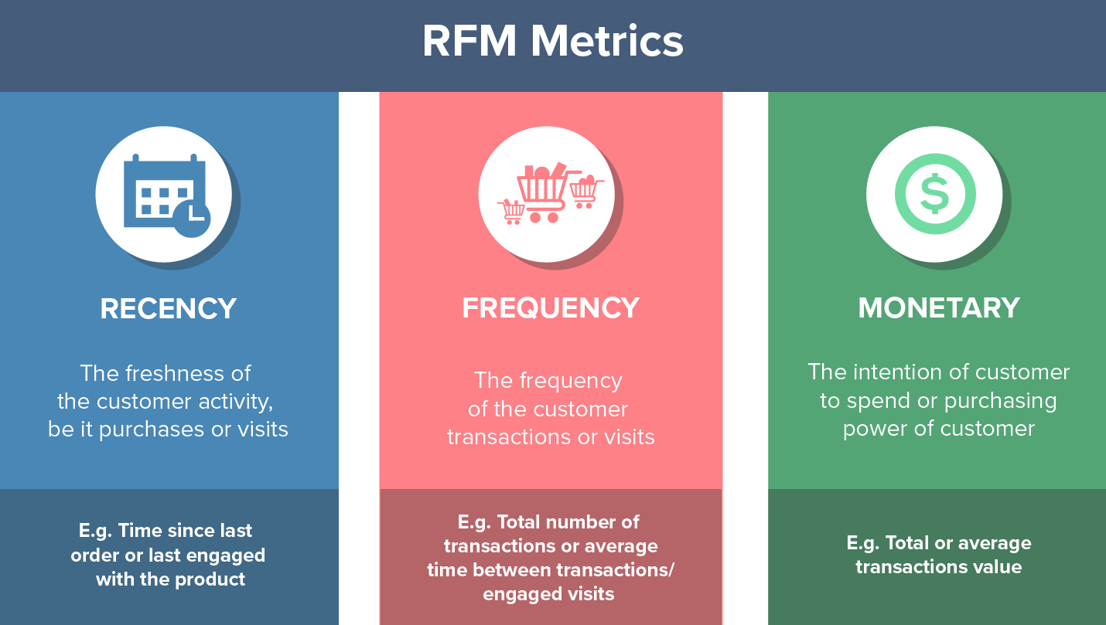
RFM Model
Q: What is it?
A: Recency, Frequency, and Monetary are three crucial factors in quantifying customer behavior and their interaction with the business, where Frequency and Monetary determine the Customer Lifetime Value, and Recency influences Customer Retention.

Slide 5
RFM Model
Q: How helpful is it?
A:
Identify high-values customer:
Ex: How many types of customers do we have, base on revenue, active? What is the core one, that contribute most revenue…? How many of them?
Detect and improve retention:
Ex: How many days does it take on average for a customer to repurchase the product? What is the difference between types of customer?
Develop personalized marketing campaigns:
Ex: What type of campaigns for customers who buy a lot but don’t do it often? How can we target churn customer?
Optimized pricing prices:
Ex: Do we need to adjust the price or add more discounts for customers who often buy but just small amount of product?

Slide 6
RFM score - Q: How one customer is scored?
Customers are scored on three factors: Recency, Frequency (F), and Monetary value (M), each rated from 1 to 4, with 1 being the lowest and 4 the highest. These scores are then combined into a single RFM index for customer segmentation.
Customer groups | Description | RFM Combination
Champions | VIP. Those who spend a lot, use the service frequently, and have recently used the service. | 444, 443, 434, 344
Loyal Customer | Those may not spend as much as VIPs, but they frequently use the service and have used it recently. | 442, 441, 432, 431, 433, 343, 342, 341
Potential Loyalist | Those with the potential to become loyal may use the service less frequently, but they have a high spending level. | 424, 423, 324, 323, 413, 414, 343, 334
Promising | Customers spend less than loyal ones, but use the service quite frequently and quite recently | 333, 332, 331, 313
New Customer | New customers have recently used the service; they haven’t had many opportunities to purchase, so their spending is not yet significant or frequent. | 422, 421, 412, 411, 311, 321, 312, 322
Price Sensitive | Customers spend frequently, however, their spending level is low, possibly due to their frugality or careful spending habits.

Slide 7
Customer groups | Description | RFM Combination
Needs Attention | Customers have spent a lot and used the service frequently in the past, however, it has been a while since they last used the service. | 244, 234, 243, 233, 224, 214, 213, 134, 144, 143, 133
About to sleep | Customers have used the service before, but they haven’t spent much, haven’t used it frequently or recently, although it hasn’t been too long. | 223, 221, 222, 211, 212, 124
Lost Customer | Customers have used the service but have not returned. | 111, 112, 113, 114, 121, 122, 123

Slide 8
Customer Segmentation
Q: What is the overview situation?
A:

