Slide 1

Bellows College
New Student Clubs

Slide 2
New Student Clubs

Slide 3
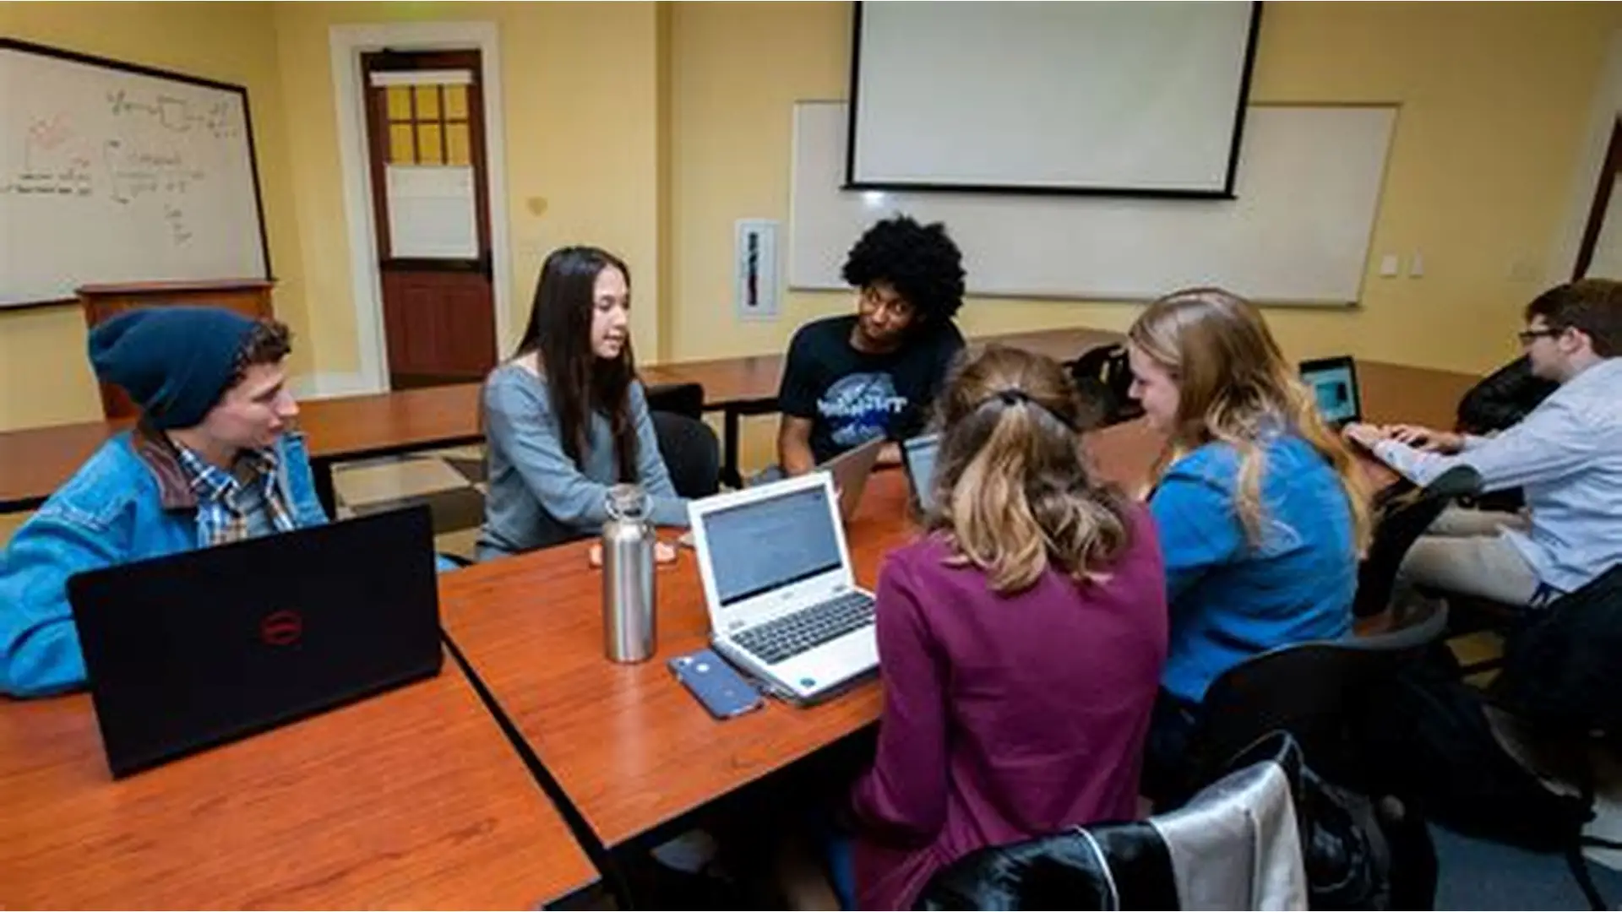

Slide 4
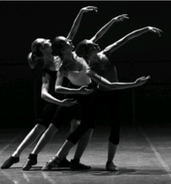
Dance Club
Use the art of dance to promote community, respect, and openness.
Open to all dance levels and styles.
Classes are Wednesday evening
Classes are in June
Membership is free

Slide 5

Music Club
Practice, play, live an learn
Open to students who want to foster unity through music listening, practicing, performances, activities, and trip.

Slide 6




Athletic Club
Promote health and wiliness through sports and movement
Open to students of all levels
Competitive and non-competitive play
Free

Slide 7
