Slide 1

Adventure Works Cycles

Slide 2
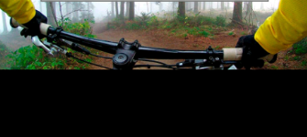
Adventure Works Cycles

Slide 3
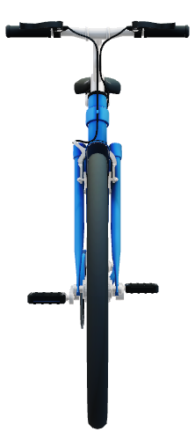
Products and Services
Bikes
  Mountain Bikes
  Touring Bikes
  Adventure Bikes
  Racing Bikes
Repair and maintenance
Parts

Slide 6
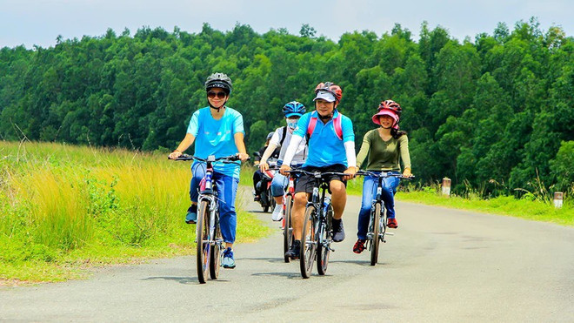

Slide 8

Contact Us
Touring Clubs
  Contact Qiang Wang
  (424)-555-0121
  Qiang@adventure:works.com
Racing Clubs
  Contact Jenni Memifield
  (424)555-0145
  Jenni@adventure:works.com
International clubs
  Contact Koos Spintor
  (424)555-0198
  Koos@adventure:works.com
Support Crews
  Raymond K, Sam
  (424)555-0123
  Raymond@adventure: works.com

