Slide 1
Trey Research

Slide 2

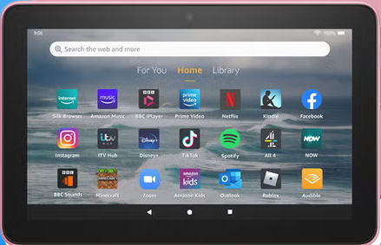
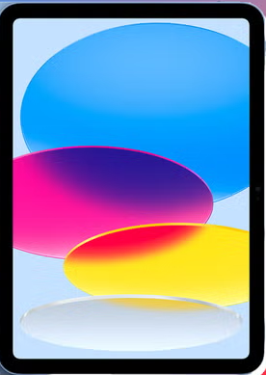
What is a screen?
TVs and monitors
Computers and laptops
Tablets
Smartphones
Video games

Slide 3
What are the dangers of too much screen time?
Difficulty making friends
Decreased focus
Poor school performance
Increased hyperactivity
Irregular sleep patters
Obesity

Slide 5
Summary
Add presentation summary here

