Slide 1
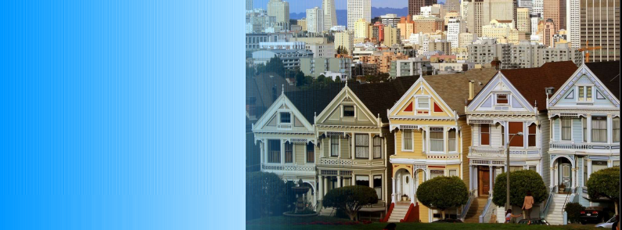
HUMONGOUS HOME INSURANCE

Slide 2
COVERAGE HIGHLIGHTS
Severe weather
Fire, flood, and earthquake
War, riot, or police action
Pandemic

Slide 3
INCREATE NEW CUSTOMER
2013 | 2014 | 2015 | 2016

Slide 4


Protect your
Home today

