Slide 1
HUMONGOUS INSURANCE

Slide 2

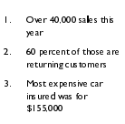

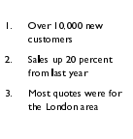

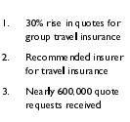

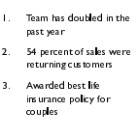

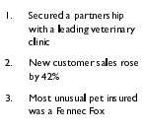

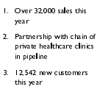
ACHIEVEMENTS

Slide 3
Q2 GOALS
Increase new customers by 10%
Retain 95%
Reduce support call by 5%
Increate pot
Develop new sale
Sell sell sell!
Increase new customers by 10%
Retain 95%
Reduce support call by 5%
Increate pot
Develop new sale
Sell sell sell!

