Slide 1
HUMONGOUS INSURANCE

Slide 2
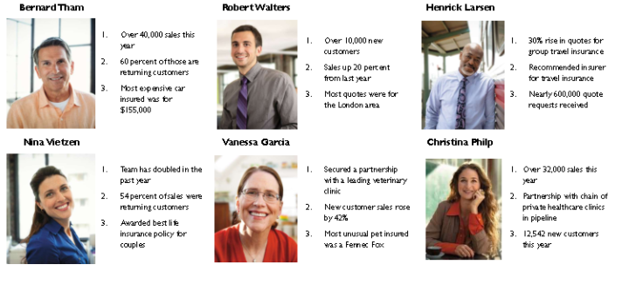
ACHIEVEMENTS

Slide 3
Q2 GOALS
Increate new customers by 10%
Retain 95% of existing customers
Reduce support calls by 5%
Increate pet by 30%
Increate social network reach
Sell, sell, sell!

