Slide 1
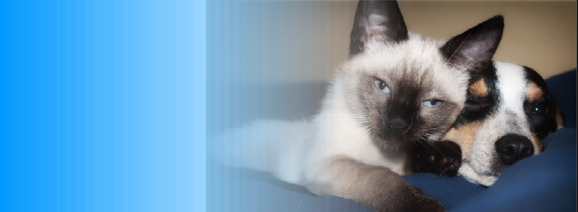
HUMONGOUS PET INSURANCE

Slide 2



Slide 3
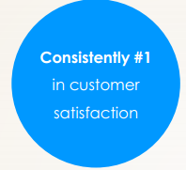
WHY CHOOSE HUMONGOUS
Choose by 95%

