Slide 1
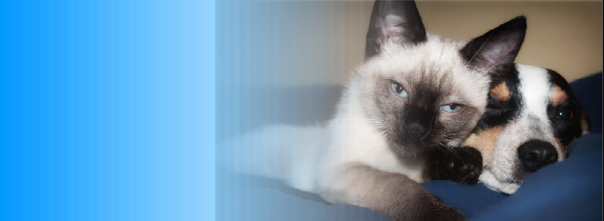
HUMONGOUS PET INSURANCE

Slide 2

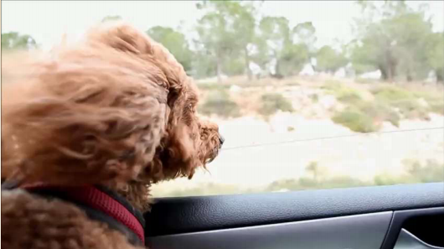

Slide 3
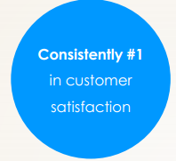
WHY CHOOSE HUMONGOUS
Choose by 95%
Random 50%
Increase 30%
Reduce 20%
Top 10

