Slide 1
Margie’s Travel
Adventure Awaits

Slide 2
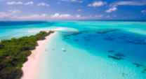
Travel Destinations
Australia
Mexico
Italy
France
Brazil
Singapore
Japan
Russia

Slide 3

Extra Activities
Event | Price
Concert | $150
Festival | $100
Theme Park | $200
Ski Ticket | $150
City Tour | $100
Event | $15

Slide 4
Price comparison
Destination | Retail Price | Margie’s Price
Australia | $4,000 | $3,000
Mexico | $2,100 | $1,900
Italy | $3,000 | $2,800
France | $3,000 | $2,750
Brazil | $2,700 | $2,300
Singapore | $4,200 | $3,700
Japan | $3,500 | $3,100
Russia | $3,200 | $3,100

