Slide 1
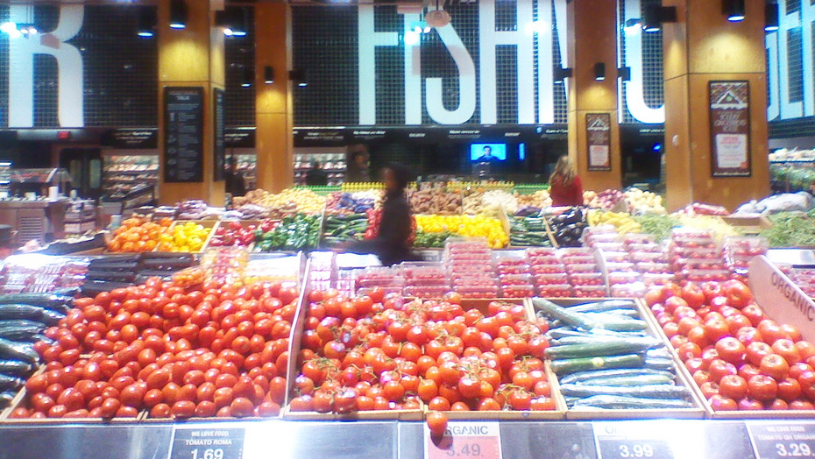
Loblaws At Maple Leaf Gardens
This Photo by Unknown Author is licensed under CC BY-NC-SA

Slide 2
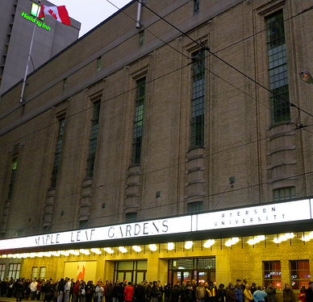
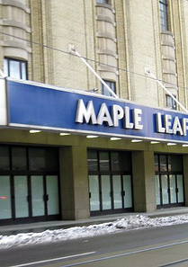
Can you Believe this used to be an n.h.l. hockey arena?
No Way!
This Photo by Unknown Author is licensed under CC BY
This Photo by Unknown Author is licensed under CC BY-NC-SA

Slide 3
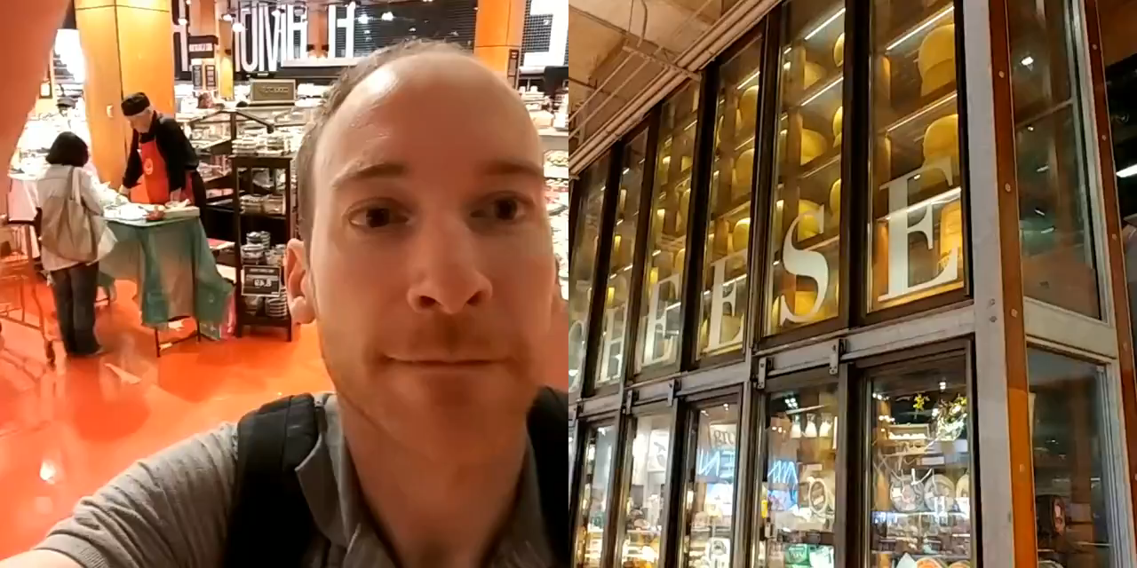
The Cheese Wall!

Slide 4
Other Reasons to Visit
History
Selection
Holiday specials
Cooking classes
Large selection of flowers
LCBO on top floor
Ryerson Athletic center

