Slide 1

Sports Equipment

Slide 2
Our Three-Point Guarantee:
All products meet stringent standards.
All products have a lifetime replacement warranty.
All products can be returned if damged within the first 30 days after being purchased
“You miss 100 percent off the shots you don’t take”
-Wayne Gretzky

Slide 3

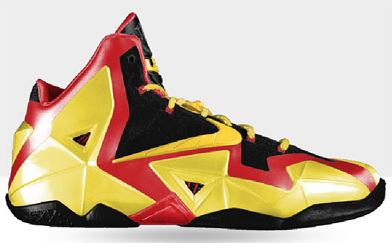

We sell:

Slide 4
Top Sellers:

Slide 5
Our Sports Products

