Slide 1



VanArsdel, Ltd.
Fitness training designed for your lifestyle

Slide 5
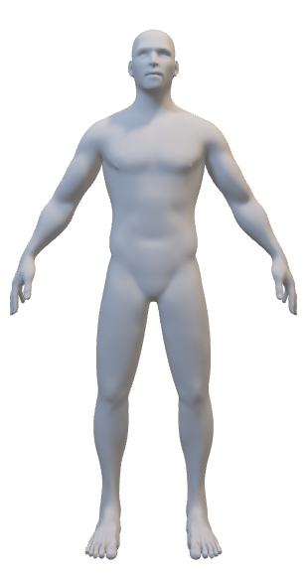
Road to Health and Fitness
Road to Fitness
Plan
train
Evaluates
Modify

Slide 6
Track Your Progress
Week | Cardio (microtps)
Week 1
Week 2
Week 3
Week 4
Week 5
Week 6

