Slide 1
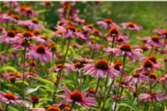
New Products
Fobrikom Residences
Landscape Division

Slide 2

Products

Slide 3
Rock Fountain
Concrete freestanding fountain
4 feel (1.2 m) in height
Electric pump included
Weatherproof
Minimal assembly required
Standard delivery fee

Slide 4
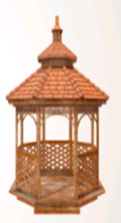
Octagonal Gazebo
12 foot (3.6 m) diameter
Cedar construction
Additional delivery fee
Kit includes
All cedar wood pieces
Shingles
All hardware (nails, screws, etc.)
Illustrated instructions

Slide 5
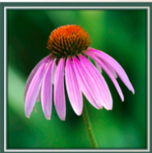
Coneflower
Height: 36-48” (90-120 cm)
Width: 18” (45 cm)
Bloom time: ???
Grows easily
Blooms for more than 4 weeks
Attracts bees
Attracts birds
Attracts butterflies

