Slide 1
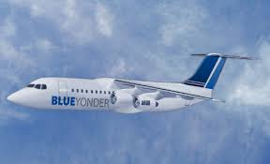
Blue Yonder Airlines
Fabulous sights await you

Slide 2
Frequent Flyer Points
Years in Program | Average Distance Traveled | Average Points Earned | Average Percent Earned
Year 1 | 4,000 | 400 | 40%
Year 5 | 6,500 | 975 | 50%
Year 10 | 8,000 | 1600 | 70%
Year 20 | 10,000 | 2,500 | 90%

Slide 6
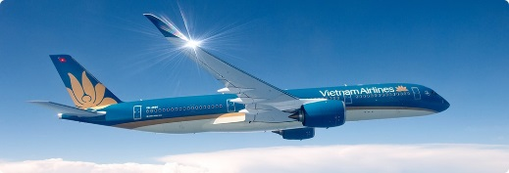
Frequent Flyer Rewards

Slide 7
Become a Frequent Flyer
Registration is easy and fast
Register for the program at www.blueyonderairlines.com
Connect your frequent flyer number to your purchases
Accumulate points and use them for your future trips

Slide 8
Frequent Flyer Points
Years in Program | Average Distance Traveled | Average Points Earned | Average Percent Earned
Year 1 | 4,000 | 400 | 10%
Year 5 | 6,500 | 975 | 15%
Year 10 | 8,000 | 1600 | 20%
Year 20 | 10,000 | 2,500 | 25%

