Slide 1

Welcome, Prospective Students
School of Fine Art

Slide 2
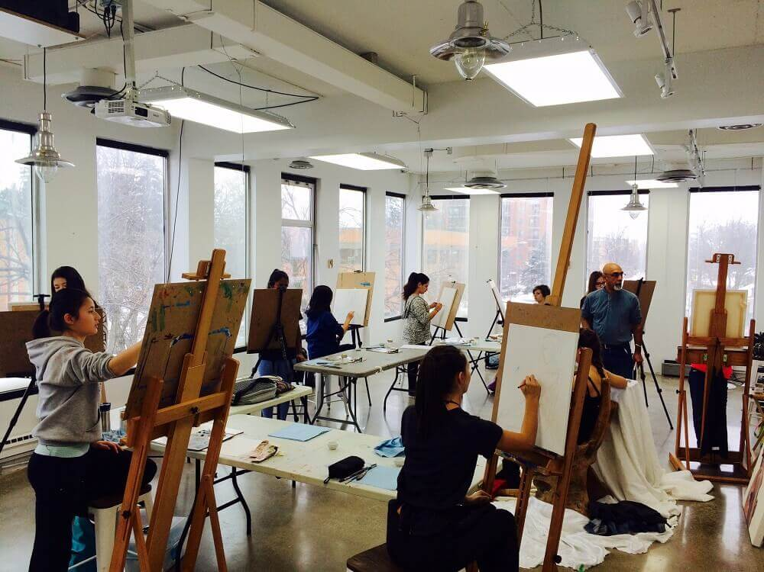
Who We Are
2,102 Undergraduate students
545 Graduate students
37% International students (from 43 countries)
9:1 Students-to-faculty ratio
13 Students (average class size)

Slide 4


Admission Information
3.5 GAP
34%
95%

Slide 5
Get Involved
8%
¼
A->Z

