Slide 1
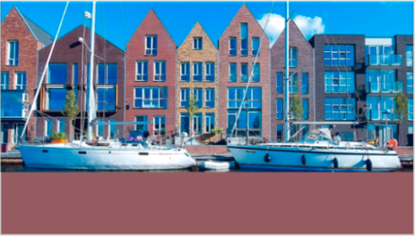
Fabrikam Residences
Colorful places to live and play

Slide 2
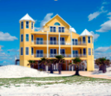
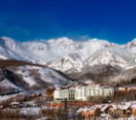
Spectacular Two-Bedroom Apartments
Waterfront Views
Mountainside

Slide 4
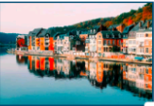

Slide 6
Beautiful City and Country Locations

