Slide 1


Slide 2
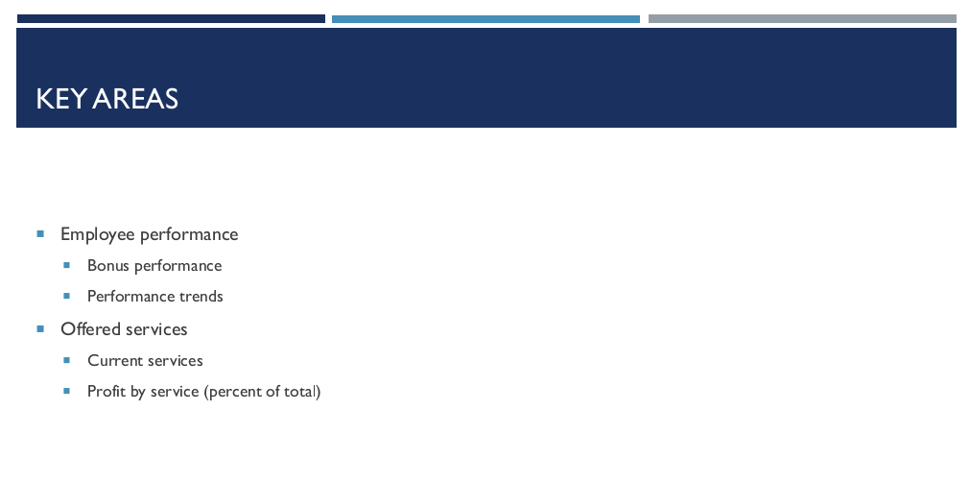

Slide 3



Slide 4
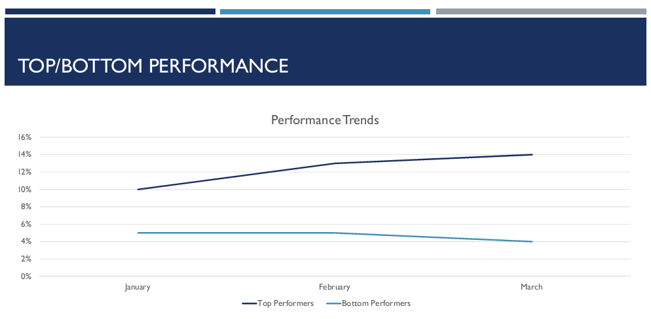

Slide 5
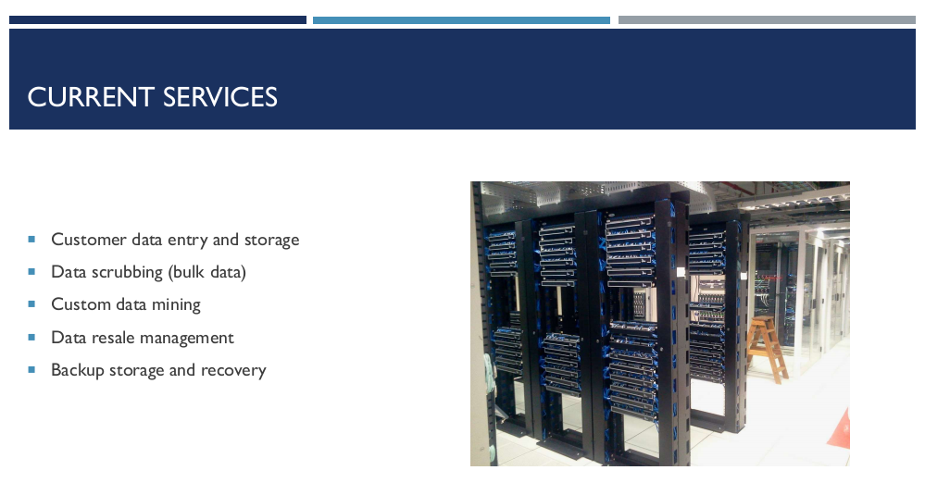

Slide 6
REVENUE BY SERVICE
We need this data

Slide 7


Slide 8


Slide 9
