Slide 1
Coho Vineyard & Winery

Slide 2
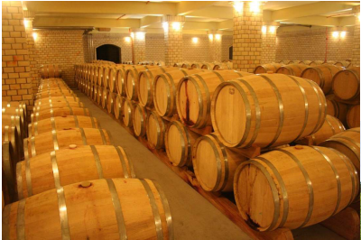
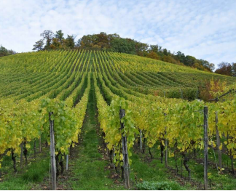
Expanding Facilities and Vineyard

Slide 3
We can’t wait…
New building
New vineyard
New excitement

Slide 4
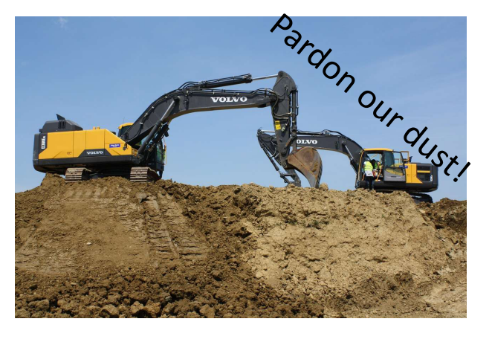

Slide 5
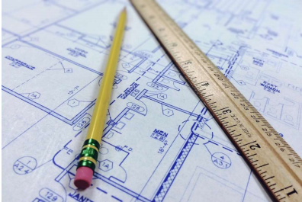
Our new building
Restaurant
Performance venue
Meeting rooms
Reception room

Slide 6
We’re done
Fine dining or a quick dessert
Weddings, reunions, receptions
Quiet, comfortable

Slide 7
And that’s not all!

