Slide 1
First Class
Basket Weaving 101

Slide 2
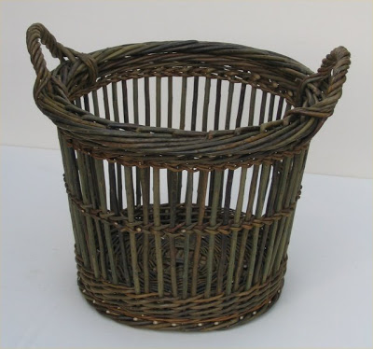
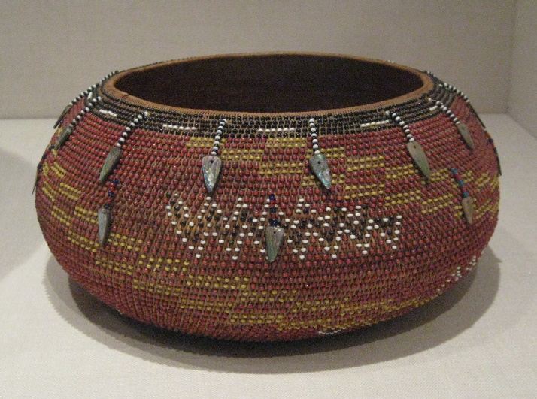
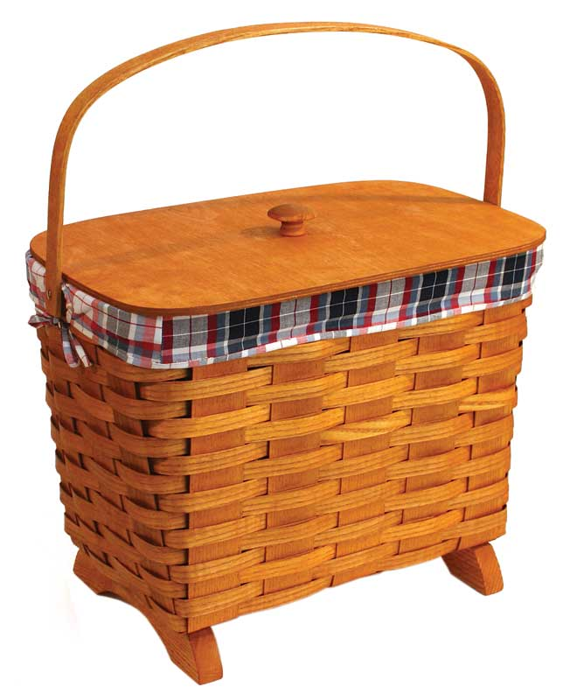
Who said basket weaving was easy?
Below are all the different types of baskets that we will be making throughout this semester:

Slide 3

Required Texts:
Basket weaving for the soul by Amy Shoelaces
Post Modern era basket weaving by Chuck Smith
Basket Weaving for Noobs by Lorrie Cartwright

Slide 4
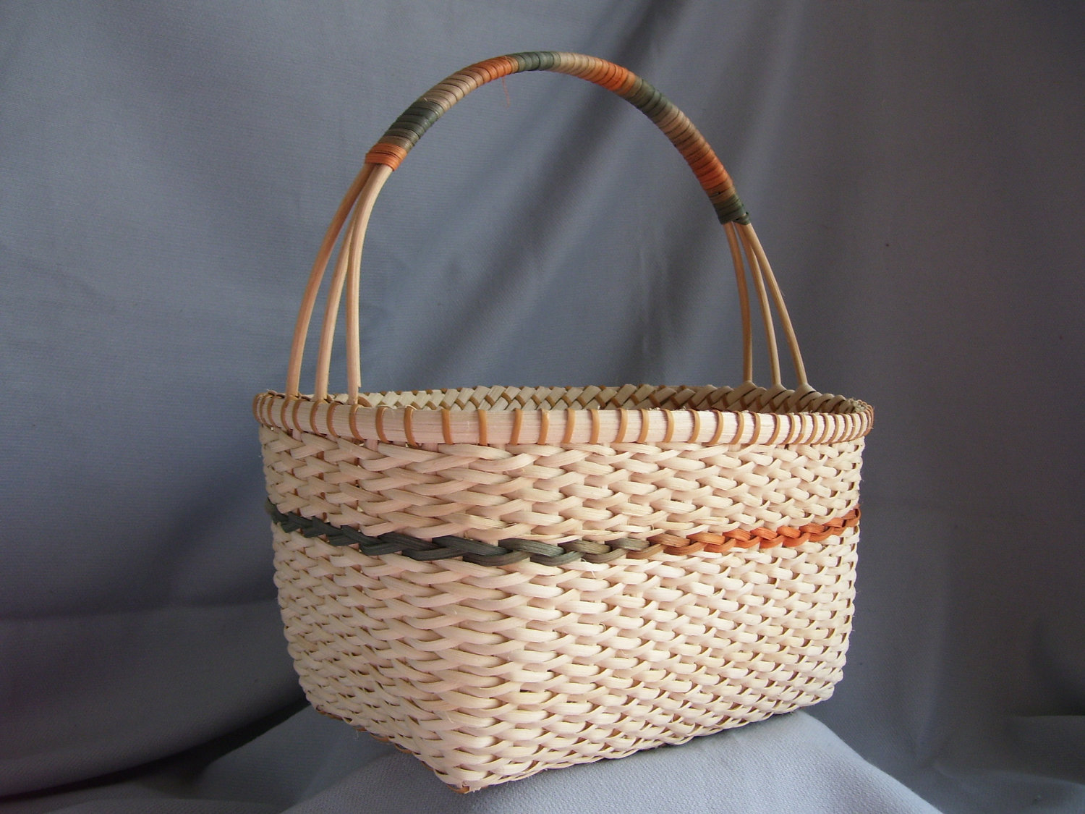
First Class
Basket Weaving 101

Slide 5
First Class
Basket Weaving 101

