Slide 1
Himalayan Coffee House

Slide 2
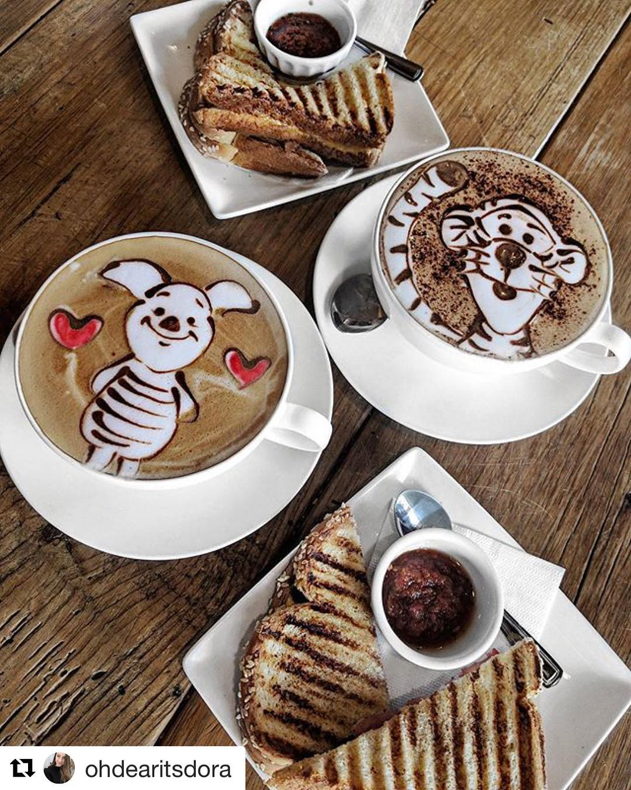
Menu
Red-Eye Latte
My-Chai Late
Tiger-Tea
Mocha-chino
Express-o!
Cafiene-plus

Slide 3
Try Our two new flavours!
Mint
Chocolate
Blue
Lagoon

