Slide 1
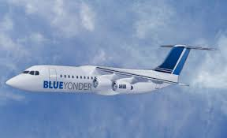
Blue Yonder Airlines
Fabulous sights await you

Slide 2
Frequent Flyer Points
Years in Program | Average Distance Traveled | Average Points Earned | Average Percent Earned
Year 1 | 4,000 | 400 | 10%
Year 5 | 6,500 | 975 | 15%
Year 10 | 8,000 | 1600 | 20%
Year 20 | 10,000 | 2,500 | 25%

Slide 6
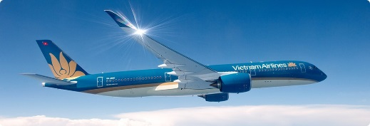
Frequent Flyer Rewards

Slide 7
Become a Frequent Flyer
Registration is easy and fast
Register for the program at www.blueyonderairlines.com
Connect your frequent flyer number to your purchases
Accumulate points and use them for your future trips

