Slide 1
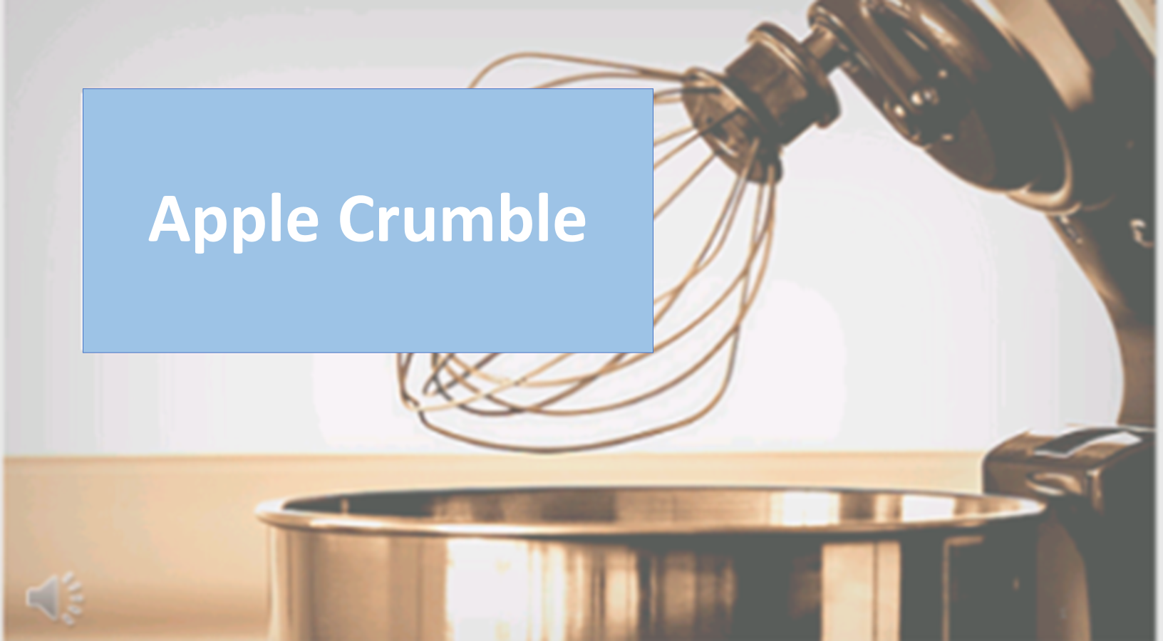

Apple Crumble

Slide 2
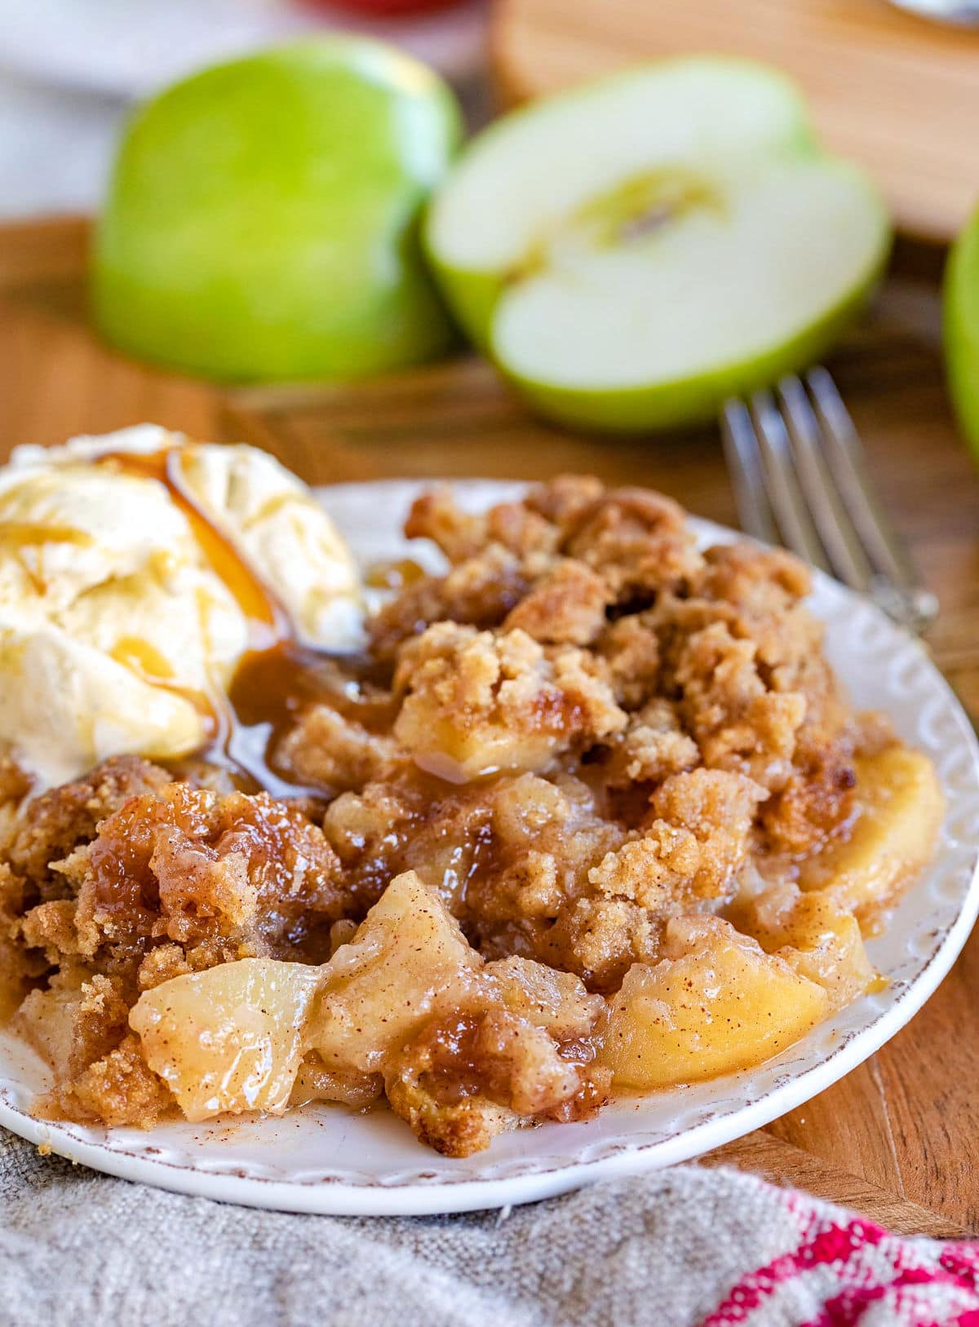
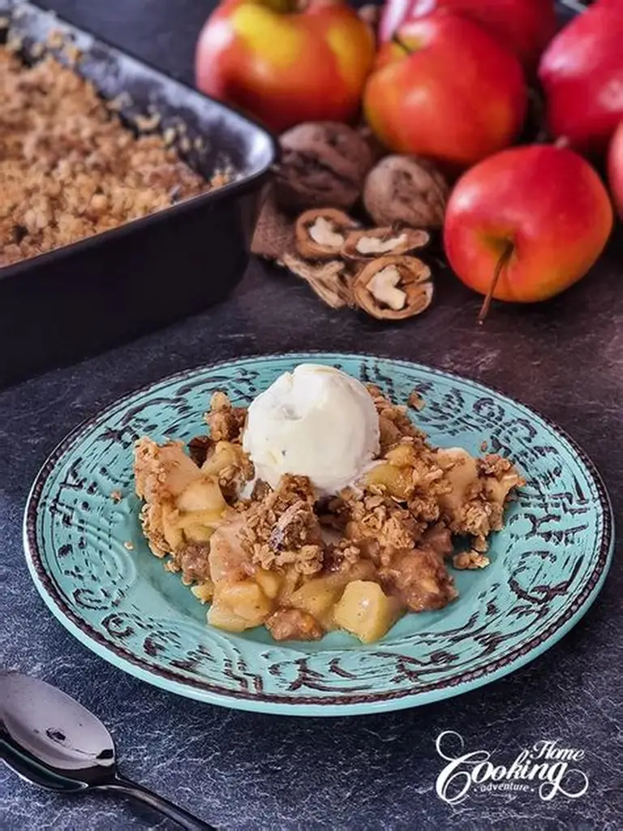
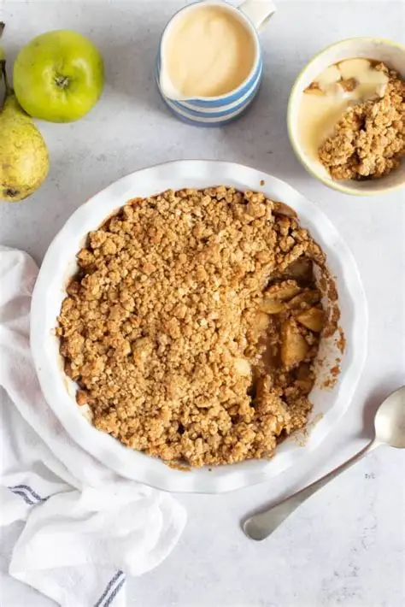
Apple Crumble

Slide 3
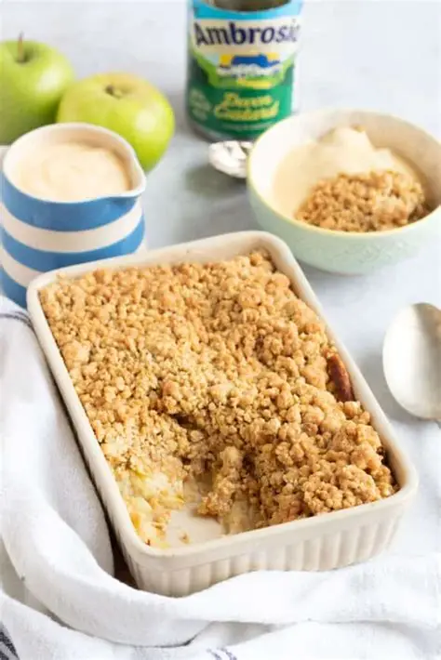
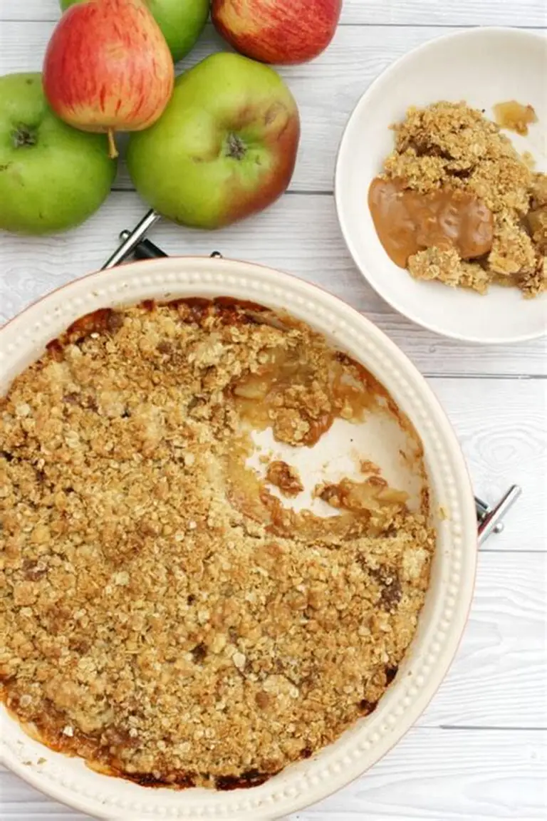

Slide 4
Apple Crumble
Method
Preheat the oven to 392 ‘F (200°C)
Peel, core, and chop the apples. Put apples into a pan with 4 tablespoons of sugar and % cup of water. Cook on medium heat for 10 minutes. Transfer the mixture to a baking dish.
Mix the butter with the flour. Stir in 1 tablespoon of sugar. Spread the butter mixture over the apples. Bake for 40 minutes. Serve with cream.

Slide 5
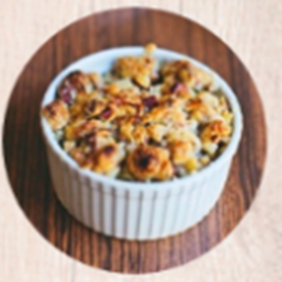
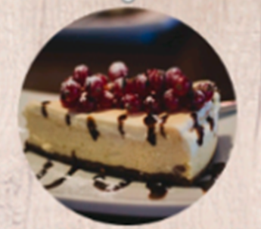
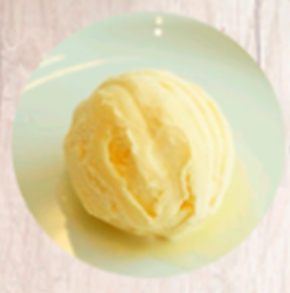
Apple Crumble
Portions

