Slide 1

Adventure Works Cycles

Slide 2
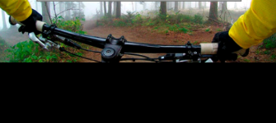
Adventure Works Cycles

Slide 3
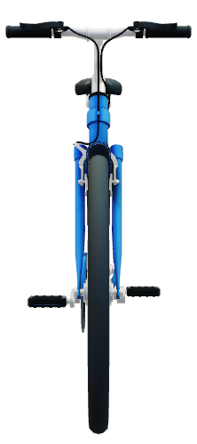
Products and Services
Bikes
Mountain Bikes
Touring Bikes
Adventure Bikes
Racing Bikes
Repair and maintenance
Parts

Slide 8

Contact Us
Touring Clubs
Contact Qiang Wang
(424)-555-0121
Qiang@adventure:works.com
Racing Clubs
Contact Jenni Memifield
(424)555-0145
Jenni@adventure:works.com
International clubs
Contact Koos Spintor
(424)555-0198
Koos@adventure:works.com
Support Crews
Raymond K, Sam
(424)555-0123
Raymond@adventure: works.com

