Slide 1

Small Business Empowerment
Pitch Deck
Company Name
Digital Solutions for Southeast Asia
Jakarta, Indonesia
May 2025

Slide 2
Vision and Mission
Vision
To become the leading digital platform that transforms how small businesses in Southeast Asia operate, helping them achieve long-term sustainability, independence, and inclusive economic growth.
Mision
We pursue this vision by:
  Providing user-friendly digital tools that simplify daily operations
  Offering affordable subscription models for micro and small businesses
  Delivering real-time analytics to support strategic decisions
  Building mobile-first, offline-accessible systems for remote areas
  Partnering with financial and telecom institutions to expand access

Slide 3





Meet the Team
John Doe
Brandon Gen
Sarah Johnson
Ahmad Fauzi
(Chief Executive Officer)
(Chief Technology Officer)
(Head of Marketing)
(Head of Product Design)
Over 10 years of experience in business operations and digital consulting
Expert in scalable cloud architecture and mobile-first development
Track record in growth marketing, user acquisition, and brand development
Specializes in user-centered design, UX strategy, and cross-functional collaboration

Slide 4

Products and Services
Point of Sale and Inventory System
Mobile Application for Field Agents
Business Intelligence Dashboard
Payment System Integration
Manages stock and transactions for small businesses
Works with regional digital wallets and payment gateways
Enables order-taking, client tracking, and offline operations
Real-time insights on revenue, trends, and performance

Slide 5
Competitor Analysis
Solution Name | Weaknesses | Our Strengths
Enterprise Systems | Complex setup, high cost | Easy onboarding, budget-friendly
Local ERP Tools | Urban-focused, internet-dependent | Rural-optimized, offline capability
Urban Platforms | Poor mobile experience | Mobile-first, intuitive interface

Slide 6


Market Opportunities
60+
60+ million small businesses in Southeast Asia remain underserved
80%
Tier 2 and Tier 3 regions have over 80% smartphone adoption
Digital transformation is a regional government priority
Growing demand for automation, digital finance, and analytics

Slide 7
Market Size
Revenue Model
Monthly subscriptions, paid features, and API integrations
Total Addressable Market
12 B
12 billion United States dollars
Serviceable Available Market
3.5 B
3.5 billion United States dollars
Serviceable Obtainable Market
200 M
200 million United States dollars within 3 years

Slide 8
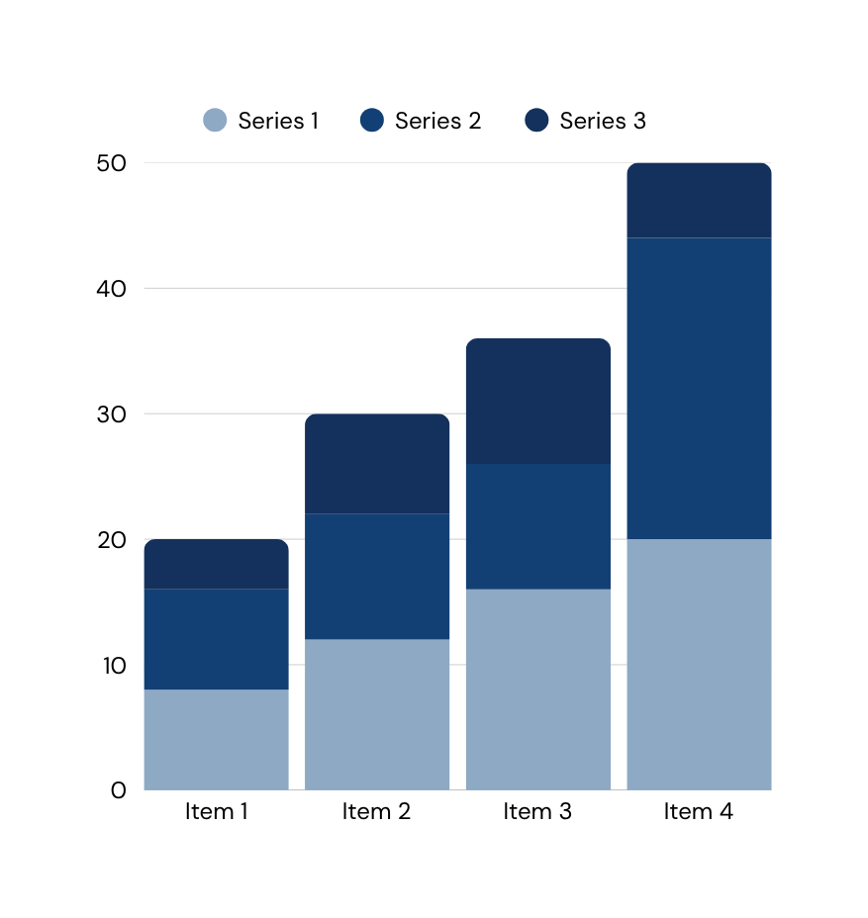
Performance Overview
150K USD
4.60 USD
Monthly recurring revenue
Customer acquisition cost
7,200+
92.10 USD
active paying users
active paying users
45%
Monthly user growth

Slide 9
Roadmap
Quarter 3
Quarter 4
Year
Year
2025
2025
2026
2027–2028
Launch AI-based inventory and sales forecasting
Expand to Malaysia and the Philippines
Reach 100,000 users and 5 million United States dollars in annual revenue
Prepare for public listing or acquisition

Slide 10
Information
Contact
Company Name
Mobile Number
+123-456-7890
Website
www.reallygreatsite.com
Email Address
hello@reallygreatsite.com
Social Media Handle
@reallygreatsite
Jakarta, Indonesia
Physical Address
May 2025
123 Anywhere St., Any City, ST 12345

