Slide 1

Store Management

Slide 2
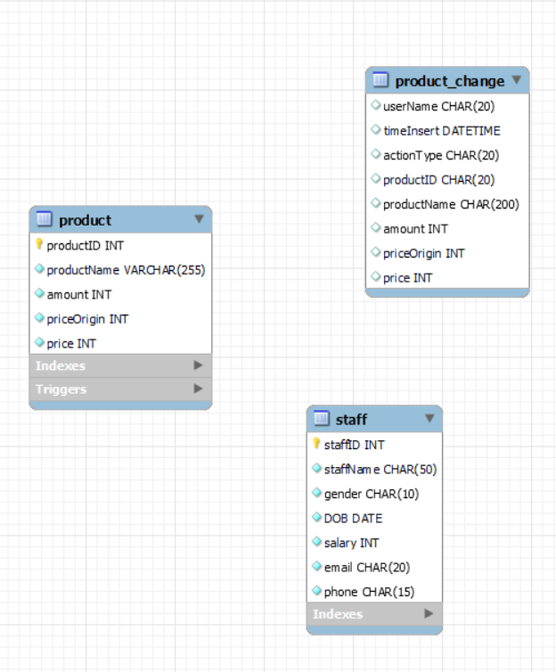
Table in database:

Slide 3


Function in application:
Product:
Staff:
Search product
Sort product
+ Sort by name(a-z)
+ Sort by name(z-a)
+ Sort by price(ascending)
+ Sort by price(descending)
Add product
Remove product
Modify product
Export to excel file
History change
Exit
Search staff
Add staff
Modify staff
Remove staff
Reset

Slide 4


Procedure and trigger in MySQL:
Procedure:
Trigger:
ProductDelete
ProductInsert
ProductUpdate
ProductSortNameasc
ProductSortNamedes
ProductSortPriceasc
ProductSortPricedes
staffDelete
staffInsert
staffUpdate
Trigger store_delete
Trigger store_update
Trigger store_insert

Slide 5
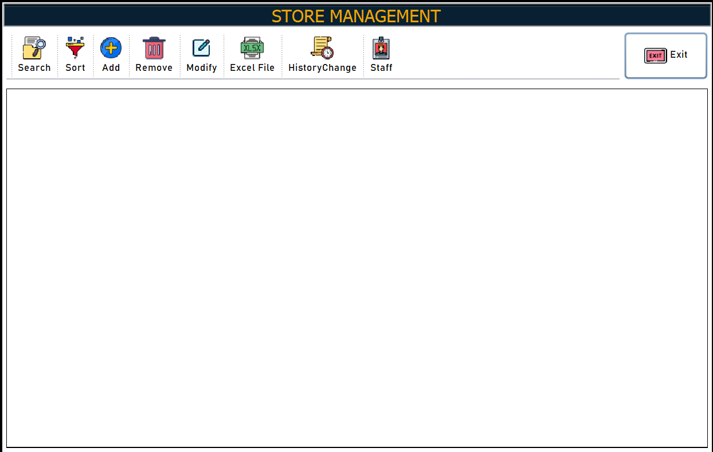
Demo:

Slide 6
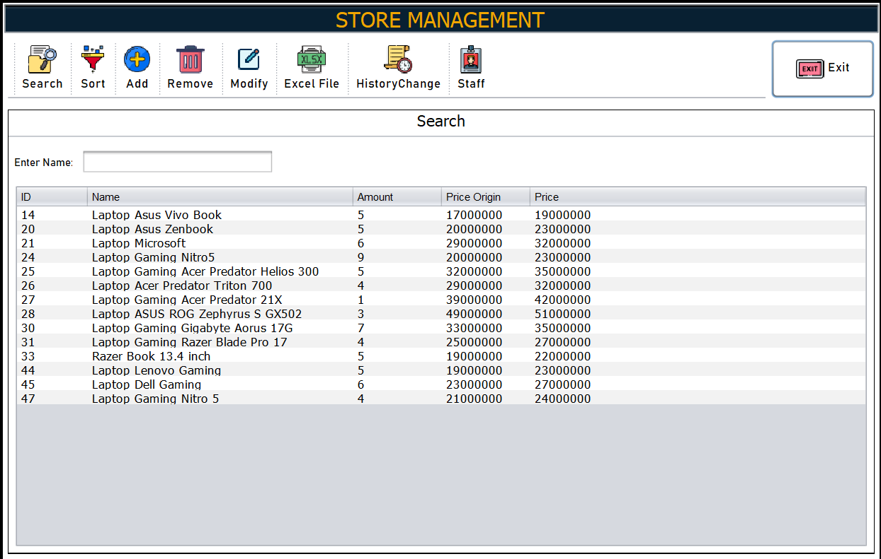
Demo:

Slide 7
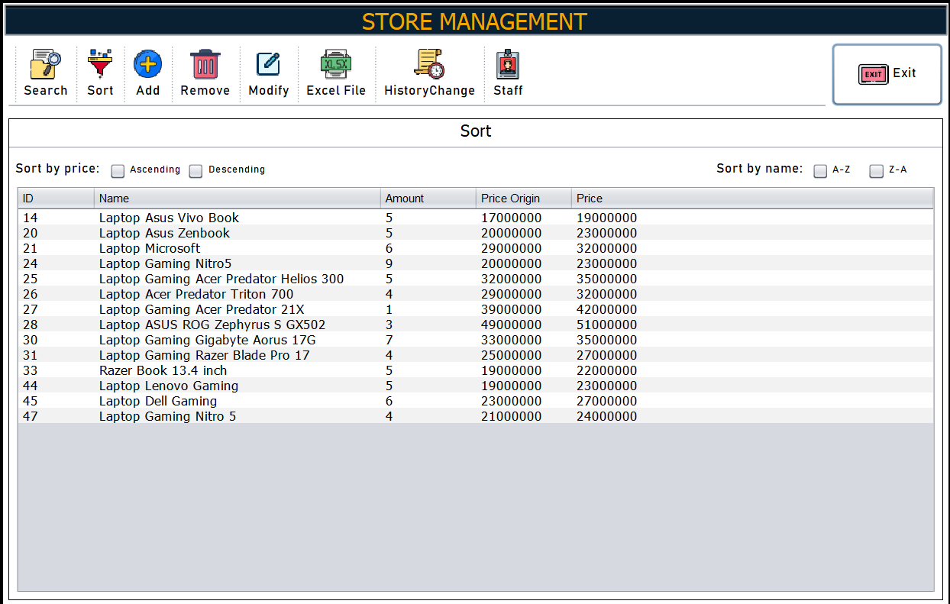
Demo:

Slide 8
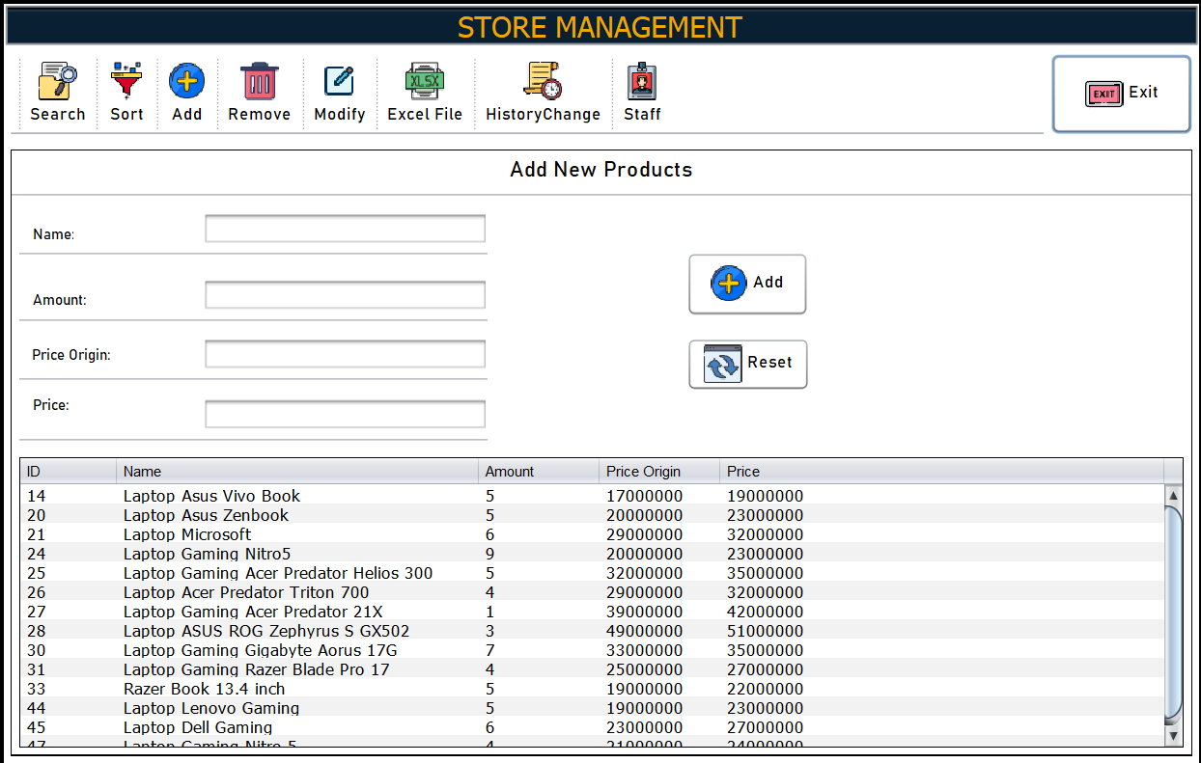
Demo:

Slide 9
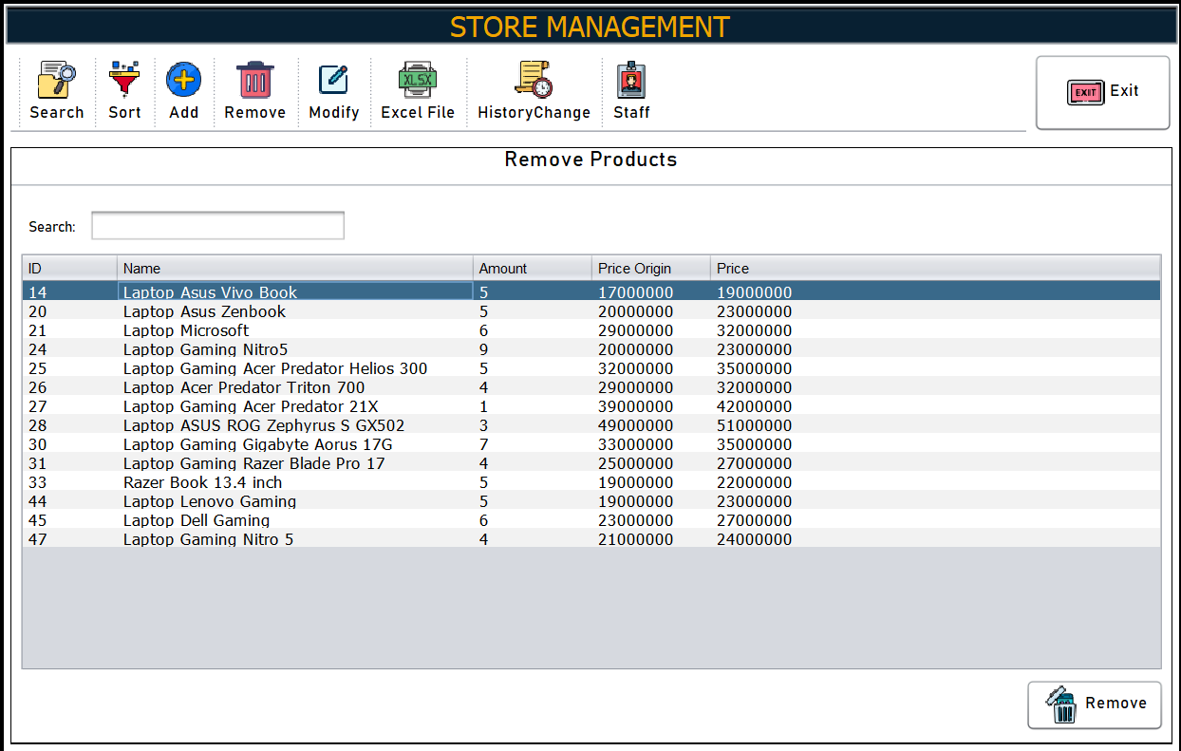
Demo:

Slide 10
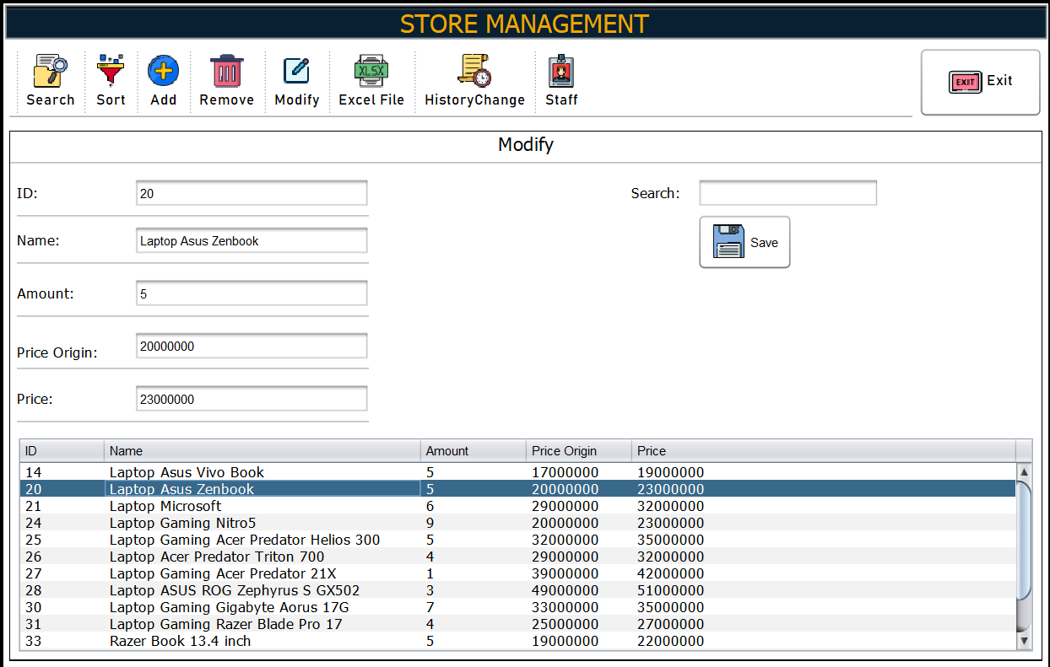
Demo:

Slide 11
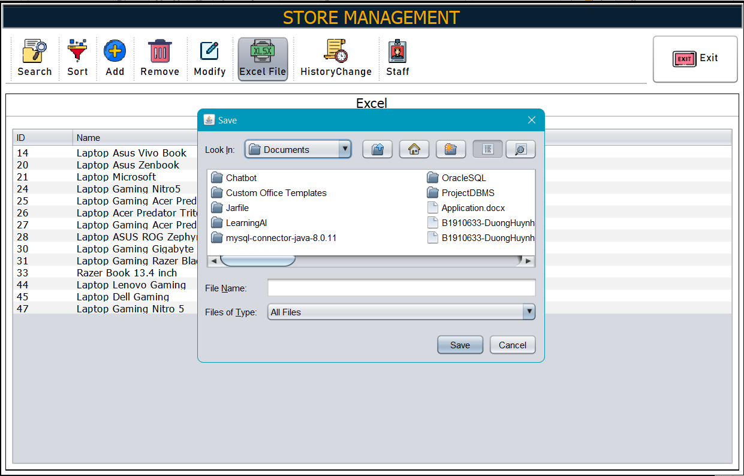
Demo:

Slide 12
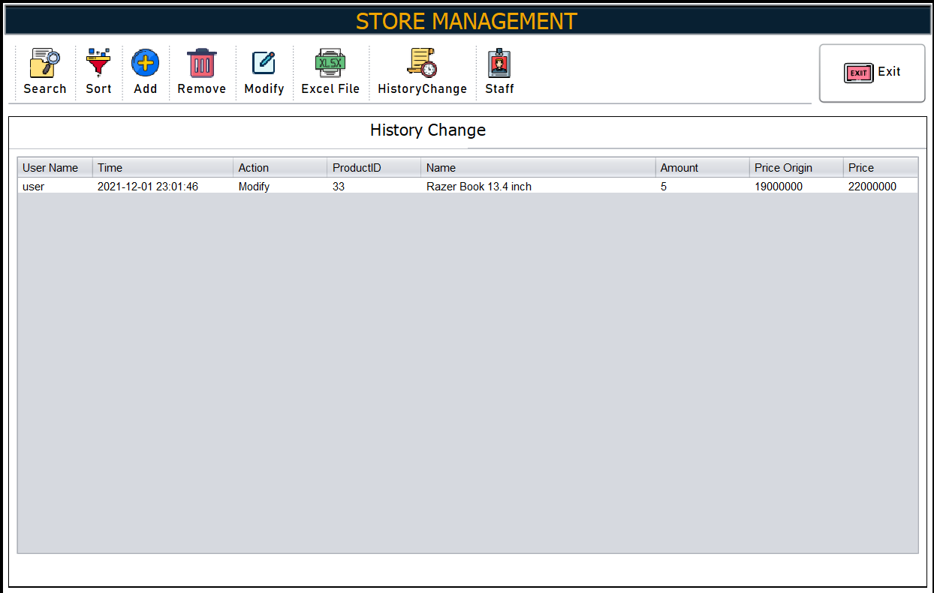
Demo:

Slide 13
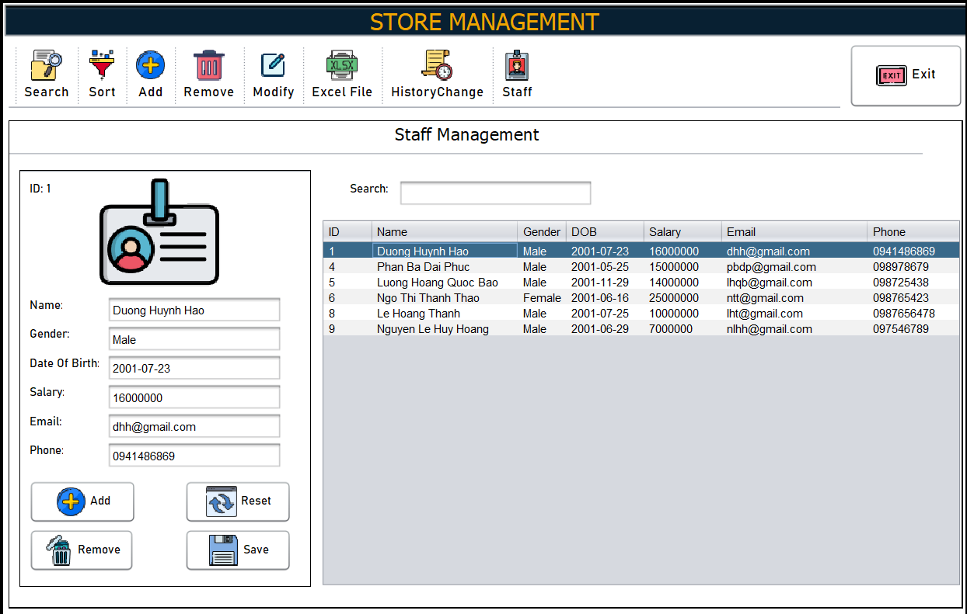
Demo:

Slide 14


